Slide 1
CAMBRIDGE PLATFORM UNITS 3 AND 4
Norma Janette Zarate Agundis 1”D”

Slide 2
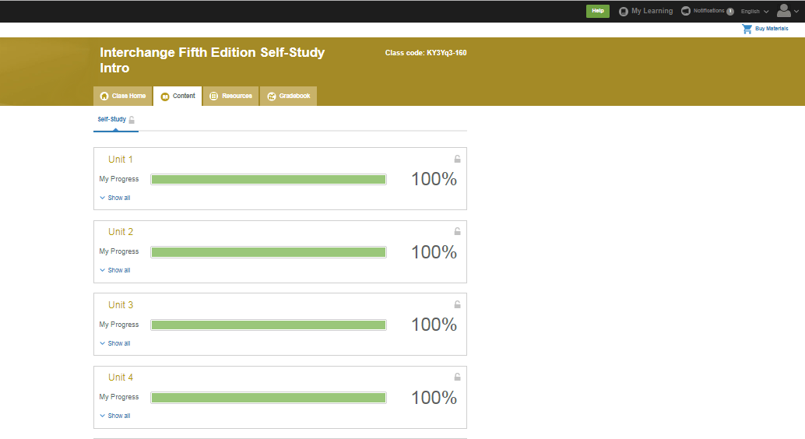

Slide 3
