Slide 1

CAMBRIDGE PLATFORM UNIT 3 AND 4.
García Soto Jaqueline.

Slide 2
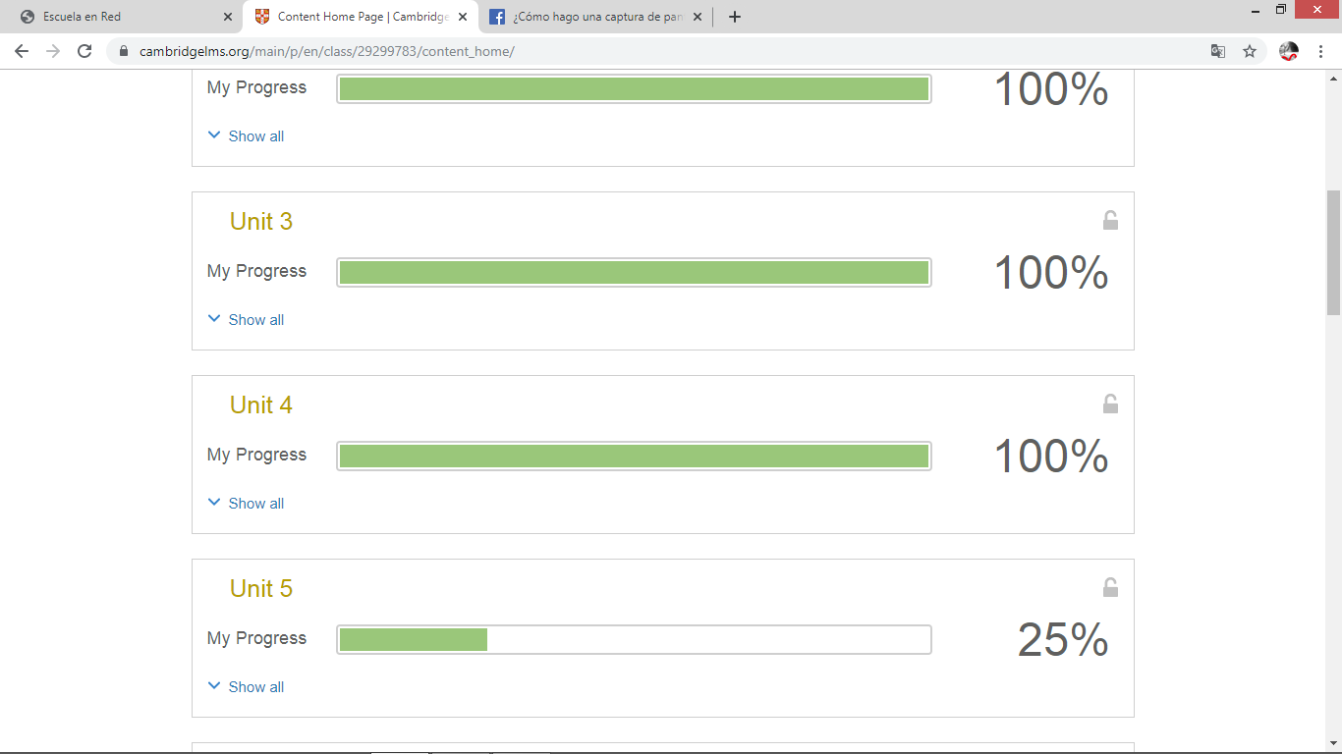
Games.

Slide 3
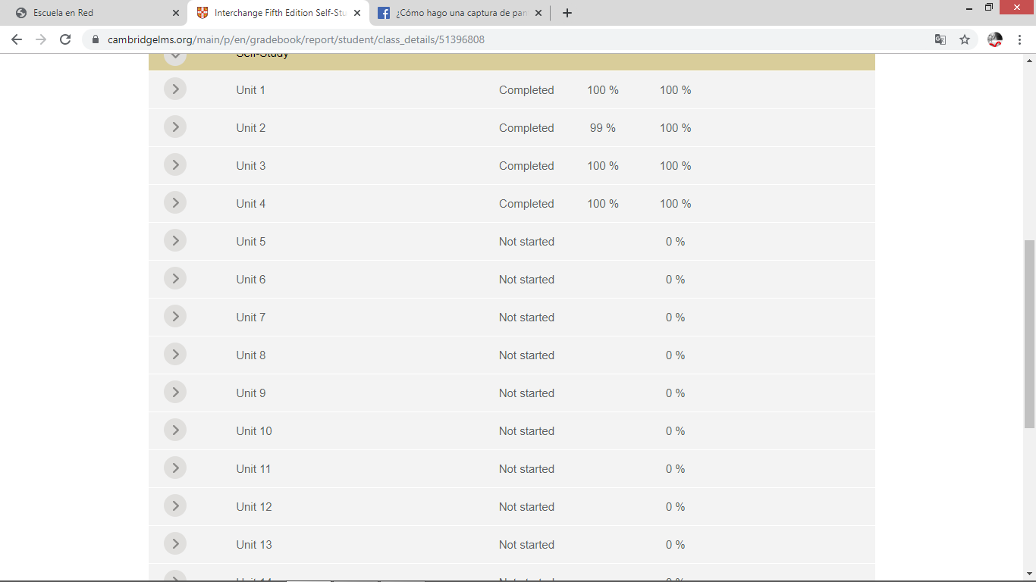

Self-study.

