Slide 2
BUILDING VOCABULARY FAMILY MEMBERS

Slide 3
WARM UP

Slide 4
LET´S PLAY!

Slide 5
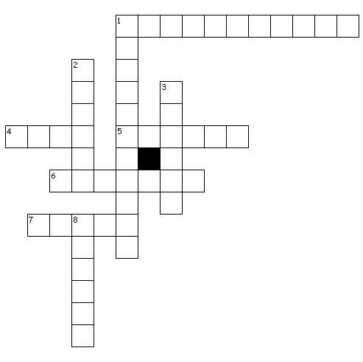
Across
1. SHE IS MY AUNT´S MOTHER
4. SHE IS MY FATHER´S SISTER
5. HE IS MY MOTHER´S HUSBAND
6. HE IS MY FATHER´S SON
7. HE IS MY FATHER´S BROTHER
Down
1. HE IS MY UNCLE´S FATHER
2. SHE IS MY MOTHER´S DAUGHTER
3. SHE IS MY GRANDPARENT´S DAUGHTER
8. HE IS MY UNCLE´S SON

Slide 6
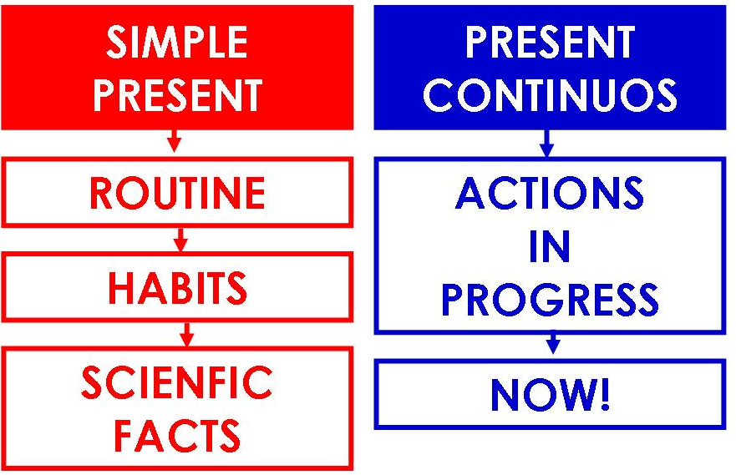
GRAMMAR
PRESENT PROGRESSIVE
We use present progressive to talk about actions that are happening at the moment of speaking, for temporary states or for future arrangements.

Slide 7
PRESENT PROGRESSIVE (Aff)
Subject | am is are | + verb + ing | Complement

Slide 8
EXAMPLES
I am waking up.
We are studying.
He is watching T.V.

Slide 10
PRESENT PROGRESSIVE(Neg)
Subject | am is are | not | + verb + ing | Complement

Slide 11
EXAMPLES
I am not driving a bus.
You are not eating junk food.
The dog is not drinking water.

Slide 13
PRESENT PROGRESSIVE (?) general
Am Is Are | + subject | + verb + ing | Complement?

Slide 14
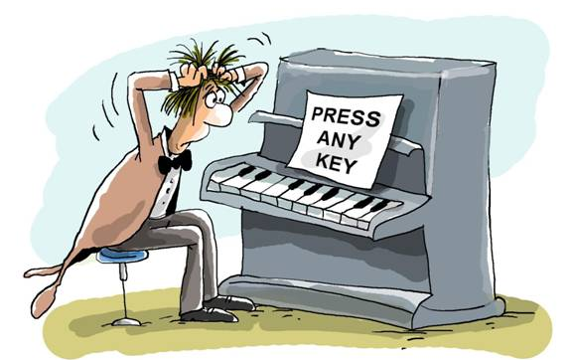
EXAMPLES
Is he playing the piano?
No, he isn´t.
No, he is not.
Am I feeding the bird?
No, I´m not.
Are they walking?
Yes, they are.

Slide 15
PRESENT PROGRESSIVE (?) special
Question word | Am Is Are | + subject | + verb + ing | Complement?

Slide 16
EXAMPLES
Where is she driving to?
She´s driving to her house.
What is he doing?
He´s watching T.V.
Where are they going?
They´re going to the park.

Slide 18
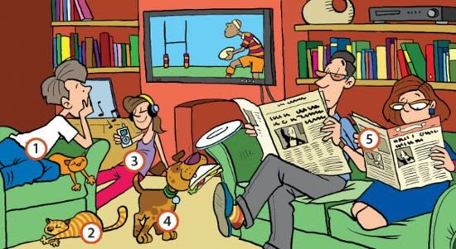

Slide 19
SONG – LEMON TREE
By Fool´s Garden

Slide 20
