Slide 1

BUILDING
VOCABULARY
PREPOSITIONS OF PLACE

Slide 2
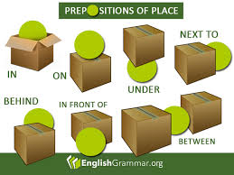

Slide 3

Worksheet

Slide 4
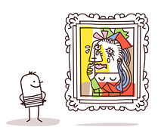
LET´S PLAY!
Draw a ____ _____ the ____________.
In
On
Under
Next to
Behind
Between
In front of
Above
Heart
Square
Moon
Triangle
Star
Sun
circle

Slide 6
BUILDING
VOCABULARY
ROOMS & FURNITURE

Slide 7
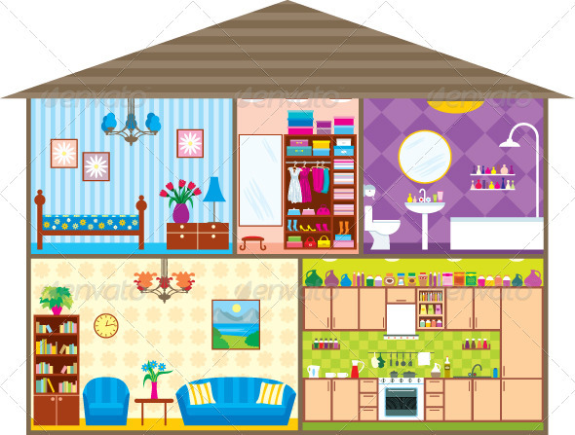
LET´S PLAY!
BEDROOM
BATHROOM
LIVING
ROOM
KITCHEN

Slide 8
Worksheet

Slide 9
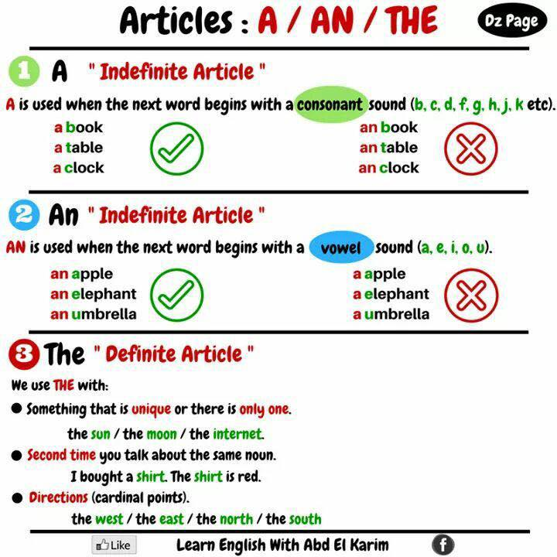
______ bed
______ lamp
______ armchair
______ oven
______ Sun
______ world

Slide 10
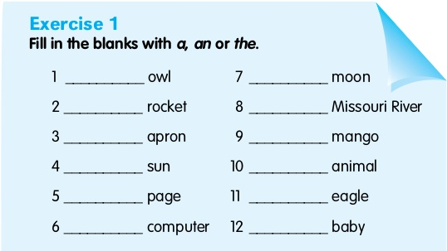

Slide 11
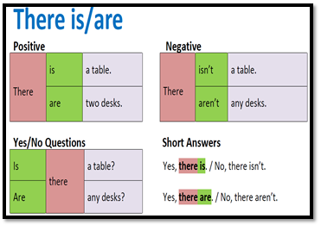

Slide 12
Worksheet

Slide 13
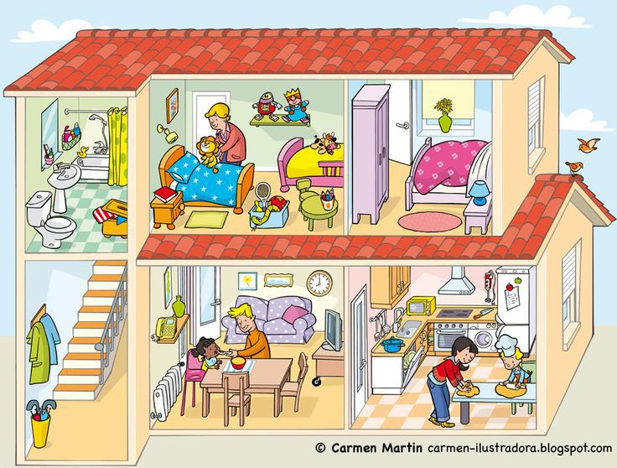
I LIVE IN A/AN BIG HOUSE WITH A/AN RED ROOF.
DOWNSTAIRS THERE IS/ARE A HALLWAY, A/AN KITCHEN AND A/AN LIVING ROOM. THE LIVING ROOM HAS A/AN SOFA AND A/AN BIG T. V. THERE IS/ ISN´T AN ARMCHAIR.
UPSTAIRS, THERE IS/ARE TWO BEDROOMS AND A/AN BATHROOM.

Slide 14
LET´S PLAY!
BEDROOM
BATHROOM
LIVING
ROOM
KITCHEN

Slide 15
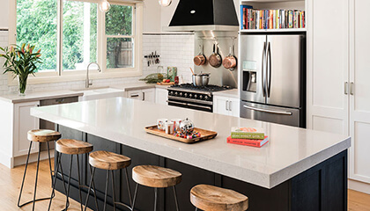

Slide 16
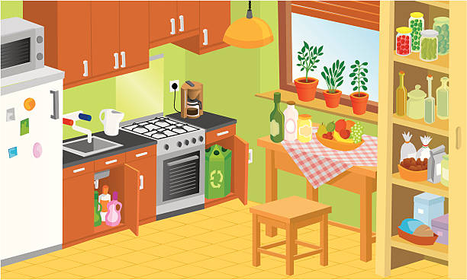

Slide 17
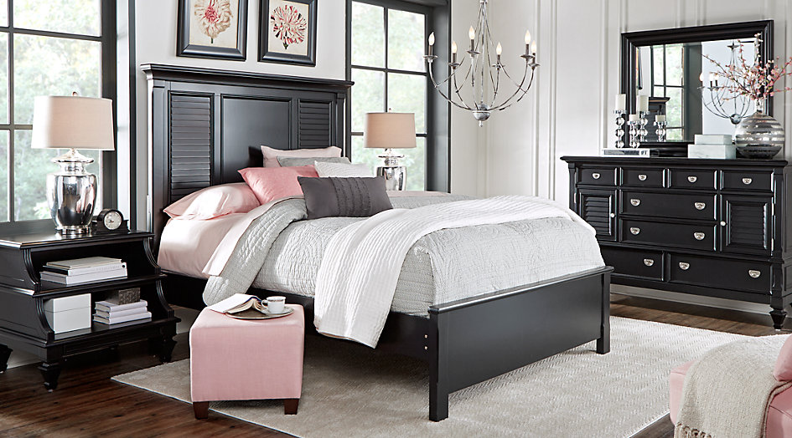

Slide 18
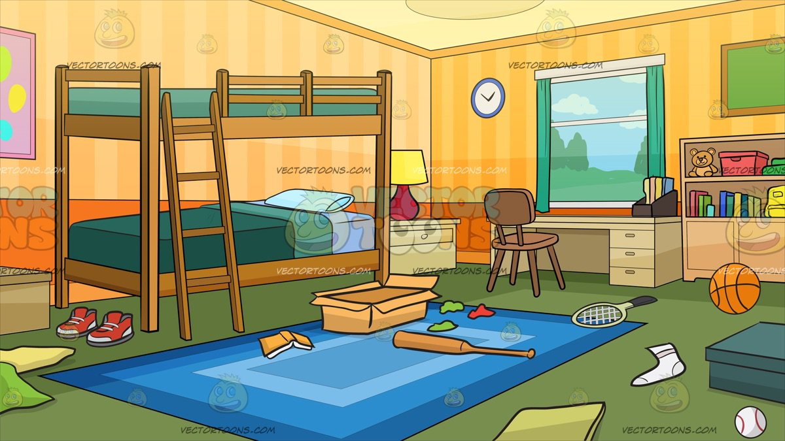

Slide 19
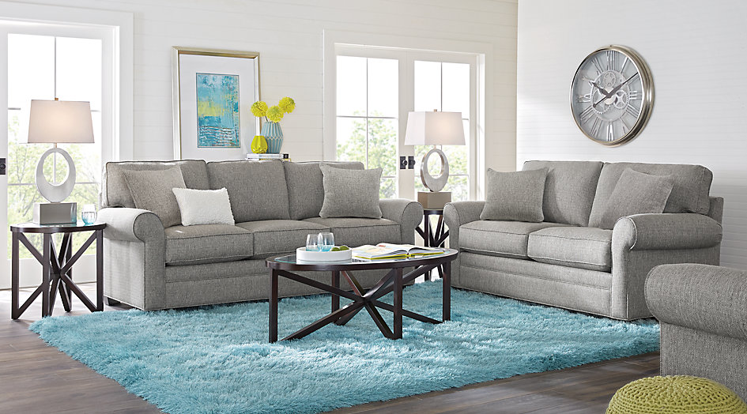

Slide 20
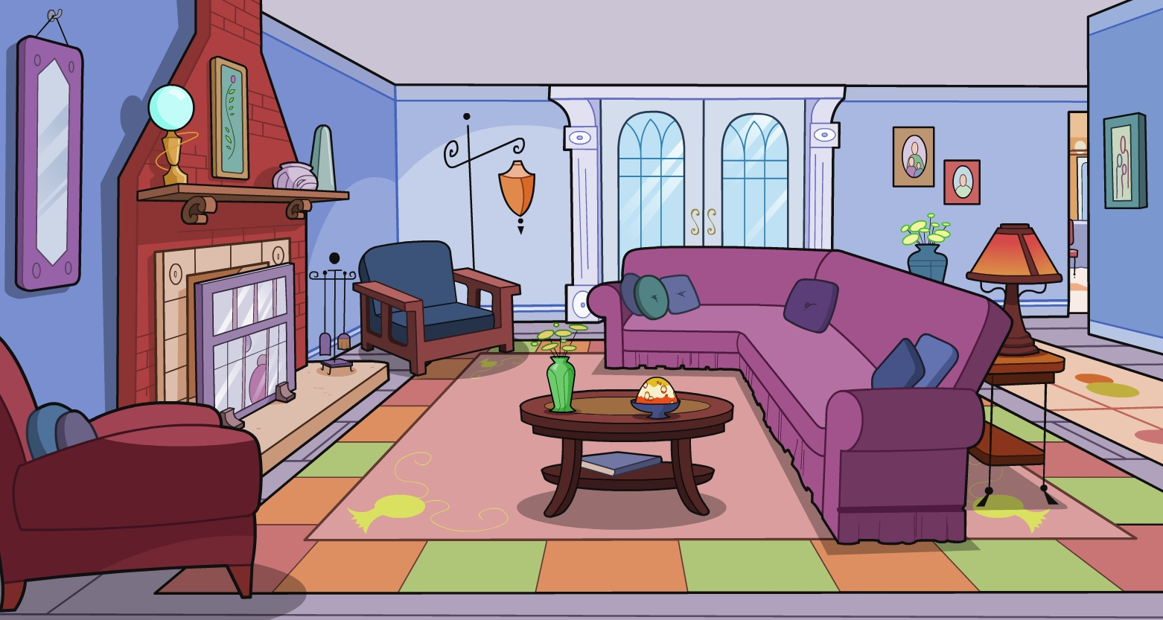

Slide 21
You can sleep in this room. | You can take a shower in this room. | Yo can watch T. V. in this room. | You can cook in this room.
There are pictures on the wall. | There is a lamp on the bedside table. | There is a mirror above the sink. | There is a coffee table between the sofa and the armchair.
There is a clock on the wall. | There is a sink between the shower and the toilet. | There is a stove between the cabinets. | There are spoons above the stove.
There is a painting above the sofa. | There are shoes in the wardrobe. | There is a plant on the bookcase. | There are jars on the cabinets.

Slide 22
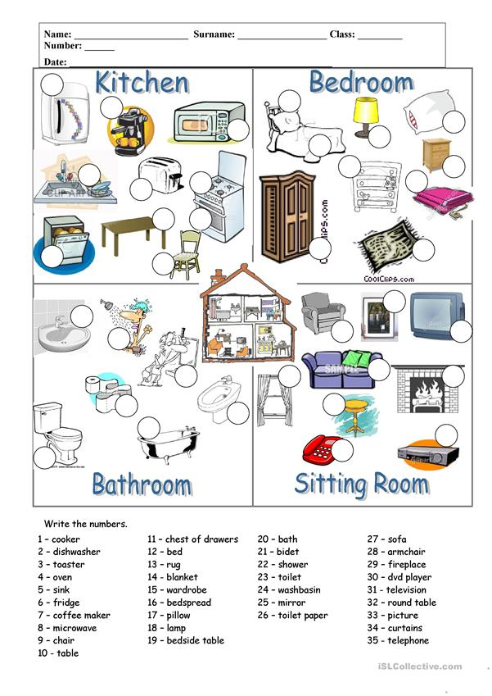

Slide 23
