Slide 1
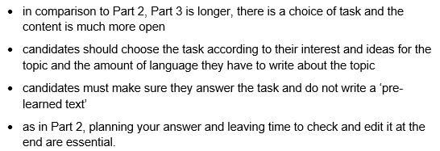
PET WRITING – PART 3

Slide 2
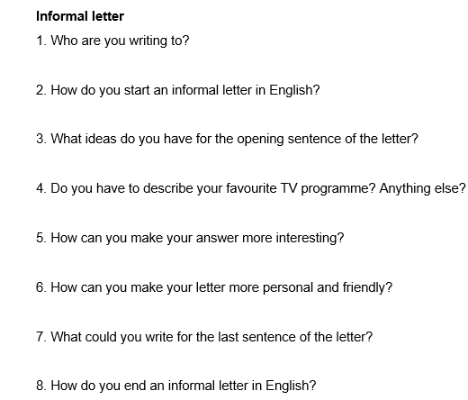
TASK 1 ANALYSIS
Answer the following questions to plan your answer.

Slide 3
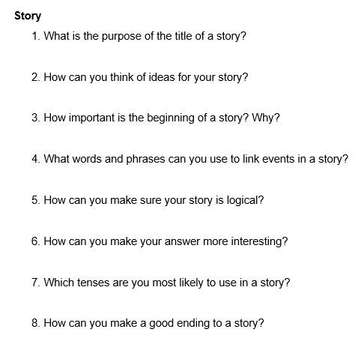
TASK 1 ANALYSIS
Answer the following questions to plan your answer.

Slide 4
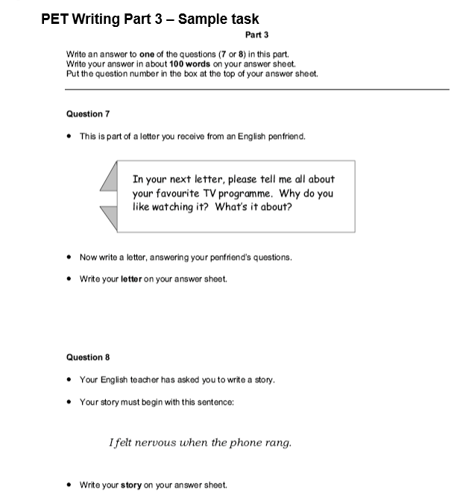
TASK 1

