Slide 1
REPORTED SPEECH: REQUESTS

Slide 3
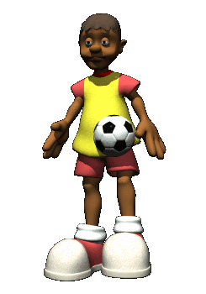
Drink six glasses of water a day.
Don’t miss practice again.
What did the coach tell you?
What did the doctor say?
He told me not to miss practice again.
She said to drink 6 glasses of water a day.
He told me to eat healthy foods and sleep well.
She said not to eat too much junk food.

Slide 4
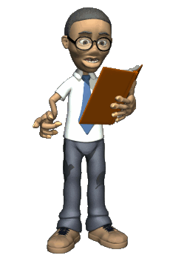
Can you please open your book on page 100?
What did the teacher ask?
He asked us to open our books on page 100.
He asked us not to talk during the exam.

Slide 5
Reported speech
It is used to talk about , or report, something that was asked of said in the past.
The most common verbs for reporting requests are ask, tell and say. They are used in the past tens to match the past action.
All three of these verbs are followed by an infinitive.
NOT is usually placed before the infinitive.
e.g., She asked me
She told me
She said
to call her tonight
e.g., The coach asked me
told me
not to miss practice again.

Slide 6
Your turn!

Slide 7
STATEMENTS

Slide 8
STATEMENTS
Direct statement
“I’m going with my family to visit Cuatro Ciénegas.”
Reported statement
“She said (that) she was going with her family to Cuatro Ciénegas.”
“She told me (that) she was going with her family to Cuatro Ciénegas.”
What happens when we report a statement?
The verbs move back one tense in the reported statement.

Slide 9
Participate matching the examples to the time line.

Slide 10
Direct statement
be (am,are,is)
have/go
made
have planned
can
will
may
Indirect statement
present tense
past tense
present perfect
modal

Slide 11
GRAMMAR FOCUS
A Look at these excuses. Change them into reported speech.
2. “My in-laws are coming over for dinner that night.”
1. “I already have plans for Saturday.”
4. “I promised to help my sister with her homework.”
7. “We have to pick up someone up at the airport that evening.”
3. “We have been invited to a graduation party on Saturday.”
5. “I can’t come because I broke my leg.”
6. “I’ll be moving this weekend.”
8. “I may have to work the night shift on Saturday.”

Slide 12
Your turn…
Report what your classmate said about the teacher’s pool party invitation.

