Slide 1
English A.2 Building confidence in communication
Online activities
March 30th – April 3rd

Slide 2
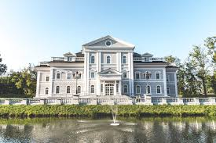
wednesday APRIL 1ST
Session 1
PAST TENSE AFF/NEG/?
Objectives:
Describe past activities.
Discribe past vacations.

Slide 3
Task 1 – Simple past
Assignment
Watch the video.
Answer the worksheets, you can print them and paste them in your notebook or you can copy them.
Product
Upload a power point presentation with a picture of your work to Escuela en Red in the activity Task 1 – Simple past.
Evaluation criteria
Delivered / Not delivered

Slide 4
I watched a movie yesterday in my house.
I did not go out last weekend.
I didn’t go out last weekend.
Did you go to school yesterday?
Yes, I did.
No, I did not. / No, I didn’t.
WATCH THE VIDEO
Elementary English #1: Talking About Past Events | Easy English at Home
https://www.youtube.com/watch?v=Hw1VzuF4KMI

Slide 5
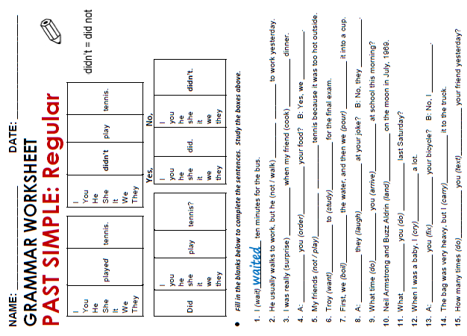

Slide 6
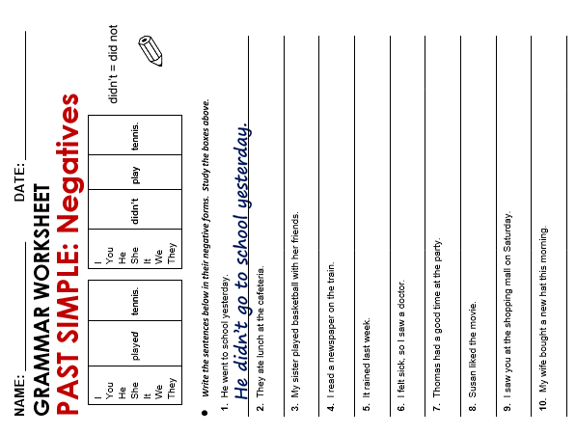

Slide 7
Today is a rainy day.
Yesterday was a sunny day.
My kids are in the house in the morning.
Last month my kids were at school in the morning.
My brother is in Mexico right now.
Last week he was in the United States.
I
He
She
It
Singular
You
We
They
Plural

Slide 8
WATCH THE VIDEO
TO BE - Past & Present Tense - Affirmative Sentences
https://www.youtube.com/watch?v=yhq1wuu7NFk

Slide 9
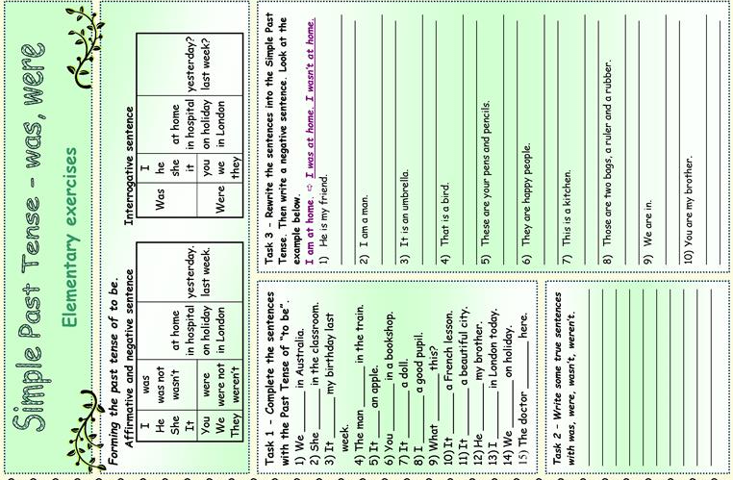

Slide 11
THURsday APRIL 2ND
Session 2
CAMBRIDGE PLATFORM
Objectives:
Describe past activities.
Discribe past vacations.

Slide 12
CAMBRIDGE PLATFORM
Assignment (notebook)
Complete the self study activities of unit 7 in the Cambridge platform.
Product
Upload a power point presentation with a picture of your progress to Escuela en Red in the activity Cambridge platform – unit 7.
Evaluation criteria
Percentage in the platform

Slide 13
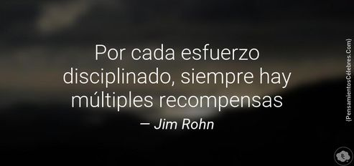

Slide 14
friday april 3rd
Session 3
English discoveries
Objectives:
Discuss past events.

Slide 15
ENGLISH DISCOVERIES
Assignment
Go to ed.engdis.com/coaenep
Complete unit 7 “We went dancing”
Product
Percentage given by the platform.
Evaluation criteria
Grade given by the platform

