Slide 1
Simple present Wh questions practice 1 (Explanation)
What | Ask about a thing | What sports do you like?
Where | Ask about a place or position | Where do you play soccer?
When | Ask about the ocasión, moment, time | When do you play soccer?
Who……. with | Ask about a person | Who do you play soccer with?
What time | Ask about the specific time | What time do you play soccer?
How often | Ask about the frequency | How often do you play soccer?

Slide 2
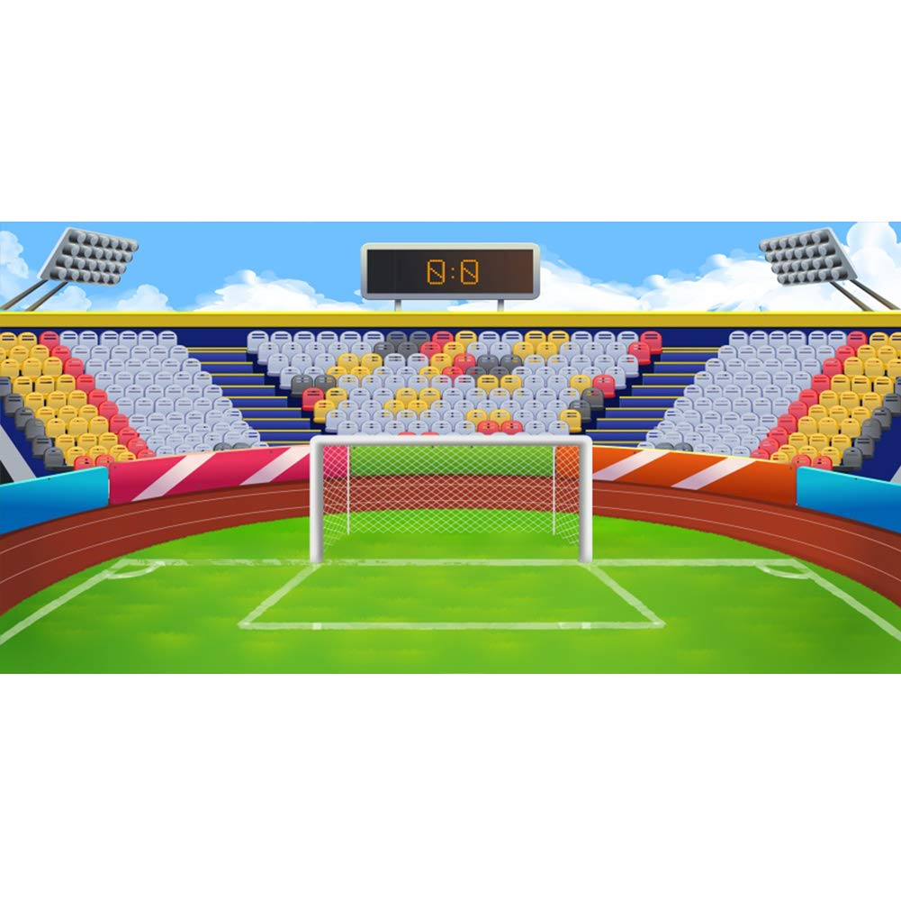
Match the question with the correct picture
What ?
Where ?
When?
What time?
Who…..with?

Slide 3
Match the three columns
What
do you live with?
I go to bed at 9:00 pm
Where
do you study english ?
I like to play tennis
What time
sports do you like?
I live with my husband
Who
do you work?
I study english twice a week
How often
do you go to bed?
I work in a hospital

Slide 4
Use Phrases of frequency to answer
How often do you……………?
How often do you go swimming? | I go swimming twice a week
How often do you play soccer? | I play soccer twice a month
How often do you play tennis? | I play tennis three times a year

Slide 5
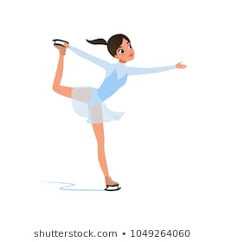
Write questions with how often for each picture and answer using phrases of frequency.
 | How often do you……………?

Slide 6
Write wh questions and answers for each picture
 | Who do you……………with ?

Slide 7
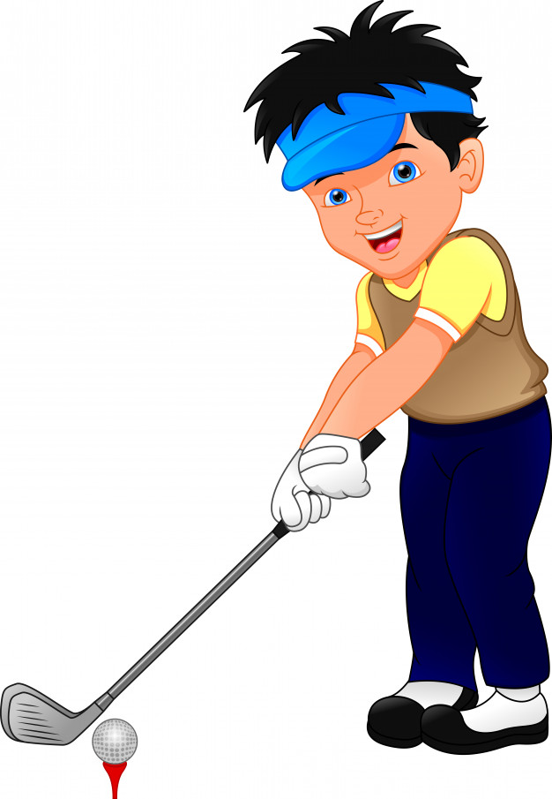
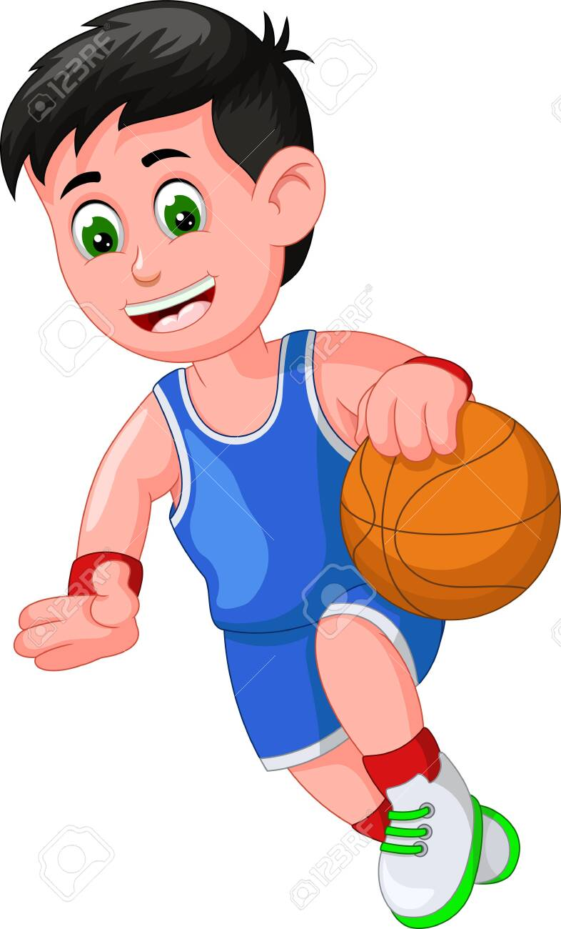
Write wh questions and answers for each picture
 | When do you…………… ?

Slide 8
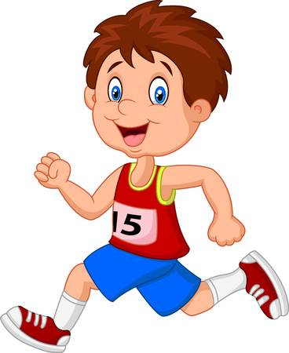
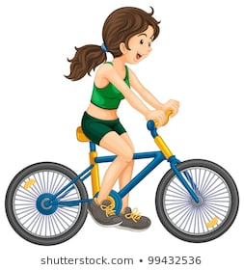
Write wh questions and answers for each picture
 | Where do you…………… ?

