Slide 1
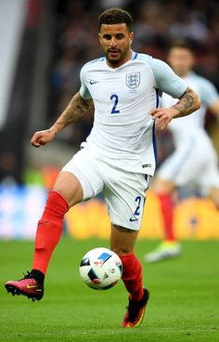
Reading Comprehension Excercise
My name is David Johnson and I´m from England. I´m a footballer and I play for Manchester United in the English premiere league. In England, football matches are usually on Saturday. On Saturday, I get up at half past seven and have breakfast at nine o´clock. I sometimes have bacon and eggs for breakfast. In the morning, I often watch TV with my children and read the newspaper. I go to the stadium at half past eleven and have lunch with the other players at quarter past twelve. For lunch, we usually have fish and vegetables, we hardly ever eat junk food. The match starts at three o´clock and finishes at quarter to five. In the evening I usually go to a restaurant with my wife. When I get home, I watch a movie on TV. and go to bed very late.

Slide 2
Write questions and its answers about the previous text
1.- What is his name? His name is David Jhonson
2.- Where _____ ______ from?_____________________________________________
3.- What _____ _______do?______________________________________________
4.- Where _____ _______ work?___________________________________________
5.- What time ______ ______ _______breakfast?______________________________
6.- How often _____ ______ _______ eggs and bacon for breakfast?______________
7.- What _____ ______ _______ in the morning?______________________________
8.- Who ______ ______ _______ TV. With?__________________________________
9.- What time _____ _____ ______ to the stadium?____________________________
10.- How often ______ ______ ______ junk food ?_____________________________
11.- What ______ ______ _______ ______ lunch?______________________________
12.- Who _______ _______ ______ lunch with?_________________________________
13.- What time _______ _______ ______ finish?_______________________________
14.- What ______ _______ _______ after the match_____________________________
15.- Where ______ _______ _______ in the evening?____________________________

