Slide 1
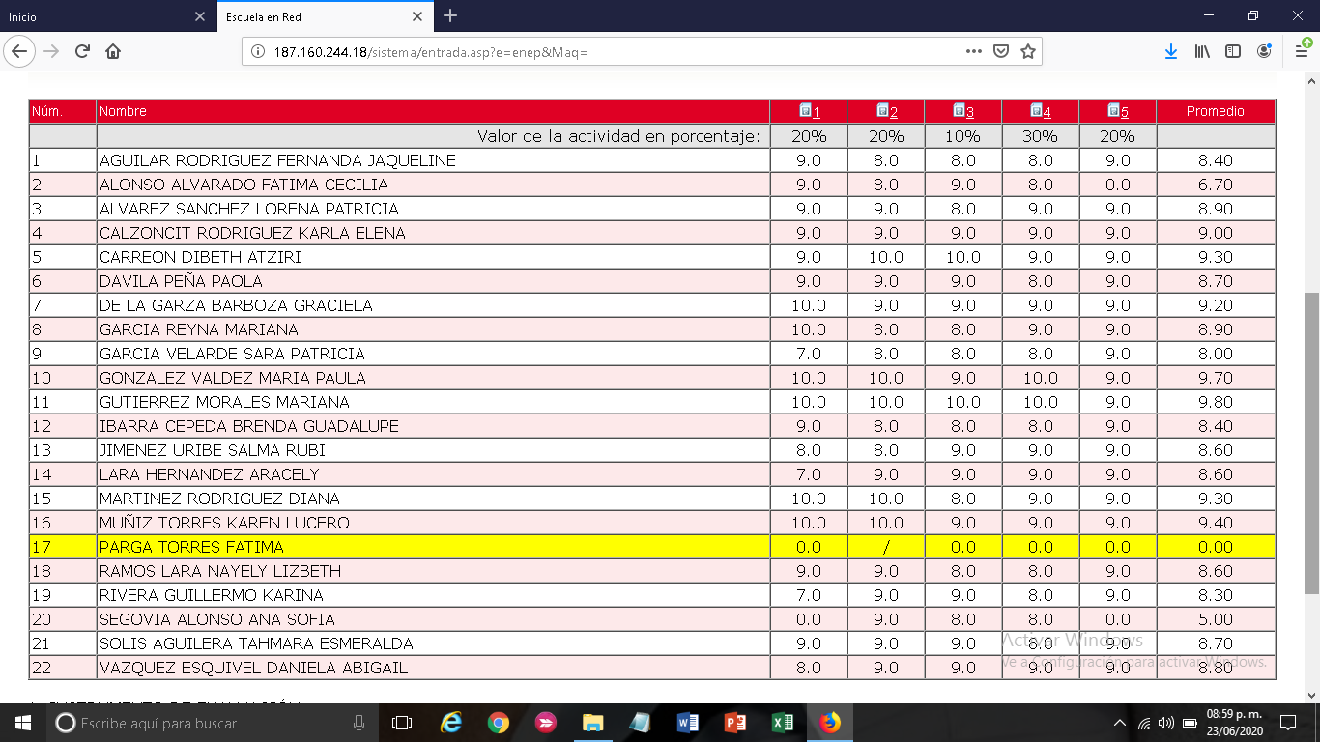

Slide 2
PROMEDIO UNIDAD # 3
# | PROMEDIO | ENTEROS
1 | 8.4 | 8
2 | 6.7 | 7
3 | 8.9 | 9
4 | 9 | 9
5 | 9.3 | 9
6 | 8.7 | 9
7 | 9.2 | 9
8 | 8.9 | 9
9 | 8 | 8
10 | 9.7 | 10
11 | 9.8 | 10
12 | 8.4 | 8
13 | 8.6 | 9
14 | 8.6 | 9
15 | 9.3 | 9
16 | 9.4 | 9
17 | / | /
18 | 8.6 | 9
19 | 8.3 | 8
20 | 5 | 5
21 | 8.7 | 9
22 | 8.8 | 9

