Slide 1
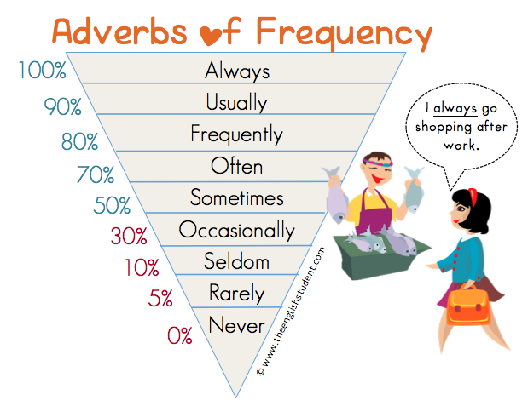

Slide 2
Frequency | Adverb of Frequency | Example Sentence
100% | always | I always go to bed before 11pm.
90% | usually | I usually have cereal for breakfast.
80% | normally / generally | I normally go to the gym.
70% | often* / frequently | I often surf the internet.
50% | sometimes | I sometimes forget my wife's birthday.
30% | occasionally | I occasionally eat junk food.
10% | seldom | I seldom read the newspaper.
5% | hardly ever / rarely | I hardly ever drink alcohol.
0% | never | I never swim in the sea.
The Position of the Adverb in a Sentencen adverb of frequency goes after the verb To Be.
An adverb of frequency goes before a main verb (except with To Be).
Subject + adverb + main verb
I always remember to do my homework.
He normally gets good marks in exams.
An adverb of frequency goes after the verb To Be.
Subject + to be + adverb
They are never pleased to see me.
She isn't usually bad tempered.
When we use an auxiliary verb (have, will, must, might, could, would, can, etc.), the adverb is placed between the auxiliary and the main verb.
Subject + auxiliary + adverb + main verb
She can sometimes beat me in a race.
I would hardly ever be unkind to someone.
They might never see each other again.
They could occasionally be heard laughing.
https://www.youtube.com/watch?v=bOzc-vF3jOQ

Slide 4
Put the following adverbs of frequency in the correct order from the most often to the least often (1-6):
 | often
 | usually
 | always
 | never
 | seldom/rarely
 | sometimes
Rewrite the complete sentence using the adverb of frequency in brackets in its correct position.
They go to the movies. (often)_____________________________
She listens to classical music. (rarely)____________________
He reads the newspaper. (sometimes)______________________
Sara smiles. (never)_____________________________
She complains about her husband. (always)__________________________

Slide 5
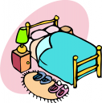
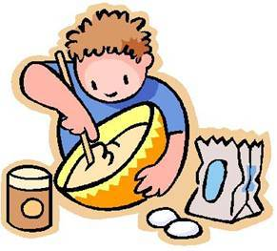
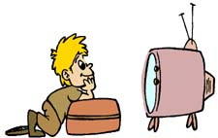
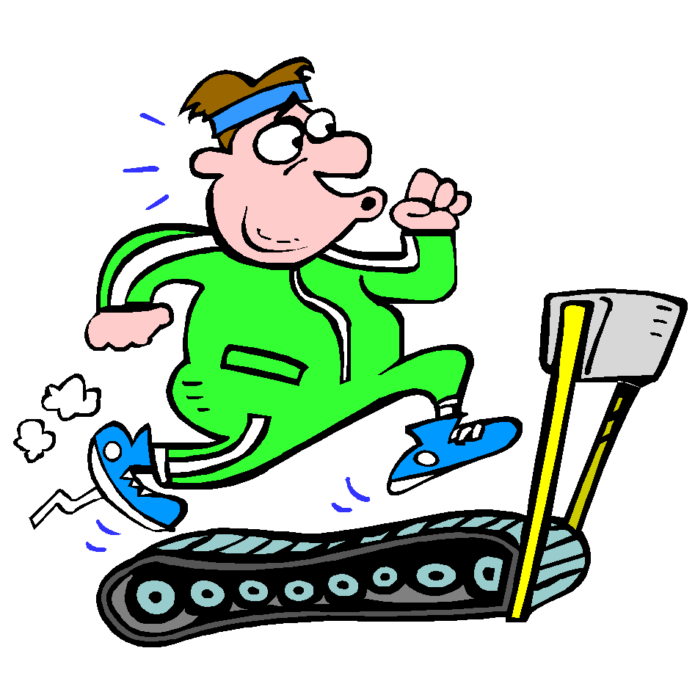
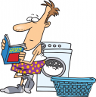
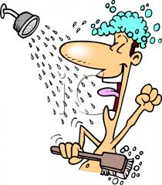
Start
Move
forward
2 squares
Go
shopping
Make my
bed
Cook
dinner
Watch tv.
Finish
Lose
Turn
Move
back
2 squares
Eat junk food
Do the
Laundry
Clean the house
Take a shower
Excercise
at home
Eat healthy food

