Slide 1
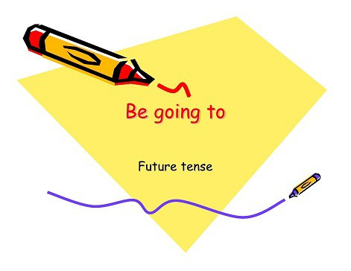

Slide 2
Affirmative sentences
I
am going to
clean
my house

Slide 3
Negative sentences
I
am NOT going to
work
next friday

Slide 4
?
Yes / No questions
Are
they going to
go
to the beach ?

Slide 5
?Wh
questions
What
are
you going to
do
on saturday?
Where
are
you going to
go
on saturday?

Slide 6
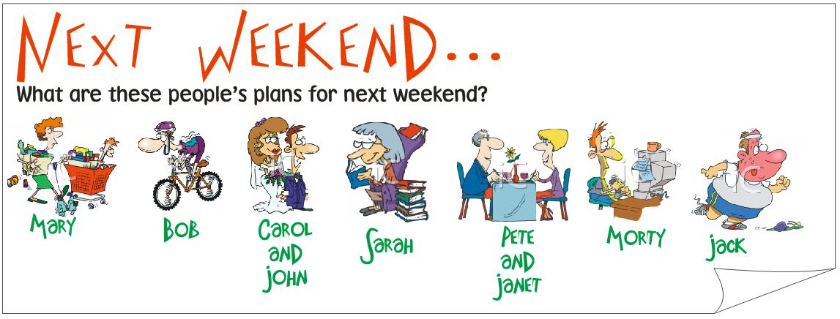
Write 5 (+ and -)sentences with going to
________________________________________________________________________________________________________________________________________________________________________________________________________________________________________________________________________________________________________________________________________________________________________________________________________________________________________________________________________________________________________________________

Slide 8
Click on the following link to play and practice (game 1)with the use f going to for future intentions
http://learnenglishkids.britishcouncil.org/en/grammar-practice/going-plans

