Slide 1
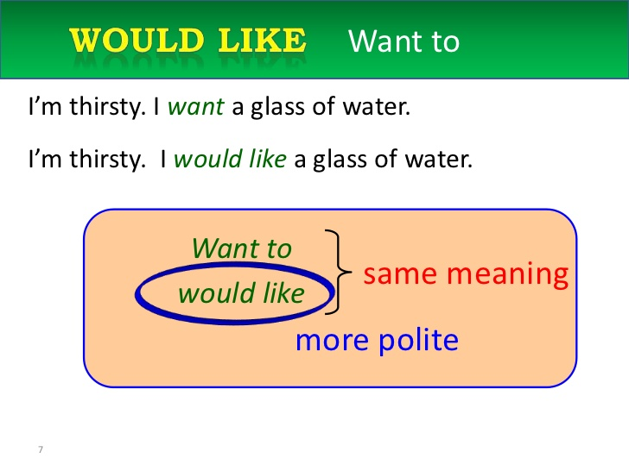

Slide 2
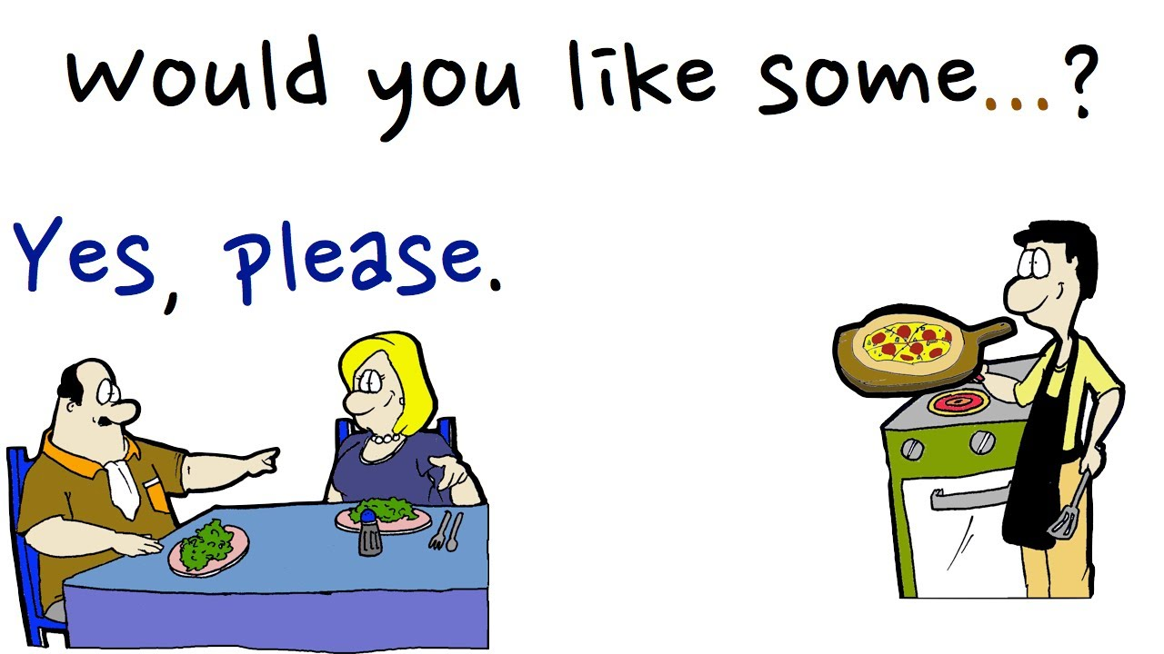

Slide 3
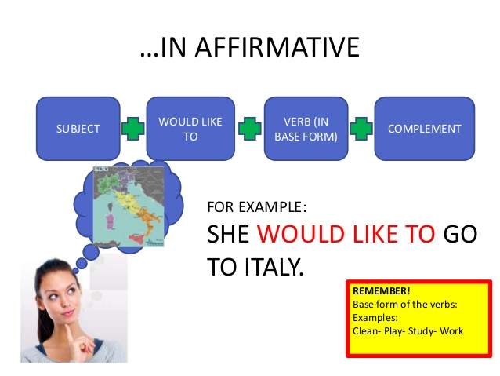

Slide 4
http://first-english.org/english_learning/english_beginners/would_want_to/01_would_like_to_courses.htm

Slide 5
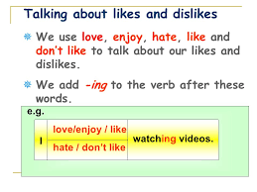

Slide 6
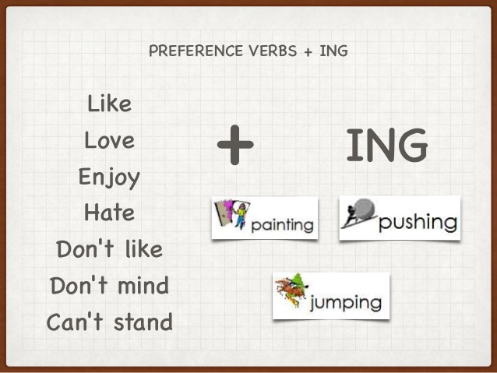



Slide 7
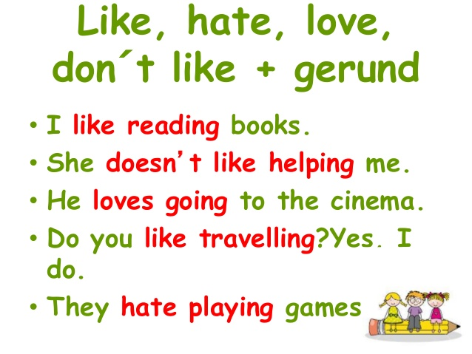

Slide 8
http://first-english.org/english_learning/english_beginners/would_want_to/04_want_to_sentences_exercises.htm

