Slide 1
Escuela Normal de Educación Preescolar English B1 Unit 6: Project: What’s a good job for me? Teacher: Beatriz Eugenia Valdés Rodríguez Members: Beltrán Balandrán Sahima Guadalupe #2 González Valdez María Paula #4 Vázquez Esquivel Daniela Abigail #9 Tuesday, March 17th, 2020. Saltillo, Coah., México.

Slide 2
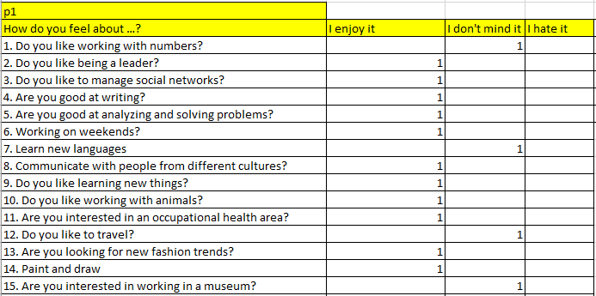
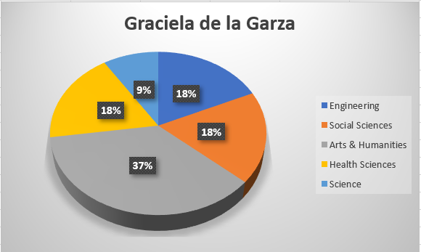
She likes to work on weekends, manage social networks, write, communicate with people from other cultures, so she would be good at working as a journalist on a television or radio station.

Slide 3
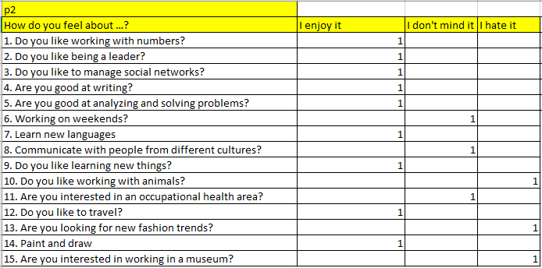
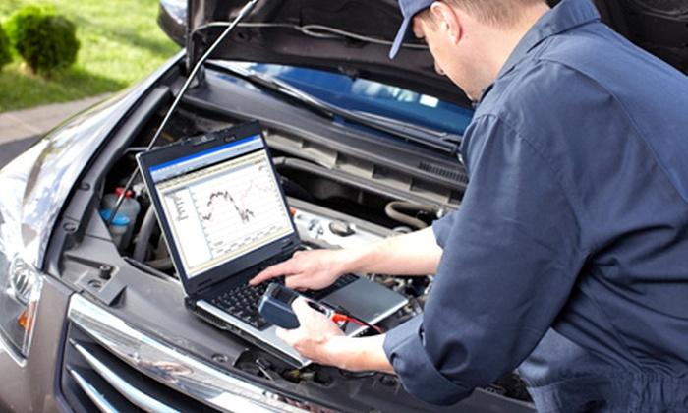
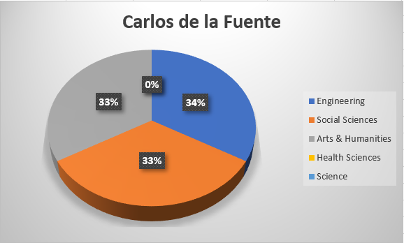
He likes to work with numbers, lead, learn new languages, travel, draw, etc. so you would be a good automotive engineer.

Slide 4
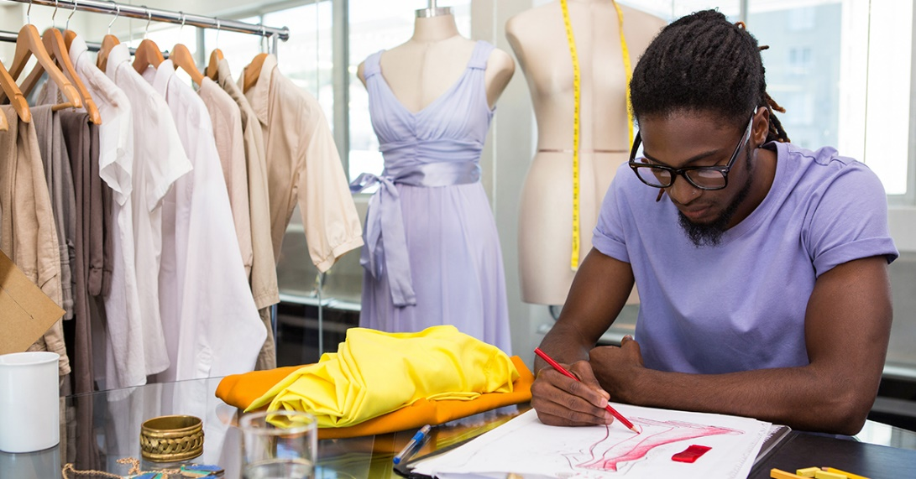
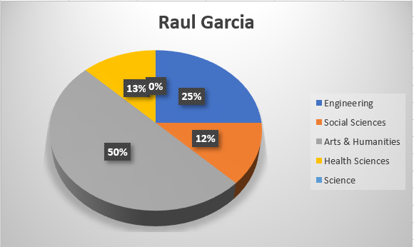
He likes to be aware of new fashions, communicate with people from other cultures, travel, learn new things and for this reason he would be a good fashion designer.

Slide 5
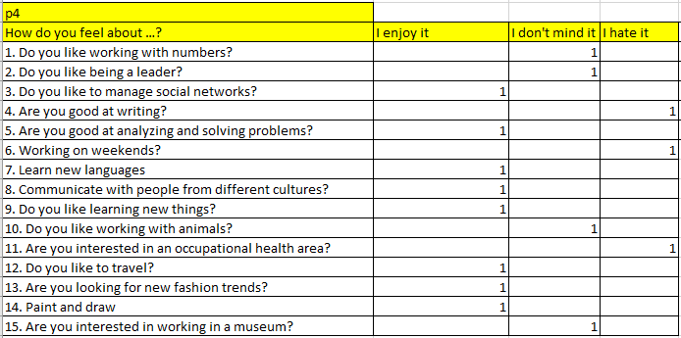
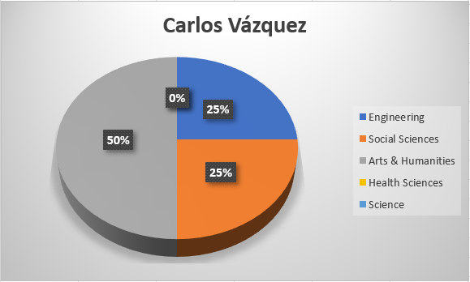
He likes to manage social networks, it does not matter much having to work with numbers, learn new languages, solve problems, learn new things and travel for what would be a good systems engineer

Slide 6
Sahima’s reflection
This project is of great help to achieve a review of the skills that people have, I consider it important to recognize the skills that each person has. since in the future when I am a kindergarten teacher those skills will have to be observed in children. on the other hand with this project I managed to have a great learning and I also managed to work very well as a team.
Daniela’s reflection
Through this project we were able to get to know the different skills and preferences of the people so that in this way they could know what their profession could be, we also put into practice what was seen in the unit such as the use of the gerund and short answers
Paula’s reflection
This activity helped us learn about the skills that people have and how, thanks to the skills, a person may be able to choose a career that will be the root of their work for life. It is important to know how to describe what you like and what you do not like, to know what things are best for you, depending on your personality.

Slide 7
Category | Score 5 | Score 4 | Score 3 | Score 2
Required elements 20 pts | Goes over and above all required elements stated in the instructions | Includes all of the required elements stated in the instructions | Missing one or more of the required elements. | Several required elements are missing from the project
Overall effectiveness and completion of task 10 pts | Project is organized and presents material captivating for viewer | Project is somewhat organized and complete and holds attention of viewer | Project is disorganized and incomplete at times and is somewhat able to hold attention of viewer | Project is incomplete and not easy to follow
Creativity 10 pts | Exceptionally unique and clever in showing deep understanding | Thoughtfully and uniquely presented; showing understanding | A few original touches enhance the project to show some understanding of the material | Shows little originality and creativity and/or effort in understanding the material
Neatness and attractiveness 10 pts | Exceptionally attractive and neat in design and layout | Attractive and neat in design and layout | Acceptably attractive but may be messy at times and/or show lack of organization | Distractingly messy or very poorly designed
Grammar 30 pts | No grammatical or mechanical mistakes | 2 or 3 grammatical mistakes which are not distracting | 4 to 6 grammatical mistakes which are distracting | More than 6 grammar or mechanical mistakes which are very distracting
Understanding of content 20 pts | Shows a sophisticated understanding of the themes | Shows an understanding of the themes | Displays a somewhat limited understanding of the themes and may have few misinterpretations | Does not show an understanding of the themes. Has quite a few misinterpretations.
Total 100 pts
Rubric to assess your project. Name of the team members:
Beltrán Balandrán Sahima Guadalupe #2
González Valdez María Paula #4
Vázquez Esquivel Daniela Abigail #9
Date: Tuesday, March 17th, 2020.

Slide 8
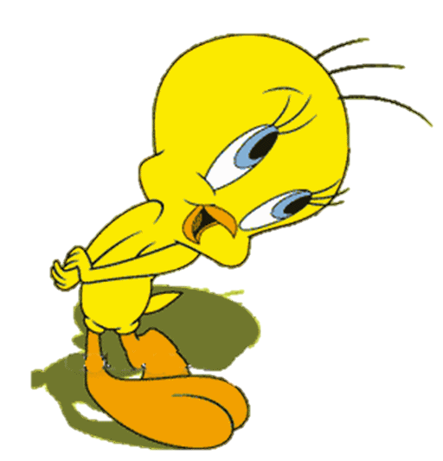
Thanks!

