Slide 1
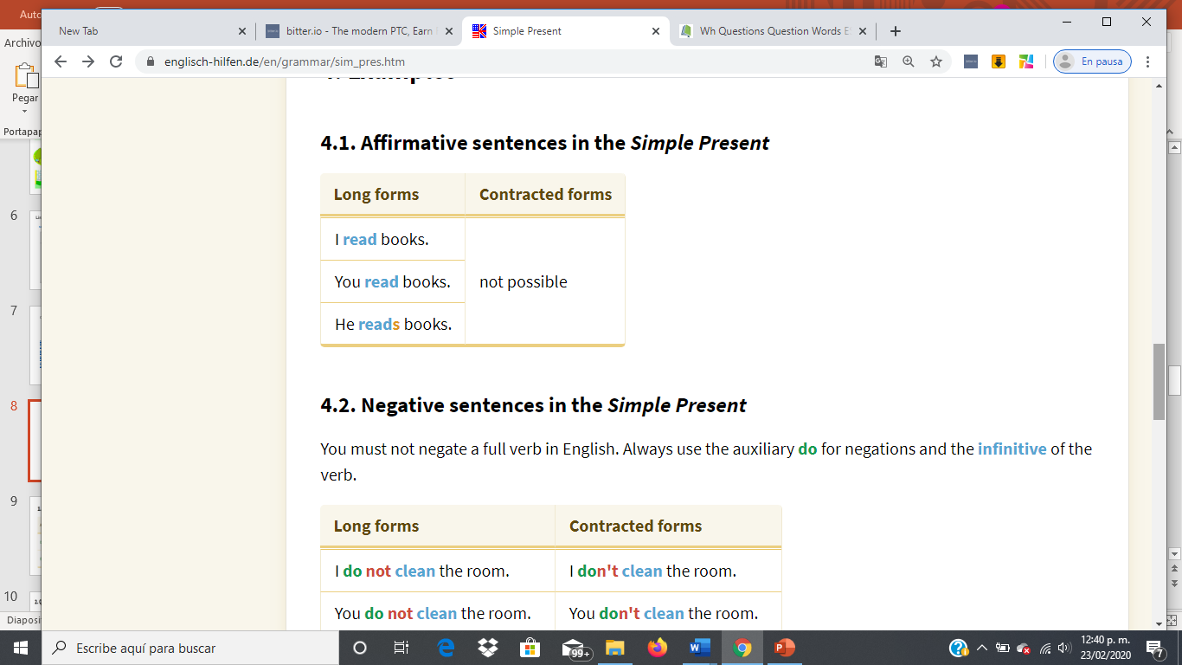
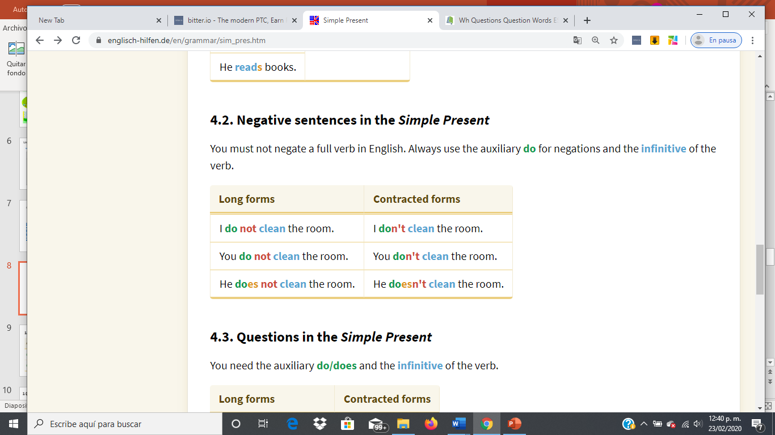
Subject + verb + Rest
Subject + auxiliar-not + verb + Rest

Slide 2
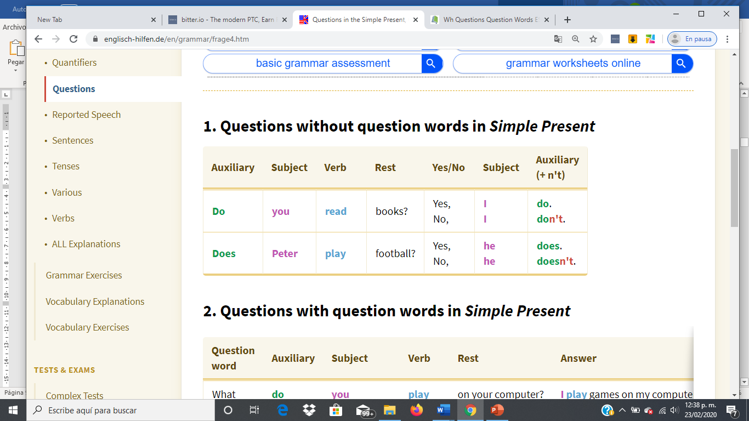
Question
Answer

Slide 3
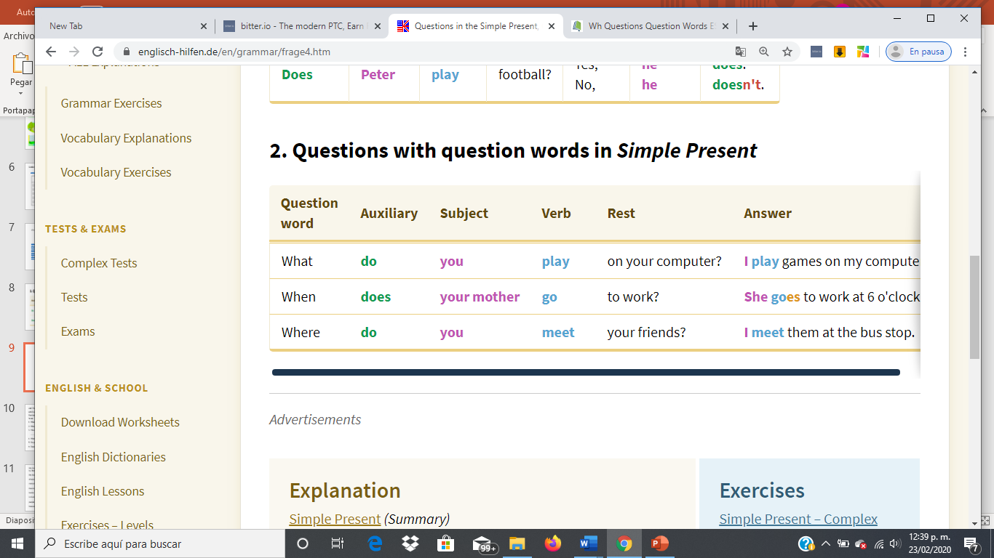
Question
Answer
Wh
Subject verb Rest

Slide 4
Write negative sentences
I ________________my bedroom.(not-clean)
Mary ___________ in the kitchen (not-eat)
My father ______________ TV in the livingroom (not-watch)
They ________________ with the dog in the yard (not-play)
We ______________ to bed early (not-go)
Albert _________ his car in the garage (not-keep)
Don´t clean
Doesn´t eat
Doesn´t watch
Don´t play
Don´t go
Doesn´t keep

Slide 5
Answer the following questions
Do you live in a house or an apartment?................................................................
Do you like your house? .......................................................................................
Does your brother has his own bedroom?.............................................................
Does your house have a yard/ swimming pool/ a nice view/etc..?...........................
Where do you live? ................................................................................................
Where does your brother sleep? ............................................................................
I do live in a house
Yes i do
Yes he does
No, he doesn´t
I do live in a house
He does sleep in the bedroom

