Slide 1
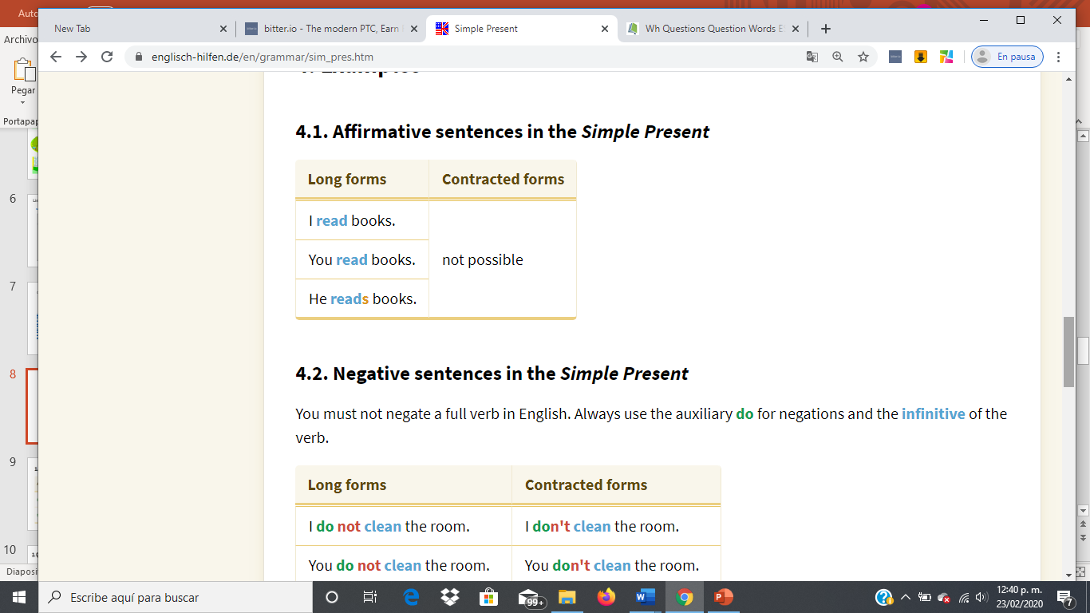
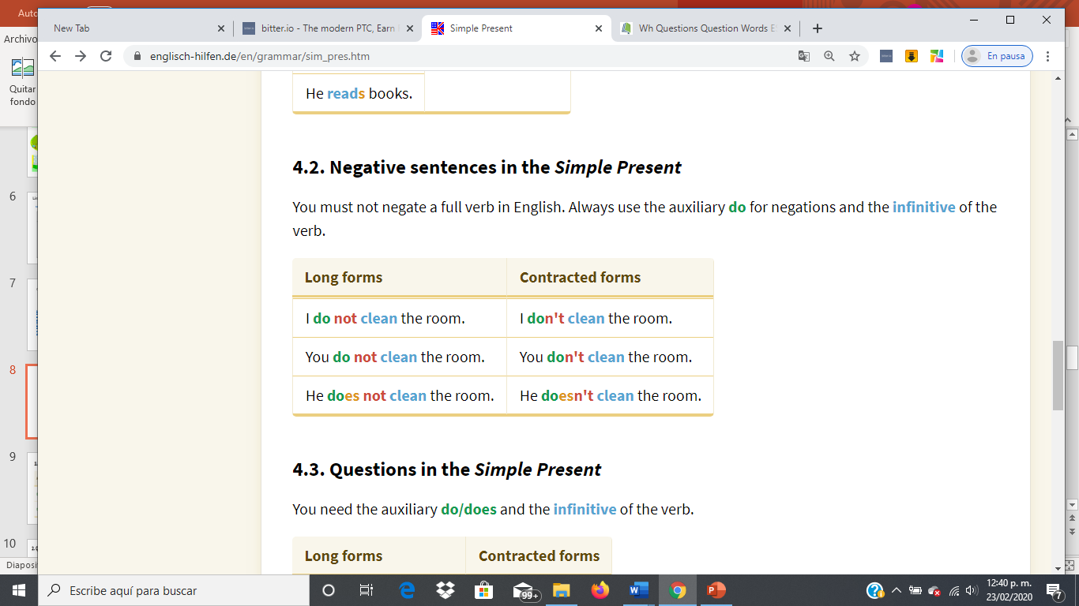
Subject + verb + Rest
Subject + auxiliar-not + verb + Rest

Slide 2
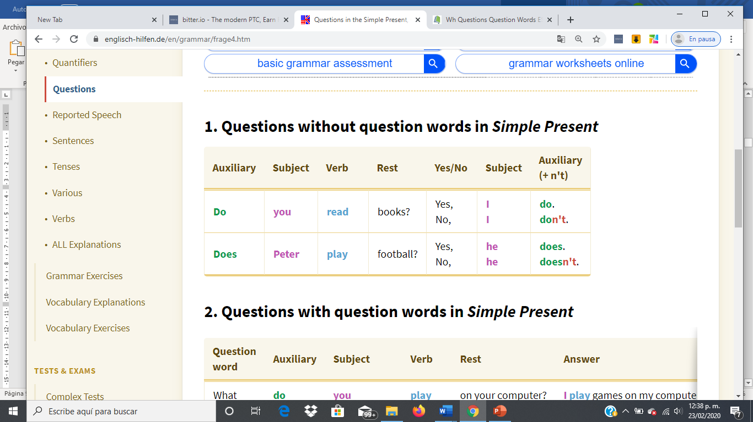
Question
Answer

Slide 3
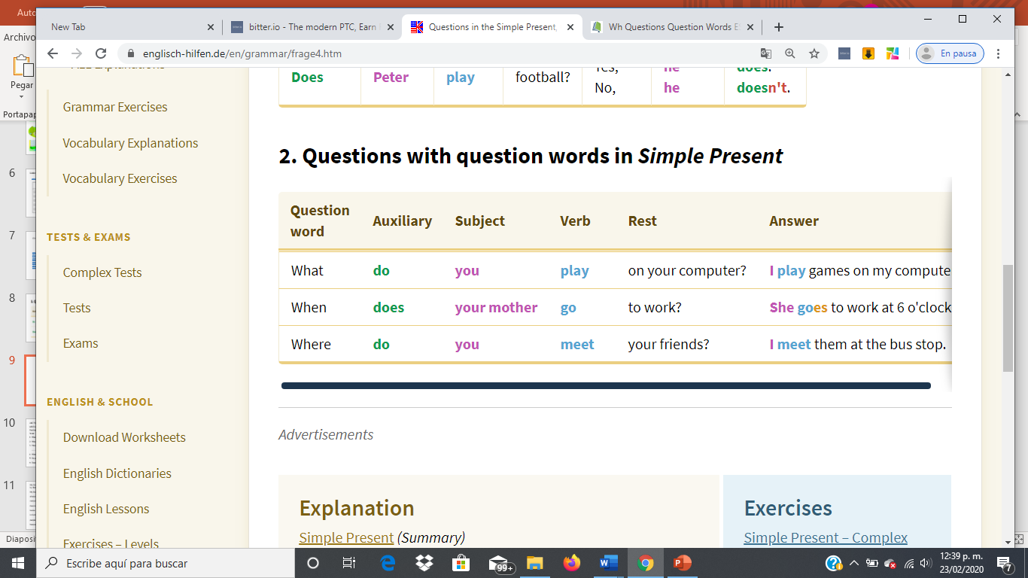
Question
Answer
Wh
Subject verb Rest

Slide 4
Write negative sentences
I my bedroom.(not-clean)
Mary ___________ in the kitchen (not-eat)
My father ______________ TV in the livingroom (not-watch)
They ________________ with the dog in the yard (not-play)
We ______________ to bed early (not-go)
Albert _________ his car in the garage (not-keep)
Don’t clean
Doesn’t eat
Doesn’t watch
Don’t play
Don’t go
Doesn’t keep

Slide 5
Answer the following questions
Do you live in a house or an apartment?................................................................
Do you like your house? .......................................................................................
Does your brother has his own bedroom?.............................................................
Does your house have a yard/ swimming pool/ a nice view/etc..?...........................
Where do you live? ................................................................................................
Where does your brother sleep? ............................................................................
I live in a house
Yes, i do
No, he doesn’t, he share bedroom
No, it doesn’t
In my house with my mother
He sleeps with my other brother in his bedroom

