Slide 1
Escuela Normal de Educación Preescolar ENGLISH A1.2
Teacher: Mayela Alejandra del Carmen Gaona García
Student: Andrea Judith Esquivel Alonzo
(And Lucia del Carmen Laureano Valdez)
UNIT 7
MY DREAM HOUSE
Saltillo, Coahuila
March 2020

Slide 2
MY DREAM HOUSE
-Do you live in an apartment?
No, I don't. I live in a house
-That's great!! Does his house have a yard?
Yes it does. My house has a beautiful yard
-Do you have plants in the yard?
Yes, there are plants in the yard
-Do you have chairs in the yard?
Yes, there are two chairs in the yard
-Do you need a coffee table in the yard?
No, I don't. I have a table in the yard
Does your yard have a swimming pool?
Yes, there´s a swimming pool in the yard
-Does your house have many bedrooms?
No it doesn't. My house has only one bedroom
-Do you need a stove in the kitchen?
No I don't. I need a microwave in the kitchen
-Does the bathroom have a bathtub?
No it doesn't. I need a bathtub in the bathroom.

Slide 3
-Do you have books in your bookcase?
No, there aren't any books in the bookcase.
-Does your bedroom have pictures?
Yes, There're three pictures in the bedroom
-Does your bathroom have a mirror?
Yes, There's a mirror in the bathroom
-Do you have a sofa in the living room?
Yes, I have a sofa in the living room
-Do you have a T.V. in the living room?
Yes, There is a TV in the living room
-Does your bedroom have a rug?
No, There isn’t a rug in the bedroom

Slide 4
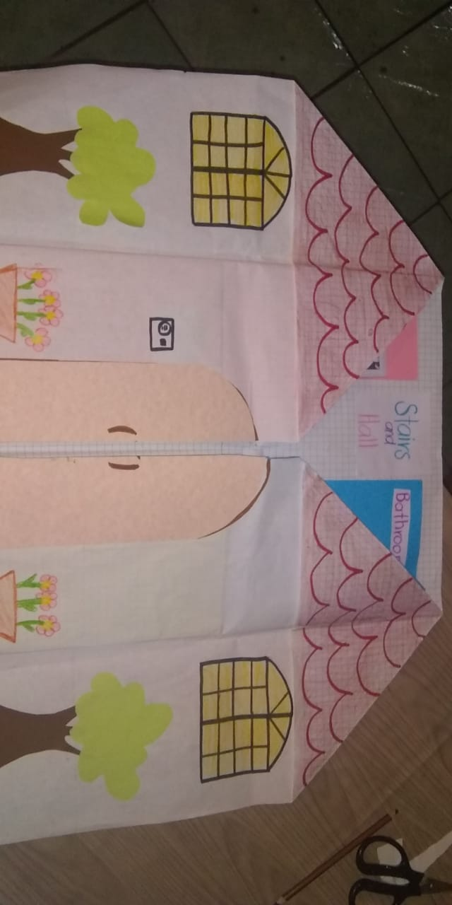

Slide 5
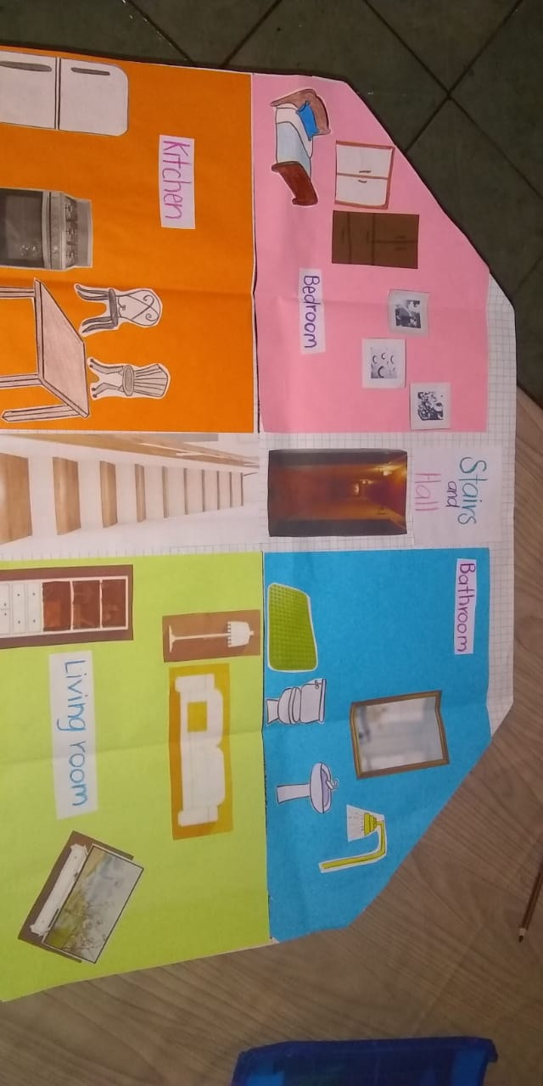

Slide 6
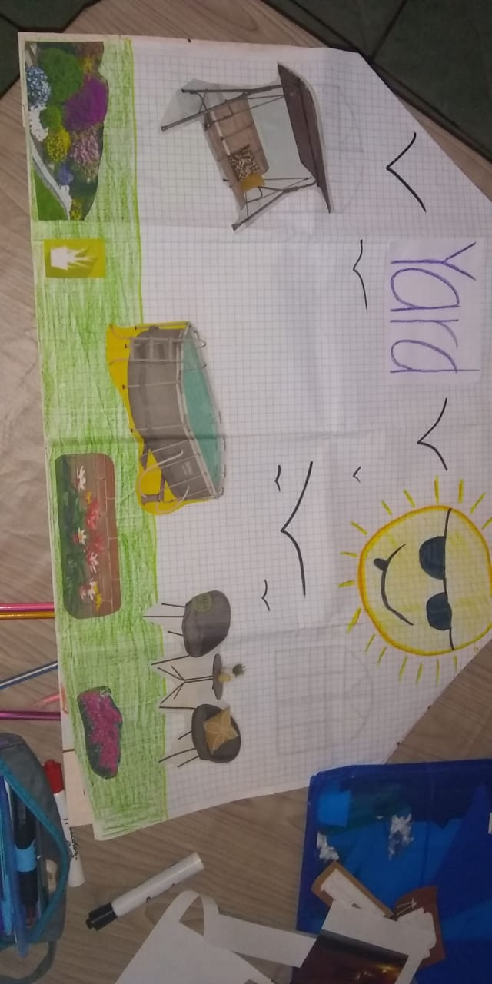

Slide 7
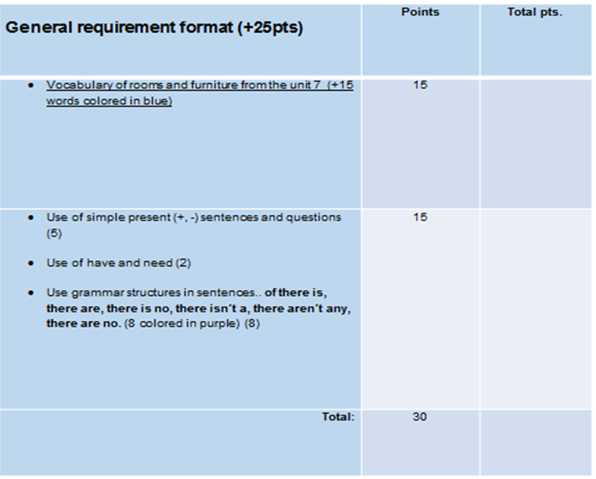

Slide 8
