Slide 1
Project unit 7
My dream house
Mayela Abigail Moncada Cadena
Alma Cristina Olvera Rodriguez

Slide 2
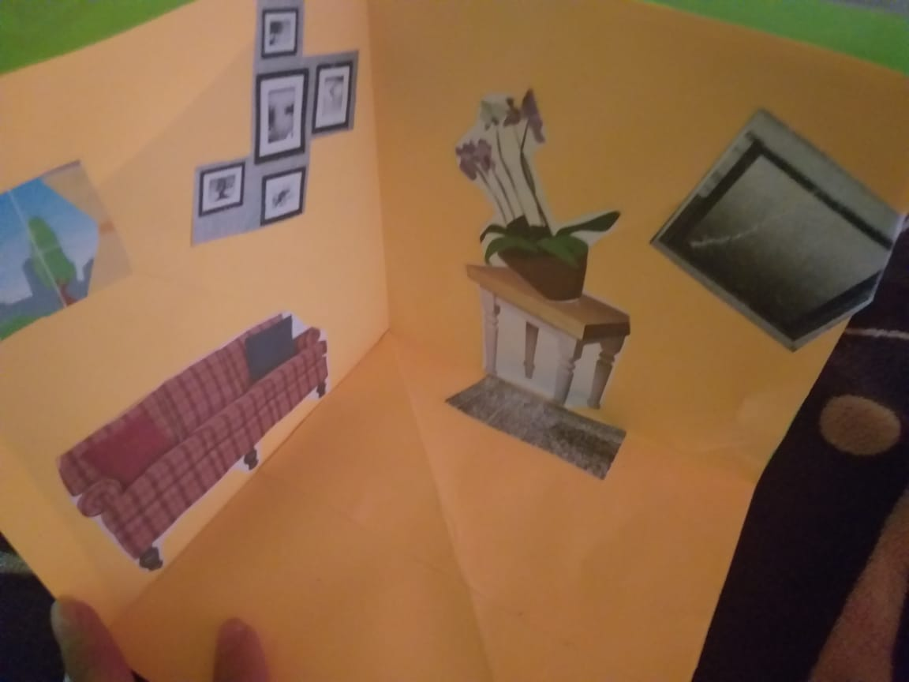

Slide 3
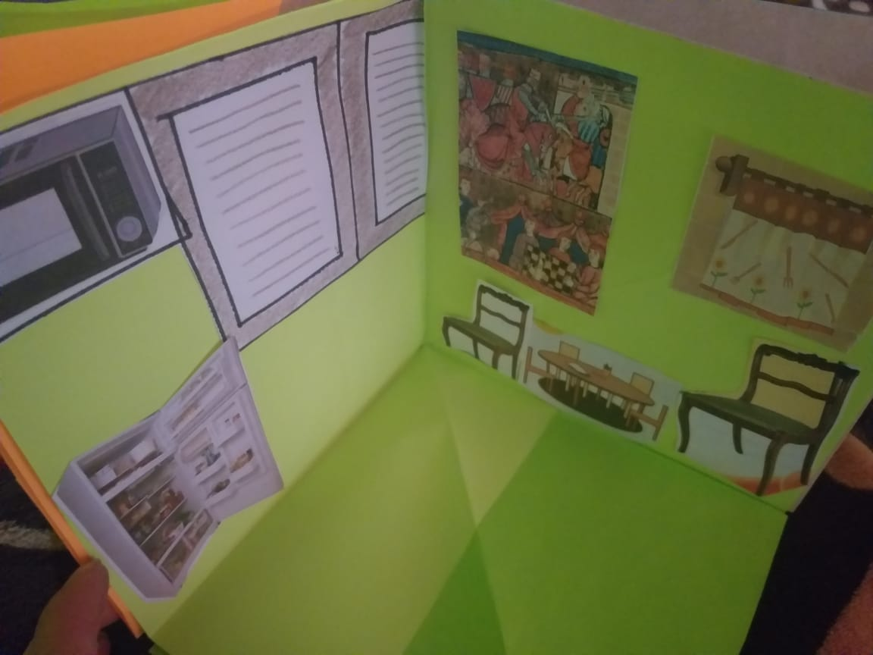

Slide 4
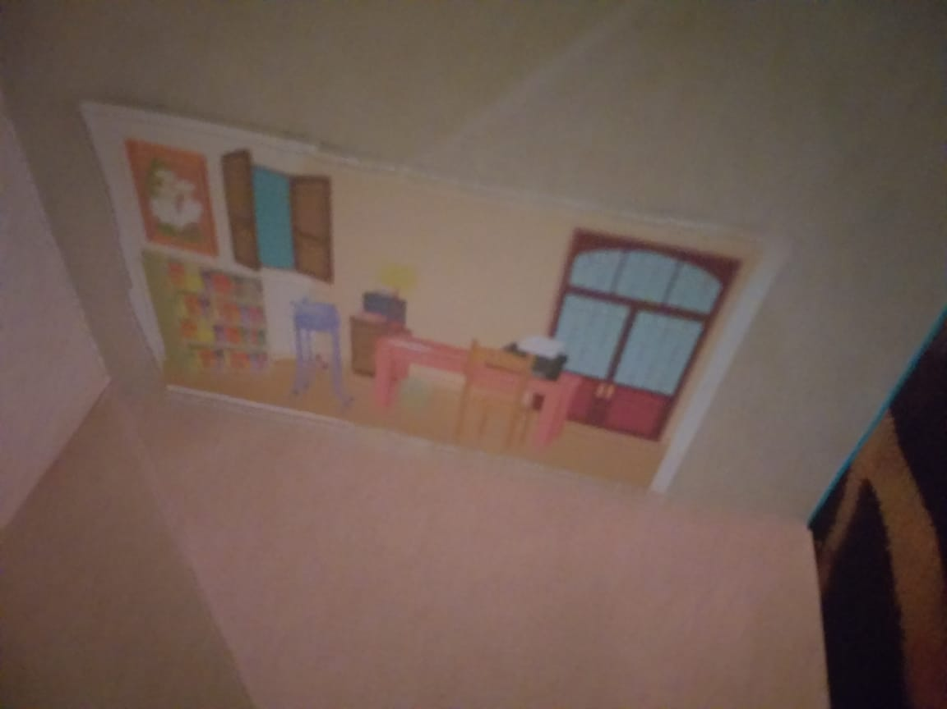

Slide 5
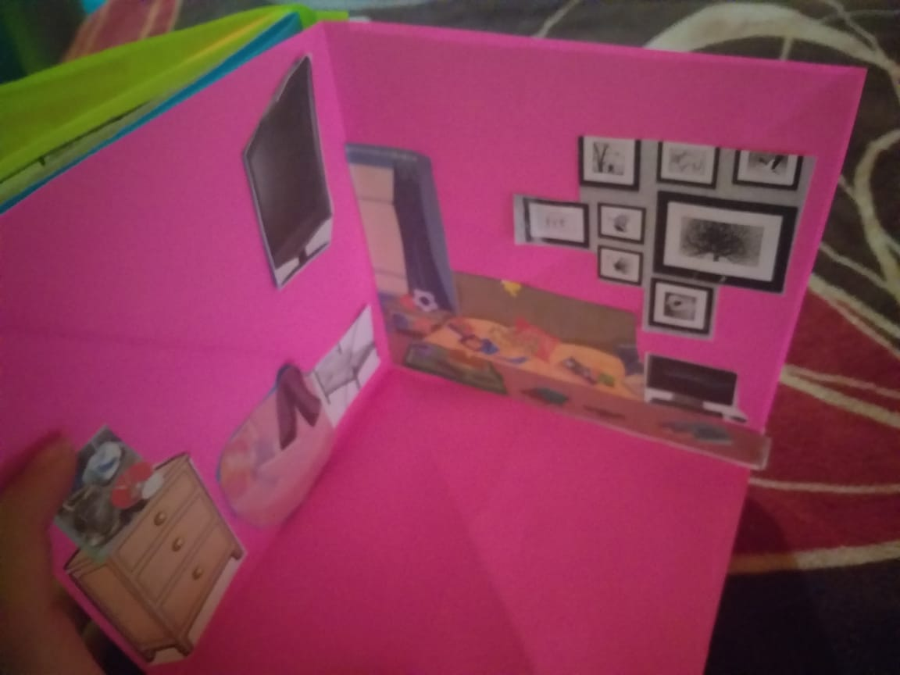

Slide 7
There isn´t a stove in the kitchen
There are some chairs in the dining room
There are some cupboards in the laundry room
There isn´t a rug in the bedroom
There´s a mirror in the bathroom
There is no dresser in the bedroom
There isn´t a desk in the bedroom
There´s a bed in the bedroom
There´s a microwave in the kitchen
There aren´t any pictures in the bathroom
Do you live alone?
No, i don´t. I live with my friend
Do you have a stairs?
No it don´t
I have a curtains, I need a lamp in the living room
I have a microware, i need a stove in the kitchen

Slide 8
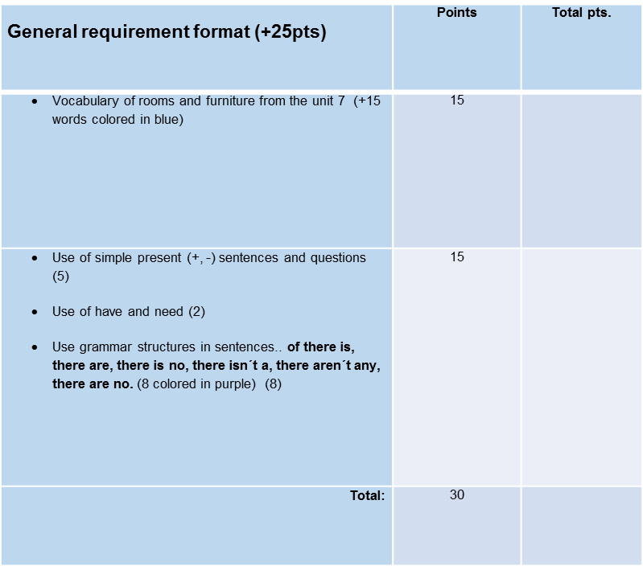
ESCUELA NORMAL DE EDUCACION PREESCOLAR
ENGLISH A1.2
TEACHER: MAYELA LAEJANDRA DEL CARMEN GAONA GARCIA
LEARNING EVIDENCE RUBRICS

