Slide 1
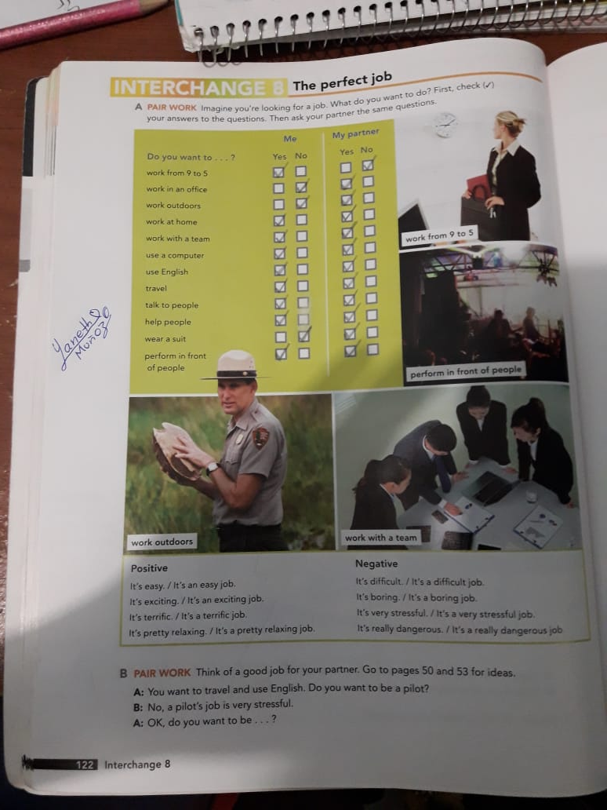

Slide 2
Conversation
Rocio: Hi Gustavo! Do you have a new job?
Gustavo: Hello Rocio. Yes, i’m taxi driver.
Rocio: Oh, great! How do you like it?
Gustavo: It’s tired, but I really like it. And you work?
Rocio: Yes, i’m a caregiver. In a children’s room.
Gustavo: Really? Wow! How do you like it?
Rocio: Yes, I like it, although it is still very tired.
Gustavo: Mmm, just like mine.

