Slide 1
The perfect job
Karina rivera Guillermo

Slide 2
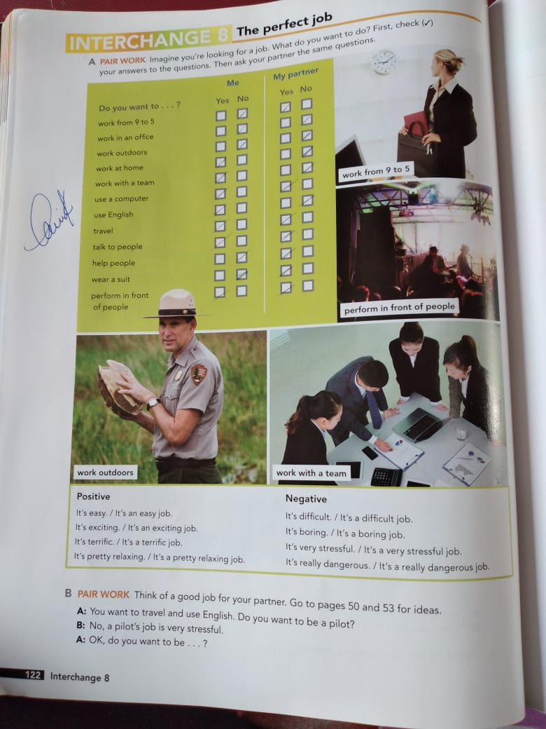

Slide 3
Karina: Hello how are you doing
Rebeca: I am fine, how are you
Karina: What are you working on?
Rebeca: I am a surgeon
Karina : oh great, and how is your job?
Rebeca: it's very difficult, stressful, tired, but I really like it
Karina: why?
Rebeca: I help people who need it
Karina: Do you have a schedule?
Rebeca: no, sometimes I'm late but that doesn't matter
Karina: I have to go, bye take care
Rebeca: see you later, nice to see you

