Slide 1
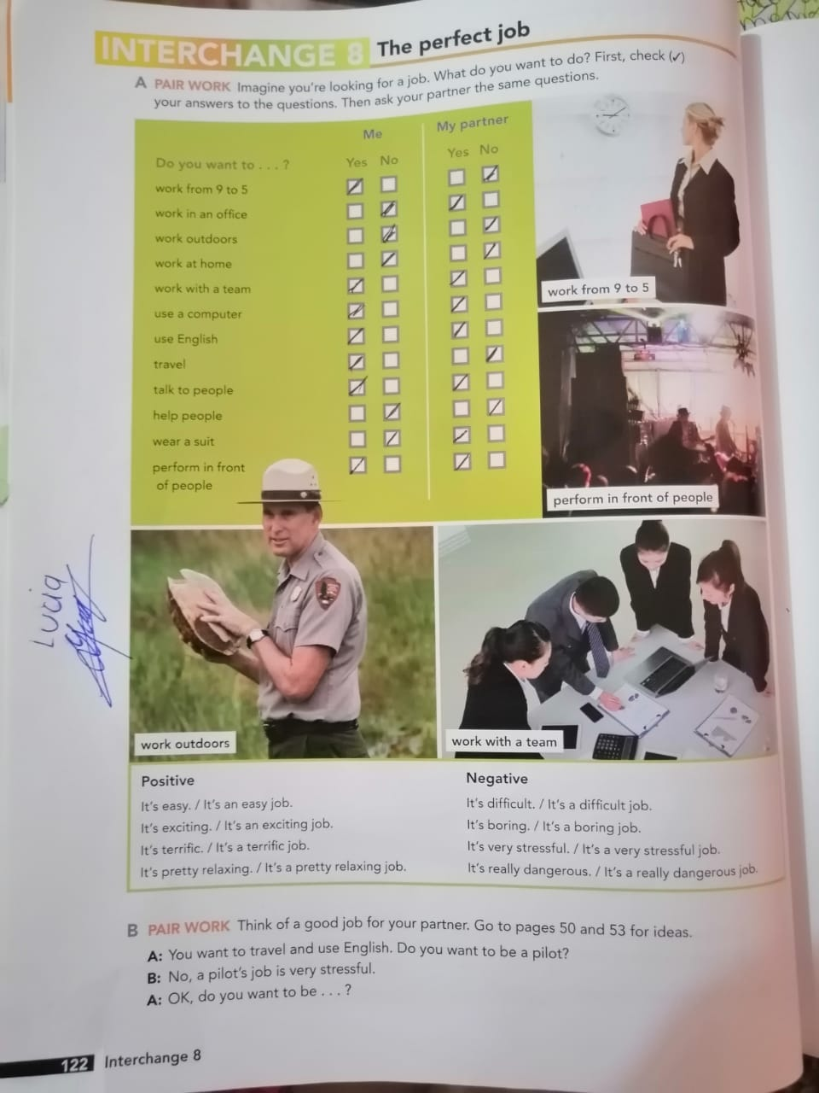

Slide 2
Conversation
Danna: Hi Patricio, how are you?
Patricio: Hi Danna, I’m good and you?
Danna: I’m excellent. Hey what do you do?
Patricio: I´m lawyer and I work in an office.
Danna: Woow! and How do you like it?
Patricio: I like my job. it’s difficult and stressful but helps to people.
Danna what do you do? and Where do you work?
Danna: I’m doctor and work in a hospital.
Patricio: Really? wow! How do you like it?
Danna: I really like it, I also helps people but has a stressful and difficult job.

