Slide 1
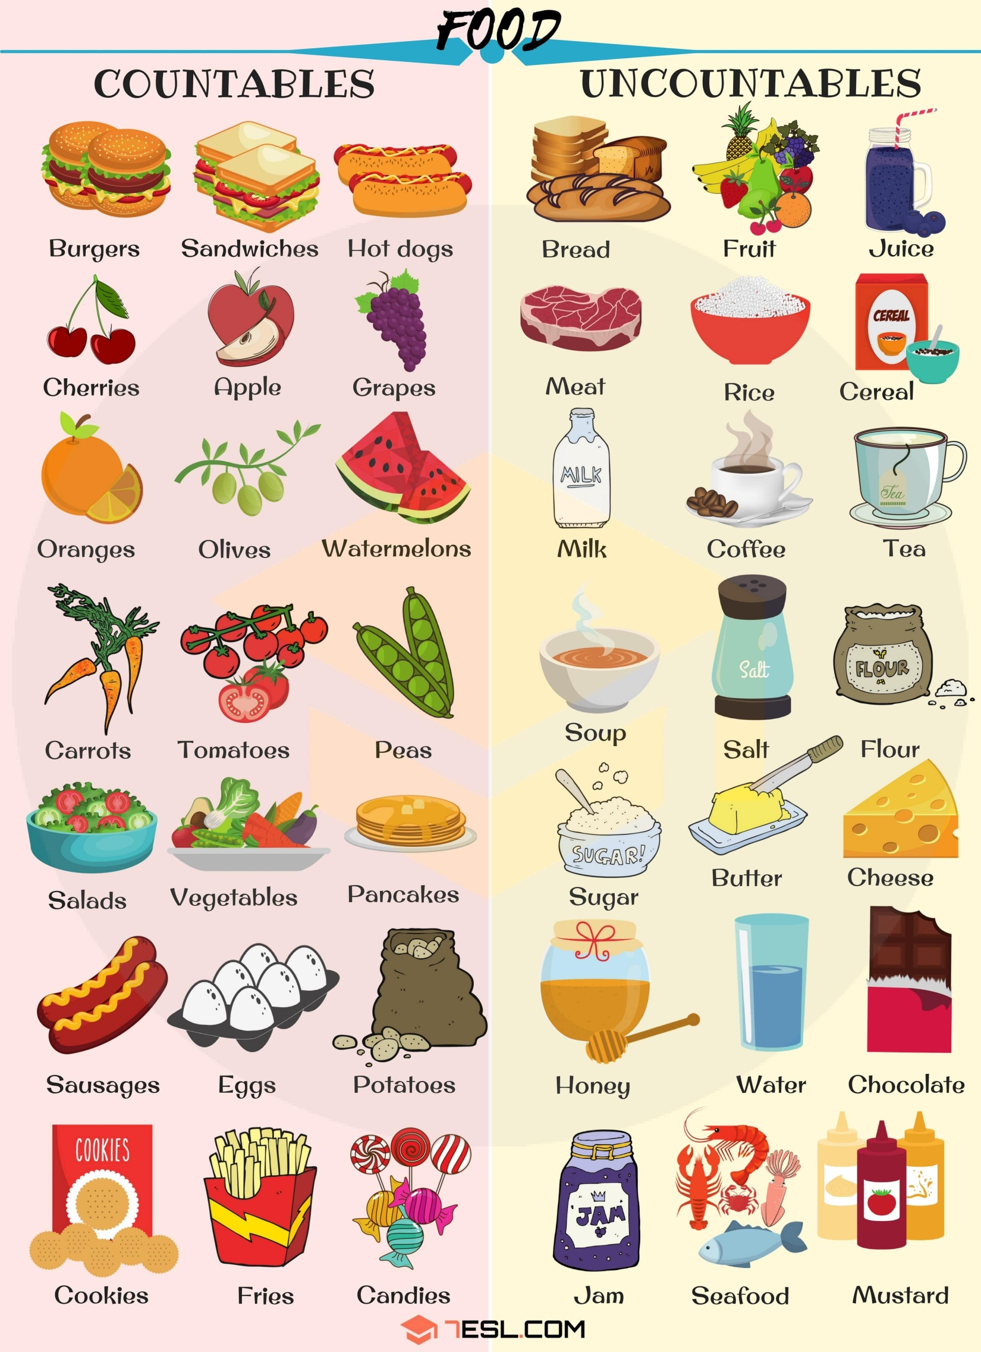

Slide 2
Drag the pictures in the correct category
Countables | Uncountables

Slide 3
Use of A, An, some, Any gramar box

Slide 4
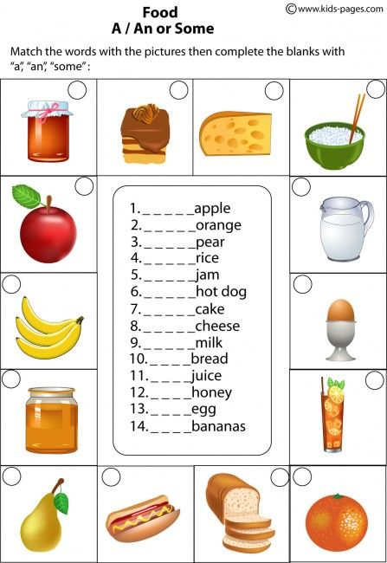
5
7
8
4
1
9
An
An
A
Some
14
Some
13
A
Some
Some
Some
some
12
Some
11
Some
An
Some
3
6
10
2

Slide 5
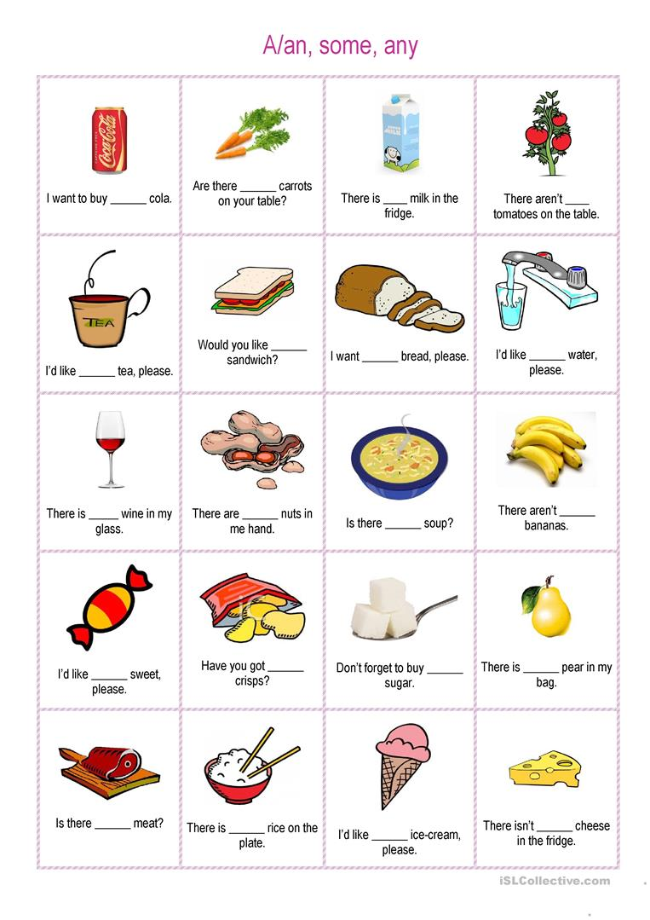
a
any
some
any
a
some
some
some
some
some
any
any
a
any
some
a
any
some
an
any

Slide 6
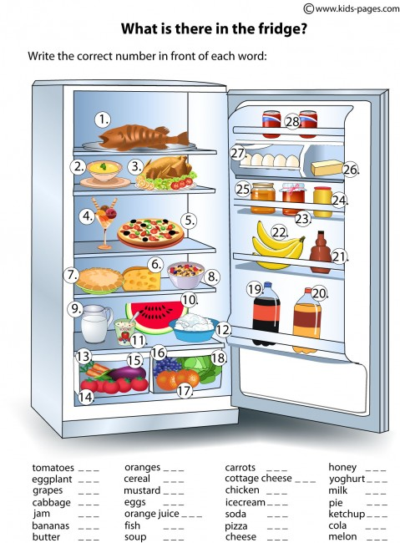
14
17
13
25
15
8
12
11
16
24
3
9
18
27
20
4
7
23
19
21
22
1
5
28
26
2
6
10

Slide 7
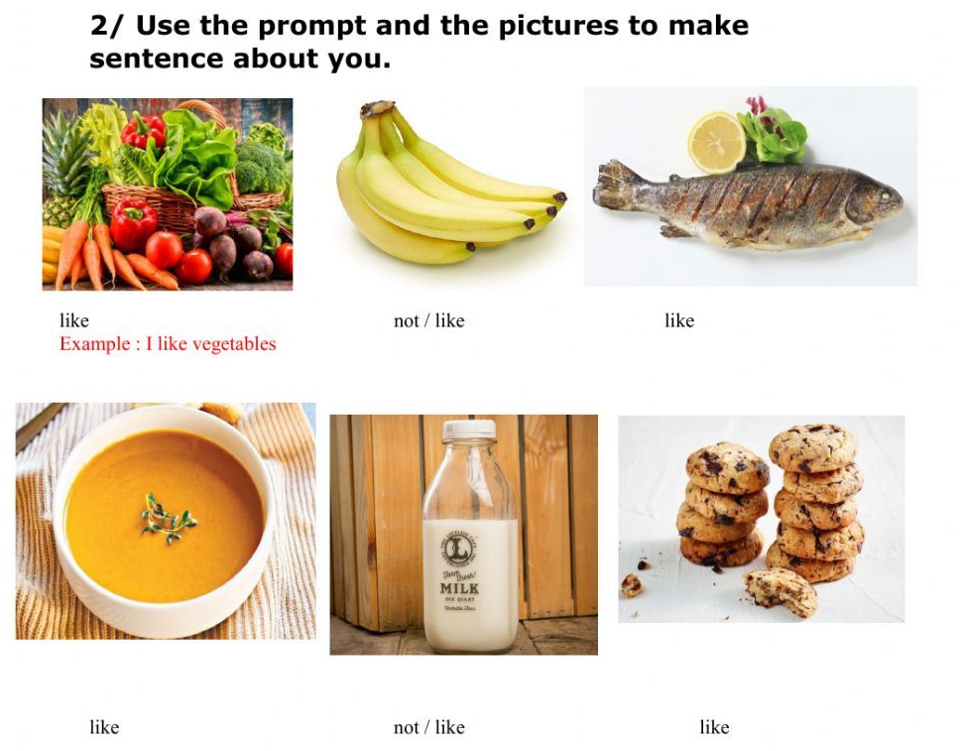
I don’t like bananas
I like Fish
I like soup
I don’t like milk
I like cookies

