Slide 1
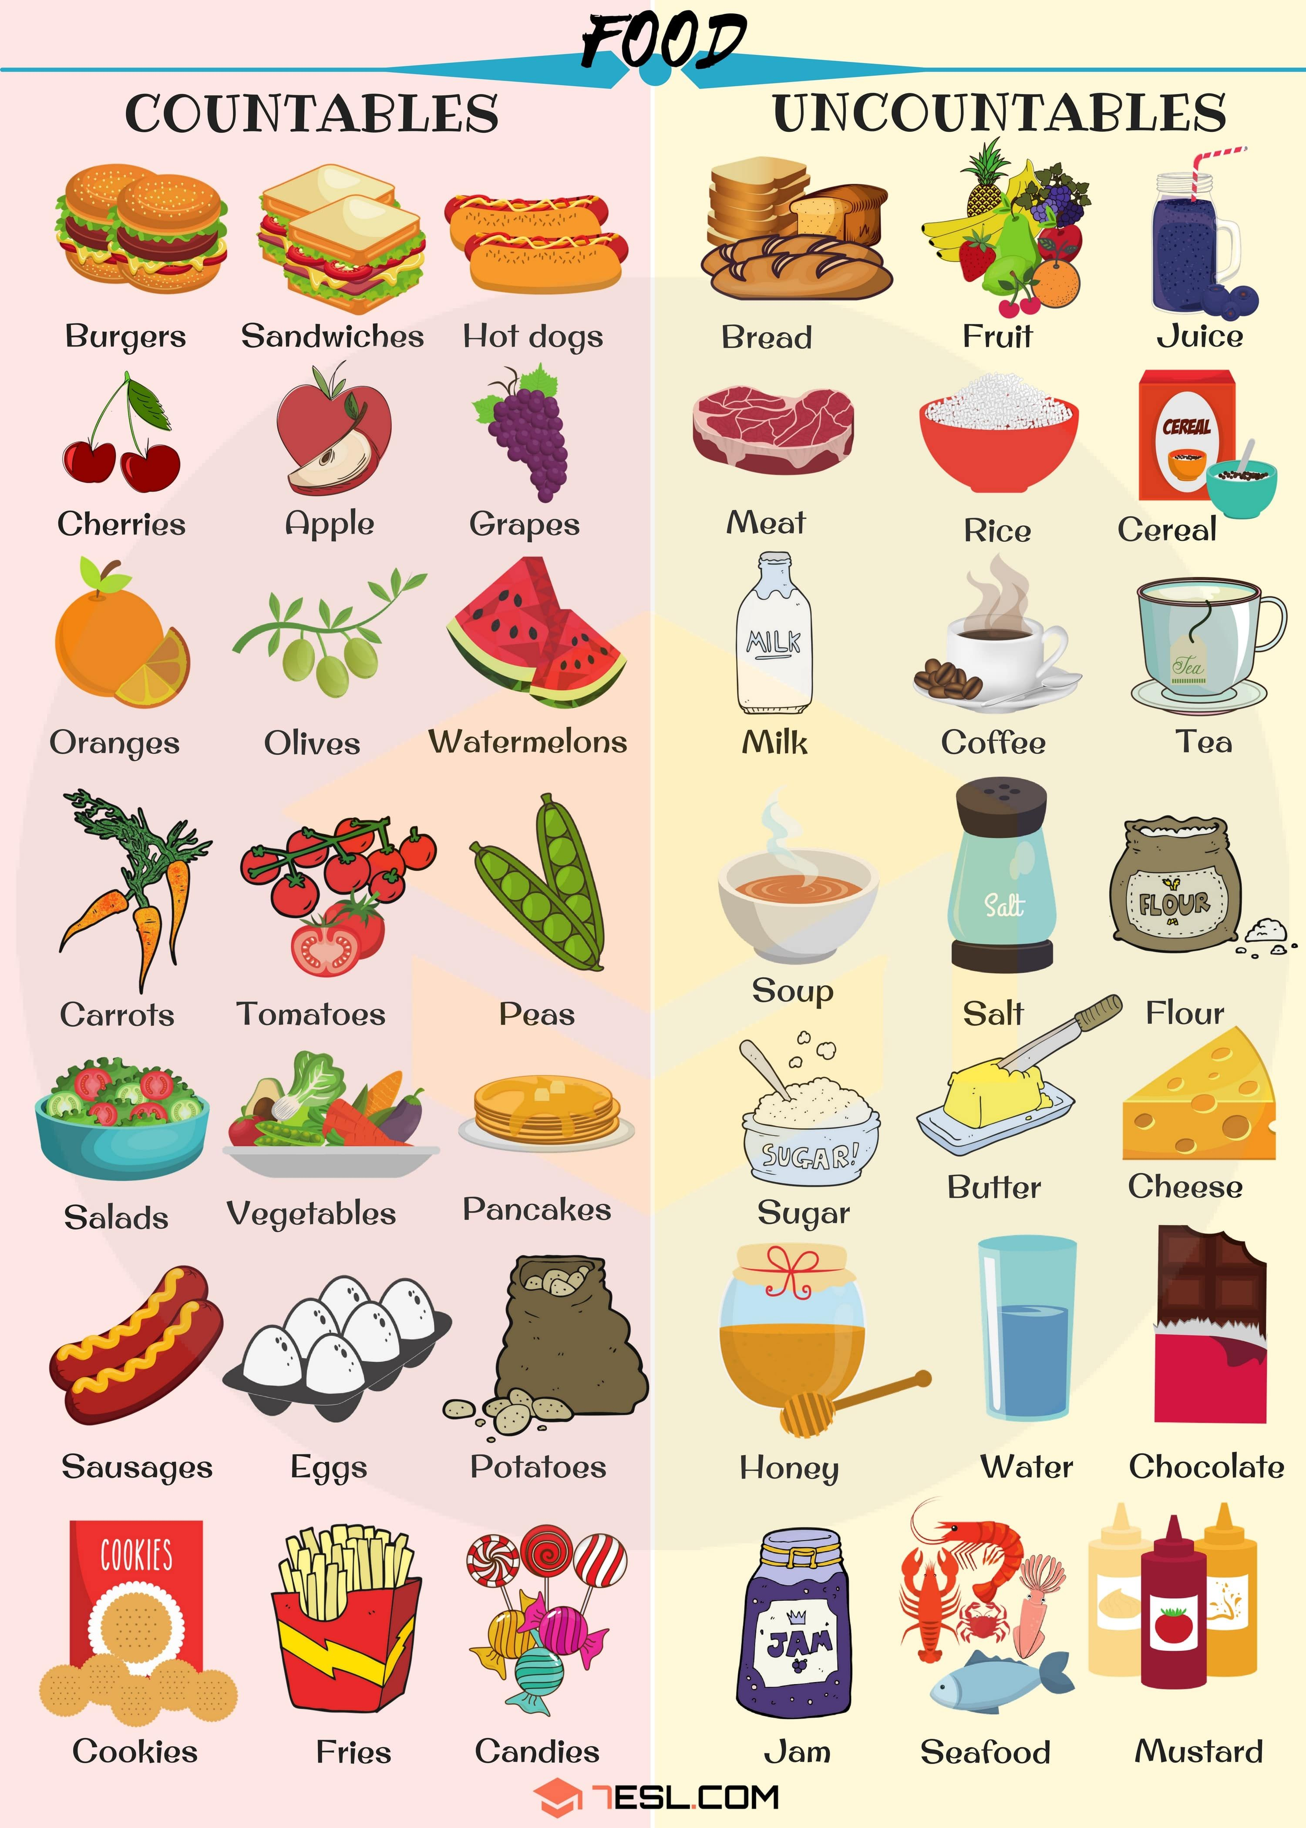

Slide 2
Drag the pictures in the correct category
Countables | Uncountables
Eggs Carrots Apple Buerger Hot dog Tomatoes Fries | Sugar Rice Honey Milk Cheese Meat jam

Slide 3
Use of A, An, some, Any gramar box

Slide 4
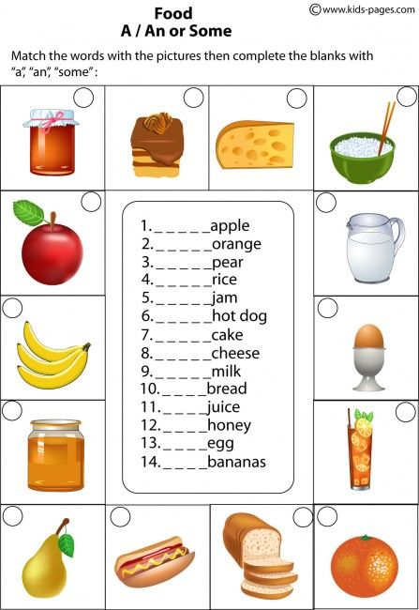
5
7
8
4
1
9
An
An
A
some
14
A
13
A
A
A
some
A
12
A
11
7
A
An
Some
3
6
10
2

Slide 5
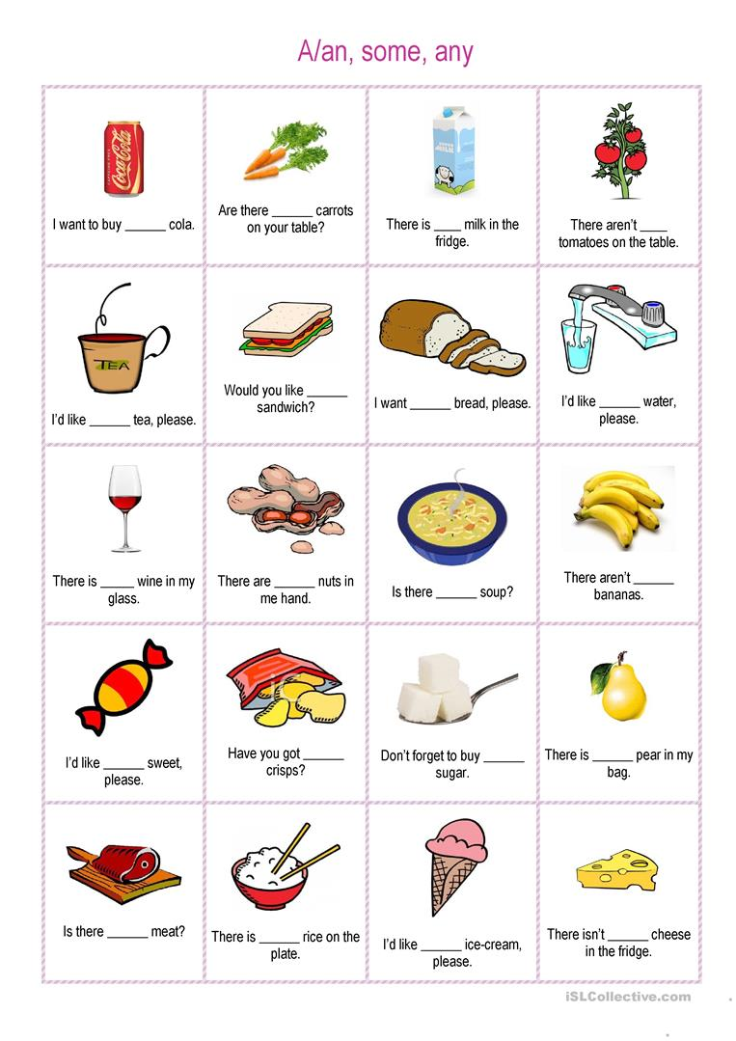
a
some
a
any
a
A
A
Any
Any
A
A
A
some
Any
some
any
a
some
a
any
any

Slide 6
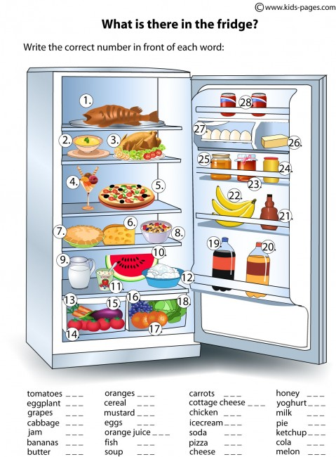
14
17
13
25
15
8
12
11
16
24
3
9
18
27
20
4
7
23
28
21
22
1
5
19
26
2
6
10

Slide 7
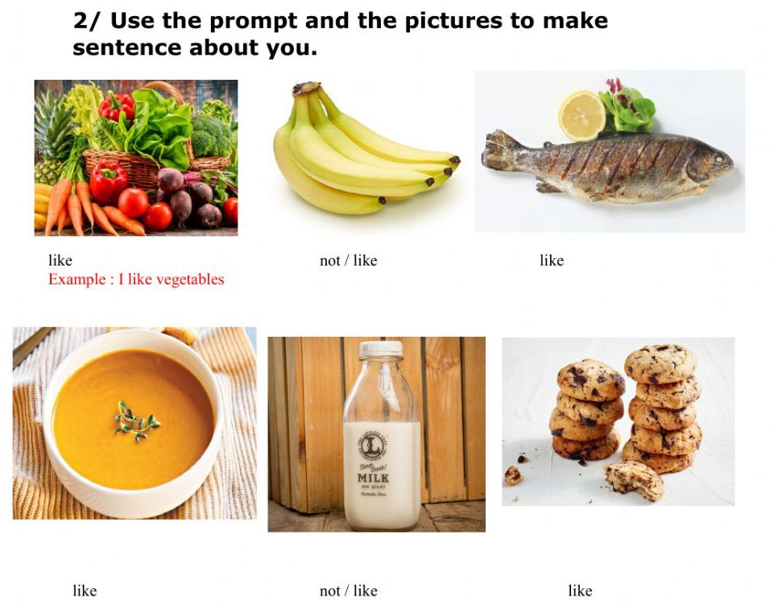
I not liike some bananas
I like fish crude
I like cold soup
I not like chocolate milk
I like chocolate cookies

