Slide 1
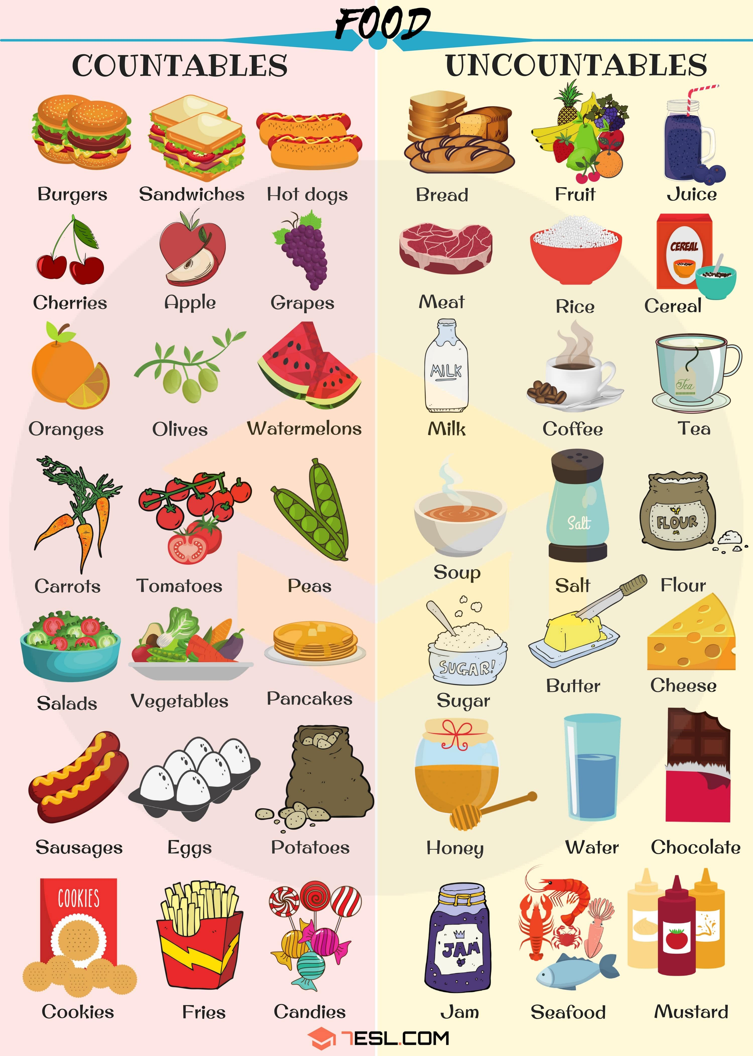

Slide 2
Drag the pictures in the correct category
Countables | Uncountables

Slide 3
Use of A, An, some, Any gramar box

Slide 4
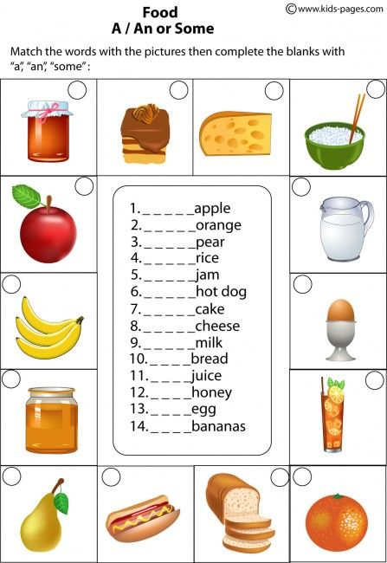
12
7
8
4
1
9
14
13
5
11
3
6
10
2

Slide 5
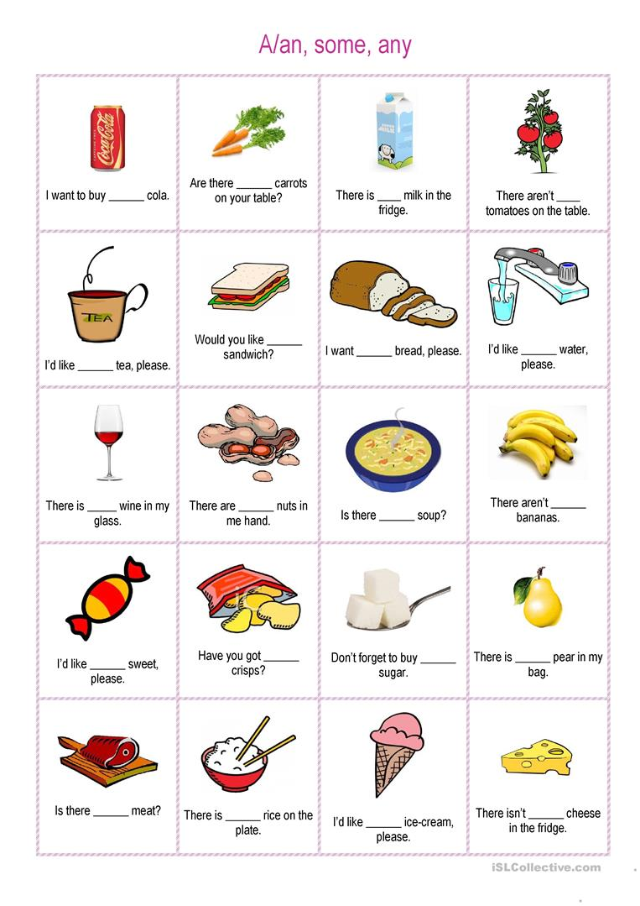
A
Any
a
Some
a
any
some
some
a
some
any
Some
a
any
any
a
a
a
an
a

Slide 6
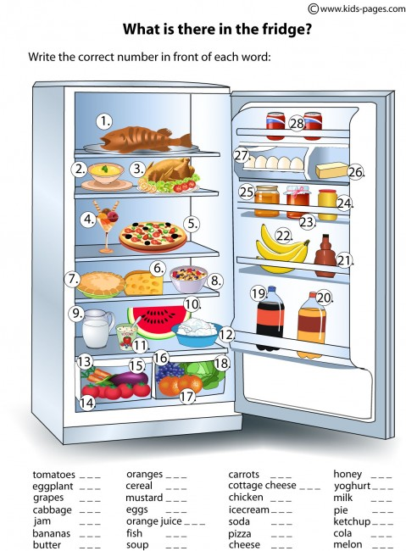
17
24
27
10
1
2
25
11
9
7
21
19
10
14 15
16
18
23
22
26
13
12
3
4
20
5
6

Slide 7
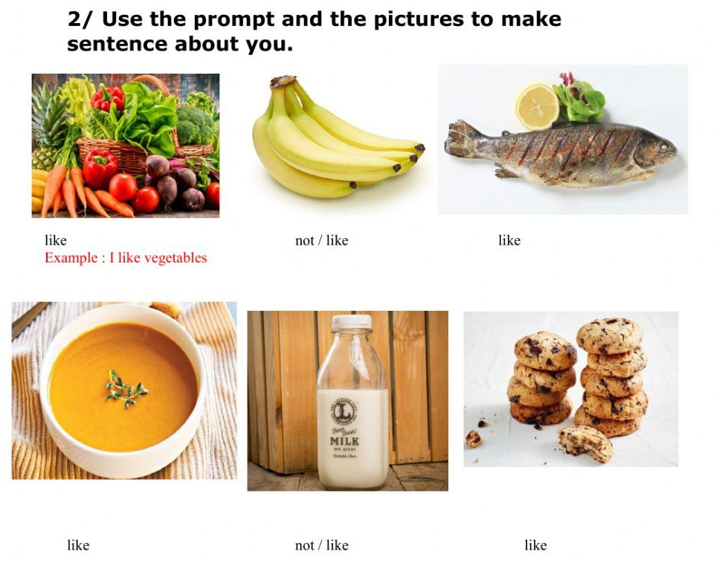
I don´t like bananas in the smoothie
I like fish in pork rinds
I really like alphabet soup
Me and my brothersdon´t like milk alone
Me and my family like cookies

