Slide 1
MELINA MARYVI MEDINA ROCHA
ESCUELA NORMAL DE EDUCACIÓN PREESCOLAR
ENGLISH A1.2 DEVELOPING ELEMENTARY CONVERSATIONS
ONLINE ACTIVITIES - APRIL 20th

Slide 2
ACTIVITY 1
Write 15 affirmative and negative sentences describing what things are in the rooms of your apartment. Use there is, there are, there is no, and there are no.
1. There is no dresser in the bedroom.
2. There is a bed in the bedroom.
3. There are no chairs in the living room
4. There are some chairs in the dinning room.
5. There is no armchair in the bedroom.
6. There are some books in the bookcase.
7. There is a lamp in the living room.
8. There is a rug in the living room.
9. There is a refrigerator in the kitchen.
10. There are some flowers in the kitchen
11. There is a stove in the kitchen
12. There is no coffee maker in the kitchen
13. There are no stairs in the house.
14. There is a T.V. in the bedroom.
15. There is no big table in the dinning room.

Slide 3
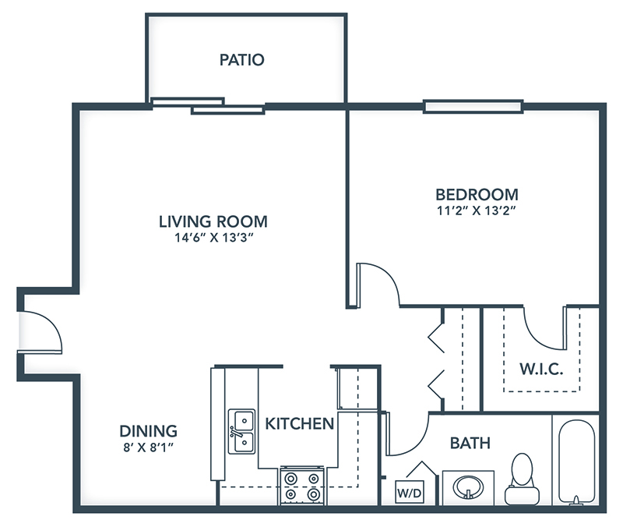
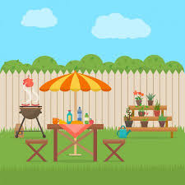
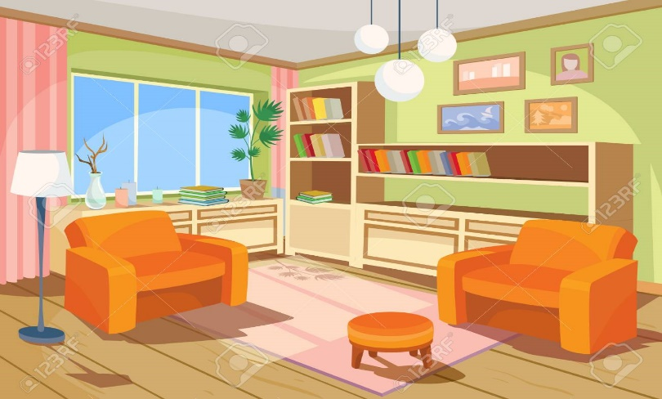
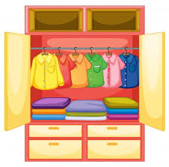
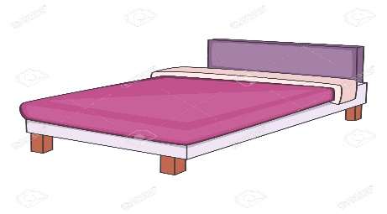
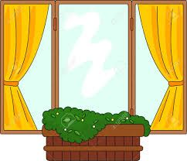
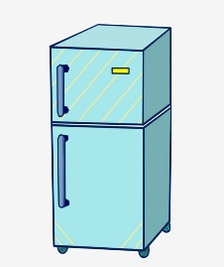
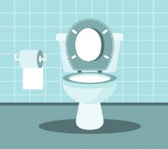
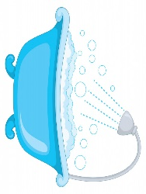
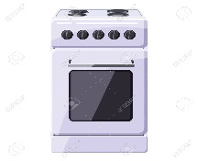
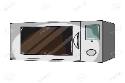
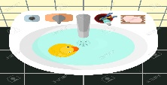

Slide 5
ACTIVITY 3
Upload a video or a voice recording where you talk about the jobs in the pictures. Tell what they do, what they do exactly, where they work and give your opinion about each job using adjectives.

