Slide 1
ESCUELA NORMAL DE EDUCACIÓN PREESCOLAR ENGLISH A1.2 SHARING INFORMATION AND IDEAS UNIT 8 – HOW’S THE NEIGHBORHOOD? DURING THIS UNIT YOU WILL LEARN HOW TO ASK ABOUT AND DESCRIBE PLACES IN A NEIGHBORHOOD.

Slide 2
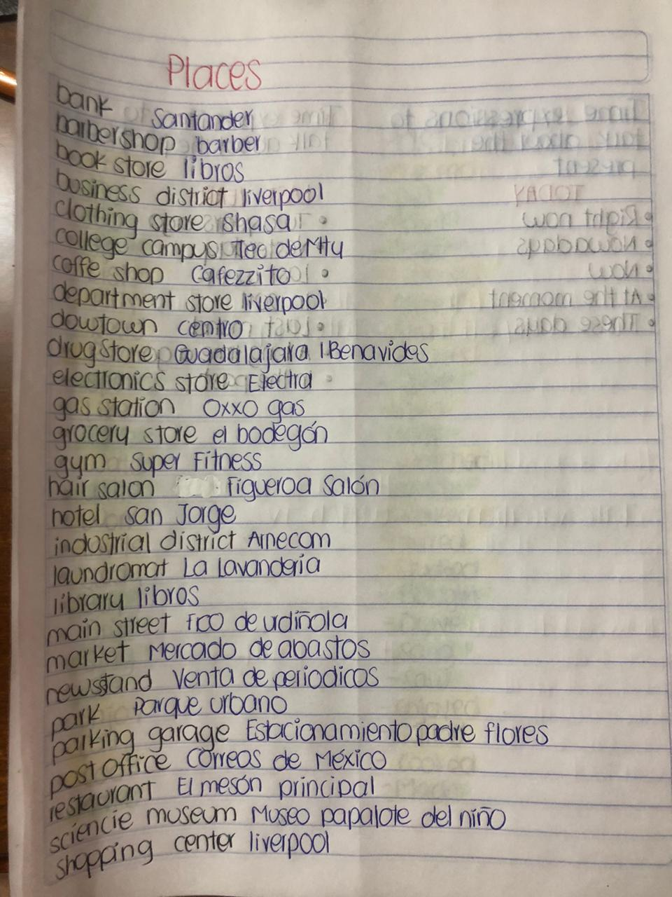
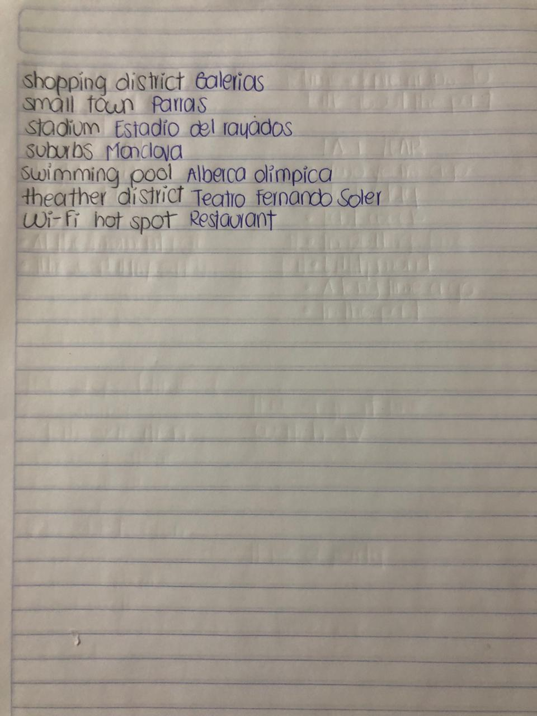

Slide 3
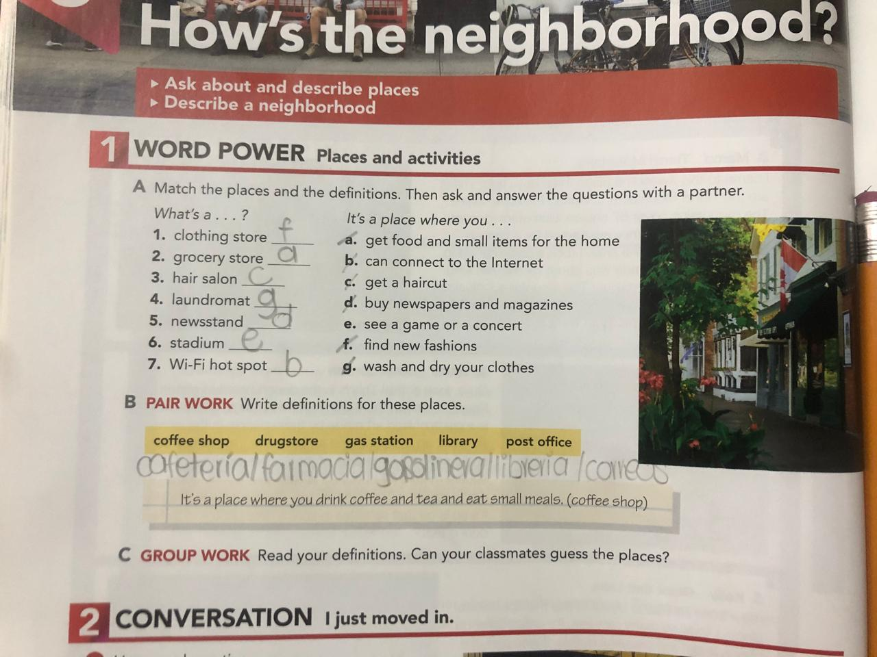

Slide 4
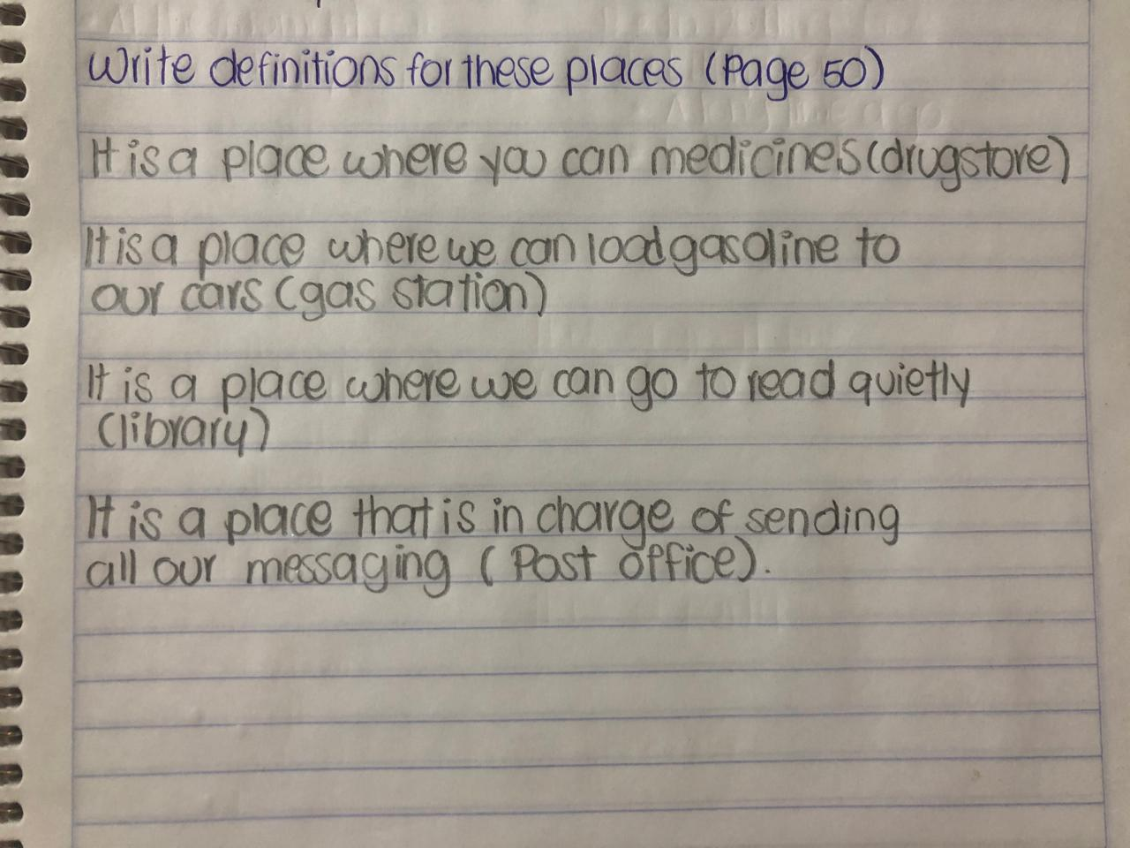

Slide 5
