Slide 1
ESCUELA NORMAL DE EDUCACIÓN PREESCOLAR
Licenciatura en Educación Preescolar
Ciclo Escolar 2019-2020
Materia:
Inglés Level B. 1.1
Maestra:
Maria Elena Meza Aguado
Alumna:
Karla Cecilia Martínez Espinosa
3° “B”
Saltillo, Coahuila a june 2020

Slide 2
Unit 10. Now I get it!
Learning objectives:
Discuss communication, including such topics as gestures and body language using modals and adverbs.
Discuss rules and recognize common signs using terms of permission, obligation and prohibition.

Slide 3
Book activity 1 SNAPSHOT
Emojis are picture symbols used in electronic messages and on Web pages. The word emoji comes from Japanese words e (“picture”) + moji (“character”).
Exercise #1. Listen to the expressions in the teacher’s audio and practice your pronunciation. Then record yourself telling the same expressions. Place your audio speaker on the Student’s circle.
Teacher’s audio:
Student’s audio:
For support about adding audio in your PowerPoint presentation, visit:
https://support.office.com/en-us/article/add-or-delete-audio-in-your-powerpoint-presentation-c3b2a9fd-2547-41d9-9182-3dfaa58f1316

Slide 4
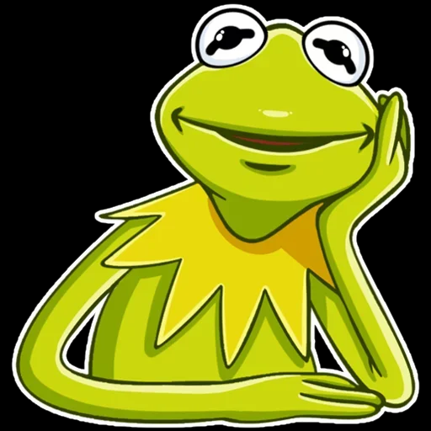
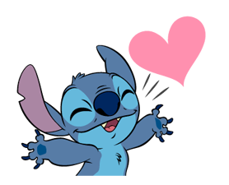
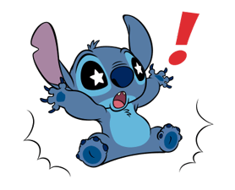
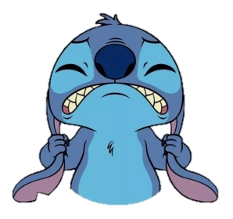
Book activity 1 SNAPSHOT
Exercise #2. Which are the three most popular emoticons (emoji) or stickers you use when responding to messages? In what situations do you use them? Place your answer in this slide.
Example: I use this sticker to react to people in a chat having a long conversation. Also to express that I am reading what they are saying.
1. I use this sticker to react to my husband says beautiful things to me. Also to express that I am watching beautiful things.
2. I use this sticker to react to people in a chat send important news. Also to express that I am shocking.
3. I use this sticker to react to people in conversations I don't understand. Also to express that I am feeling stressed.

Slide 5
Book activity 2 WORD POWER Body language
Exercise #3. What do you think the woman is doing in each picture? Complete your book task A. Then look at the adjectives in activity B and describe ORALLY (record your voice) what de woman is doing and feeling. There may be more than one answer. Record one audio for the five descriptions. Listen to the example:
Teacher’s example audio:
scratching
biting
rolling
tapping
pulling
wrinkling
Transcript: In picture A, she’s tapping her foot. She looks impatient.
Place student’s audio:
In the second picture, she's biting her nails. She looks nervous.
In the third picture, she's pulling her hair out. She looks frustrated.
In the fourth picture, she's rolling her eyes. She looks annoyed.
In the fifth picture, she's wrinkling her nose. She looks disgusted.
In the sixth picture, she's scratching her head. She looks confused.
annoyed | confused | embarrassed | frustrated | irritated
bored | disgusted | exhausted | impatient | nervous

Slide 6
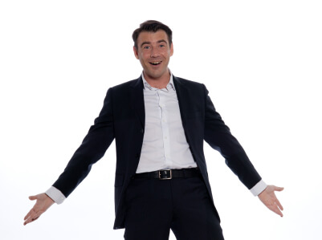
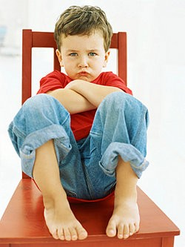
Book activity 4 GRAMMAR FOCUS
When we are not sure about the meaning of something (for example discussing what gestures from different cultures mean), we use modals of possibility (might, may, could) or adverbs (maybe, perhaps, possibly, probably).
Slight Possibility
Beginning of the sentence
MODALS | ADVERBS
It might/may mean | Maybe/Perhaps it means
It could mean | It probably means
It must mean | It definitely means
This gesture probably means he is happy and surprised.
This gesture must mean he is mad or frustrated.
Strong Possibility
When we are sure about the meaning of something, we use modal must or the adverb definitely.
Answer:
Do modals use the base form of the verb or the infinitive? ___________________________
Maybe and perhaps go at the beginning of the sentence.
Where do possibly, probably and definitely go in a sentence?_________________________

Slide 7
Book activity 4 GRAMMAR FOCUS
Exercise #4. What do these gestures mean? Make statements about each gesture. Look into your book page. Use the meanings in the box (possible meanings) or your own ideas. Record your voice (one audio for the 5 statements).
Teacher’s example audio:
Transcript: The first gesture could mean, I can’t hear you.
Place student’s audio:
The second gesture migth mean i don't know
The third gesture definitely means be quiet.
The fourth gesture maybe means come here.
The fifth gesture may mean call me.
The sixth gesture perhaps means that sonds crazy

Slide 8
Book activity 4 GRAMMAR PRACTICE
MODALS AND ADVERBS PRACTICE “STRANGE HAPPENINGS”
Exercise #5. Imagine you are in these situations. What do you think they mean? Write your answers here in the slide. Use modals and adverbs of possibility.
1. You walk into your classroom. There are no people there.
A= It might mean I’m in the wrong classroom. Or maybe it means I’m very, very late for class!
2. You are driving a car. A police officer stops you.
A= It might mean I'm in the wrong way. Or perhaps it means I'm very fast.
3. It’s 3:00 A.M. You hear a loud noise outside your door.
A= It could mean is a ghost near the door. Or it probably means something is fall.
4. You receive a greeting card. There is no message and no return address.
A= That must mean somebody like you, Or that definitely fall in love with you.
5. You find an old painting in your garage. The person in the painting looks like you.
A= It could mean he is my parent. Or it probably means they are my great grandfather.

