Slide 1




Unit 10. Now I get it!
Learning objectives:
Discuss communication, including such topics as gestures and body language using modals and adverbs.
Discuss rules and recognize common signs using terms of permission, obligation and prohibition.

Slide 2
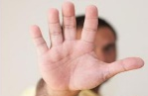
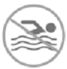
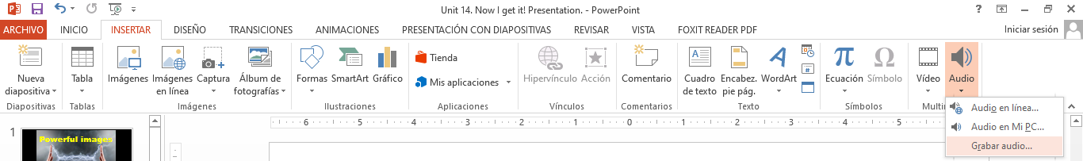

By the end of the unit 10, students must be able to respond properly to the following:
What does this gesture mean? or What do you think this other gesture means?
Show me a gesture that means “I don’t understand”/“I’m hungry”/“Come here / etc.”
Show me a gesture that means you’re bored/exhausted/nervous, etc.
What does this sign/emoticon/emoji mean? or What do you think this sign/emoticon/emoji means? What does mean? Where might you find this rule?
What rules might you find on an airplane/at school/in a museum/at work?
Show me a gesture and ask what it means. or Show a classmate a gesture and ask what it means.
Some of the following slides contain activities in which you must record your voice. If you have problems with the microphone of the computer, do it on another electronic device and then add it to the PowerPoint file. You must record your work in this file and up load it as evidence of work.

Slide 3
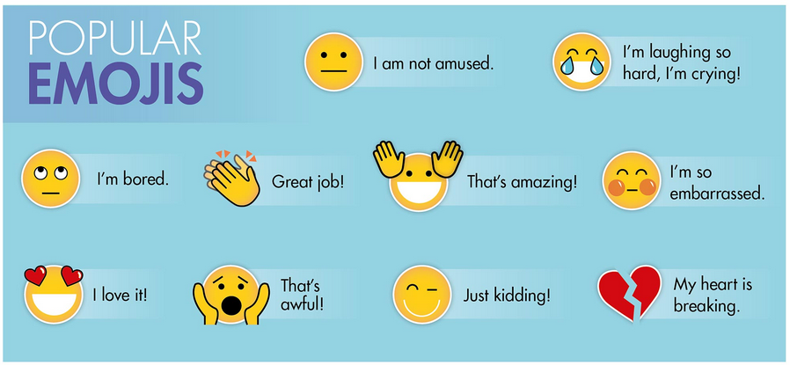

Book activity 1 SNAPSHOT
Emojis are picture symbols used in electronic messages and on Web pages. The word emoji comes from Japanese words e (“picture”) + moji (“character”).
Exercise #1. Listen to the expressions in the teacher’s audio and practice your pronunciation. Then record yourself telling the same expressions. Place your audio speaker on the Student’s circle.
Teacher’s audio:
Student’s audio:
For support about adding audio in your PowerPoint presentation, visit:
https://support.office.com/en-us/article/add-or-delete-audio-in-your-powerpoint-presentation-c3b2a9fd-2547-41d9-9182-3dfaa58f1316

Slide 4


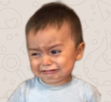
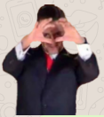
Book activity 1 SNAPSHOT
Exercise #2. Which are the three most popular emoticons (emoji) or stickers you use when responding to messages? In what situations do you use them? Place your answer in this slide.
Example: I use this sticker to react to people in a chat having a long conversation. Also to express that I am reading what they are saying.
1. I use this emoji when I want to express my love in the distance.
2. I use this sticker to react when I am very stressed and we get a lot of homework in escuela in red.
3. I use this sticker to react when I am happy and grateful for a certain situation.

Slide 5
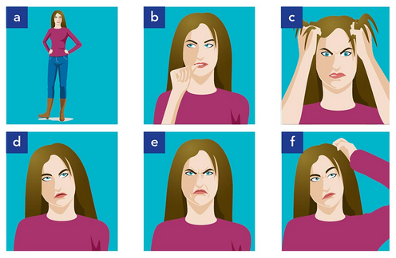
Book activity 2 WORD POWER Body language
Exercise #3. What do you think the woman is doing in each picture? Complete your book task A. Then look at the adjectives in activity B and describe ORALLY (record your voice) what de woman is doing and feeling. There may be more than one answer. Record one audio for the five descriptions. Listen to the example:
Teacher’s example audio:
scratching
biting
rolling
tapping
pulling
wrinkling
Transcript: In picture A, she’s tapping her foot. She looks impatient.
Place student’s audio:
annoyed | confused | embarrassed | frustrated | irritated
bored | disgusted | exhausted | impatient | nervous

Slide 6

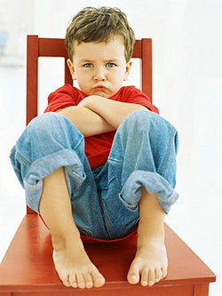

Book activity 4 GRAMMAR FOCUS
When we are not sure about the meaning of something (for example discussing what gestures from different cultures mean), we use modals of possibility (might, may, could) or adverbs (maybe, perhaps, possibly, probably).
Slight Possibility
Beginning of the sentence
MODALS | ADVERBS
It might/may mean | Maybe/Perhaps it means
It could mean | It probably means
It must mean | It definitely means
This gesture probably means he is happy and surprised.
This gesture must mean he is mad or frustrated.
Strong Possibility
When we are sure about the meaning of something, we use modal must or the adverb definitely.
Answer:
Do modals use the base form of the verb or the infinitive? maybe
Maybe and perhaps go at the beginning of the sentence.
Where do possibly, probably and definitely go in a sentence? probably

Slide 7
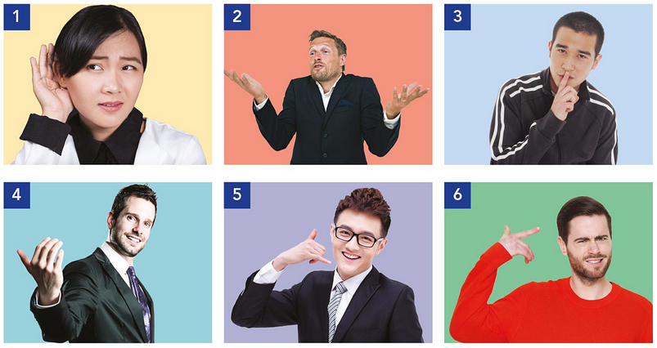
Book activity 4 GRAMMAR FOCUS
Exercise #4. What do these gestures mean? Make statements about each gesture. Look into your book page. Use the meanings in the box (possible meanings) or your own ideas. Record your voice (one audio for the 5 statements).
Teacher’s example audio:
Transcript: The first gesture could mean, I can’t hear you.
Place student’s audio:

Slide 8
Book activity 4 GRAMMAR PRACTICE
MODALS AND ADVERBS PRACTICE “STRANGE HAPPENINGS”
Exercise #5. Imagine you are in these situations. What do you think they mean? Write your answers here in the slide. Use modals and adverbs of possibility.
1. You walk into your classroom. There are no people there.
A= It might mean I’m in the wrong classroom. Or maybe it means I’m very, very late for class!
2. You are driving a car. A police officer stops you.
A=It could mean that I stop, or maybe I have a burnt out headlight.
3. It’s 3:00 A.M. You hear a loud noise outside your door.
A=It could mean that there is an open sale and the wind is blowing or someone probably woke up.
4. You receive a greeting card. There is no message and no return address.
A=It must mean that I have a secret admirer or they probably forgot to put the data.
5. You find an old painting in your garage. The person in the painting looks like you.
A=It could mean that they painted a distant relative or they probably painted me and I don't remember

