Slide 1
Testing Program 2016 Cloud Excel
Karla Cecilia Martínez Espinosa

Slide 3
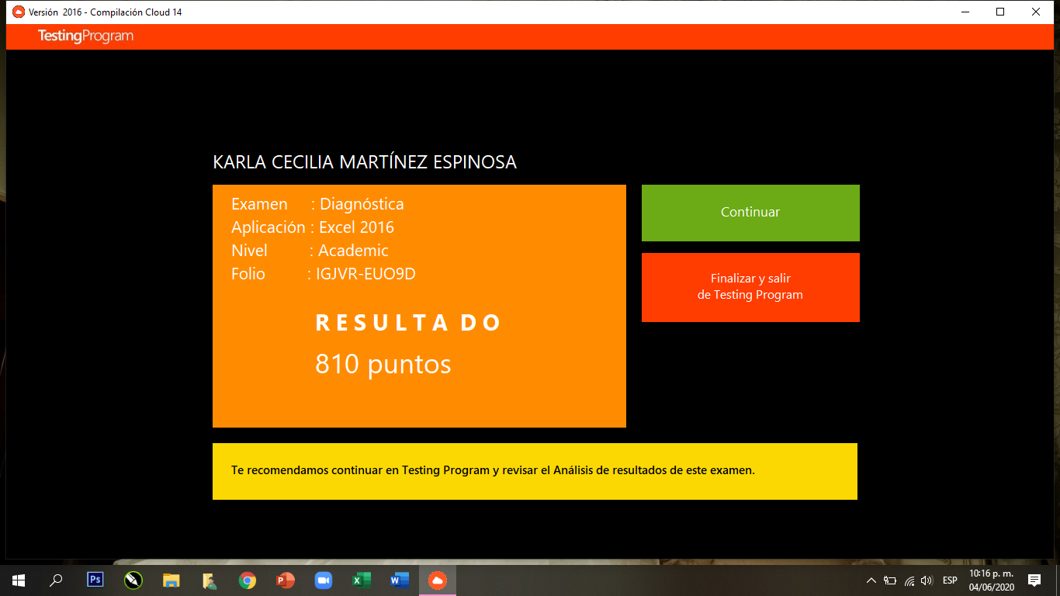

Slide 6
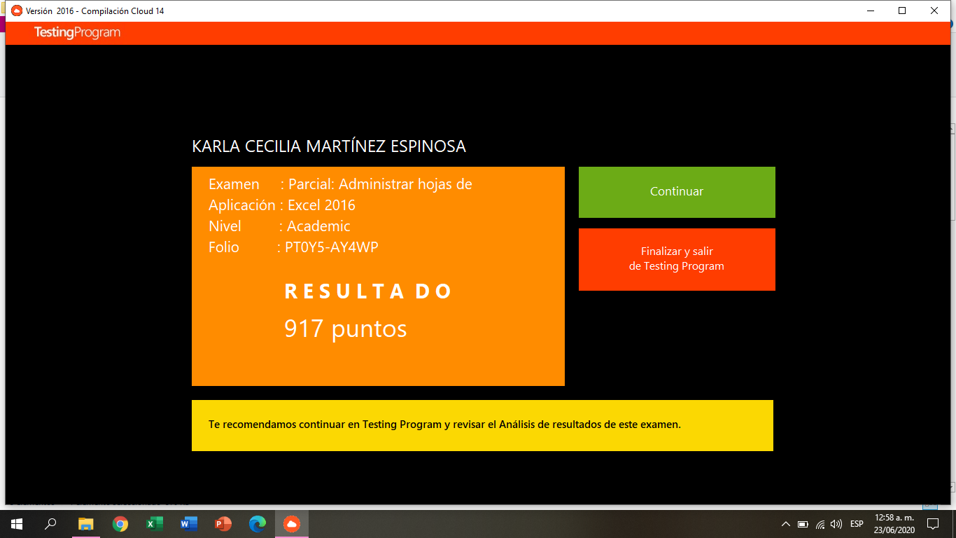

Slide 7
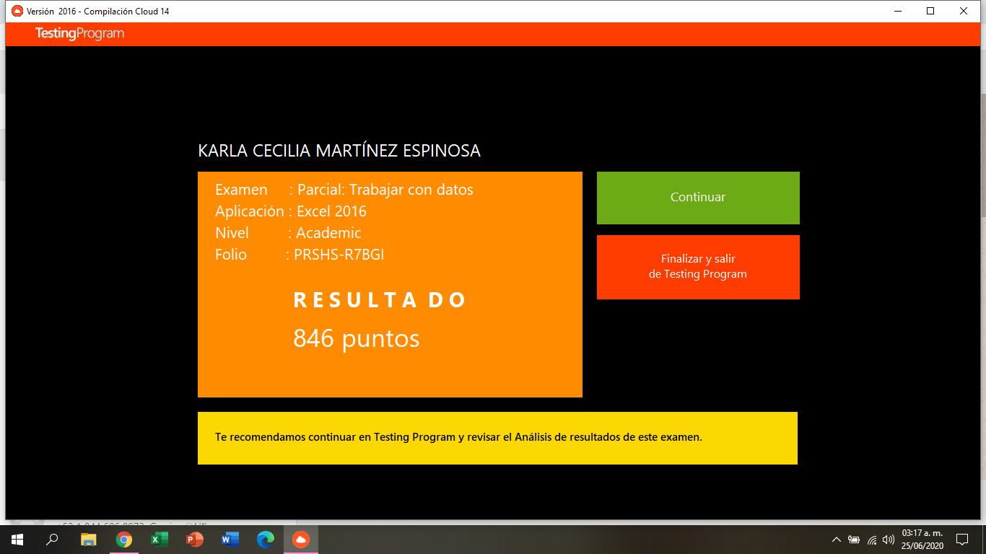

Slide 8
