Slide 1
Escuela Normal de Educación Preescolar Licenciatura en Educación Preescolar
UNIT 8
PROYECT
WHAT HAPPENED NEXT?
By
Katya Quintana Rangel
Wednesday June 18th 2020

Slide 2
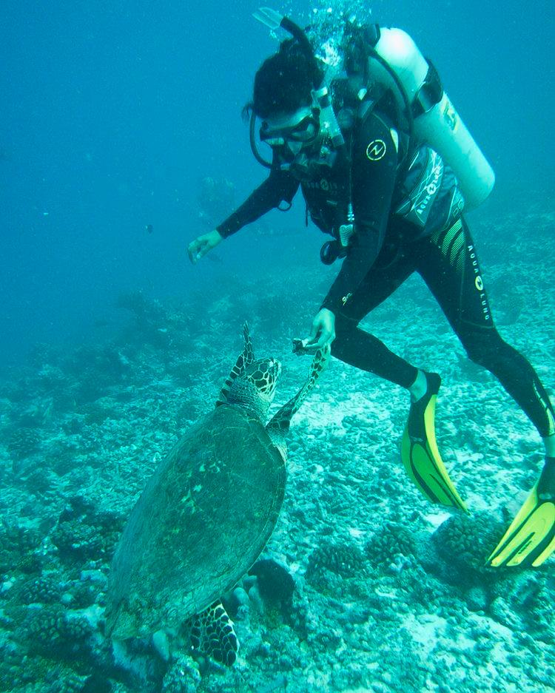
Story about my last adventure

Slide 3
I was so bored in my house when i got an idea. How about I go on vacation to a paradise island? sure will be great. While I was thinking about that, Surprisingly, my BF Hector called me to say he wanted to go with me to the island, and I say of course. So, we flight to Madagascar and when we arrived, Unexpectedly, we saw the hotel, it was a craziness natural and wild with a beautiful landscape and a deep lagoon where we could dive and observe marine life! and I said to my friend: let's go on an adventure! We plunged into the lagoon and when my friend was diving, strangely, one turtle came to him and i took a picture. After I do that, my friend and I saw many turtles coming towards us and while we were swimming to the surface, sadly, one of them bit my friend! there was blood everywhere and everything looked like a horror movie. I took my friend to shore and we immediately went back to home. That island was very wild for us.

Slide 4
CHECKLIST TO GRADE UNIT PROJECT 8
 | YES | NO
WRITTEN PRODUCT
Grammar structures from the unit are used in the story (past continuous and simple past)
The words when and while are used correctly
Adverbs for story telling are used appropriately
The story has 100 or more words
The pictures provided are connected with coherence and cohesion
VIDEO
Includes a cover with the student’s general information
Includes the pictures provided by a classmate
The student record the story and the audio is intelligible
Is able to express his/her ideas fluently with correct intonation using complete sentences and with no major production errors.

