Slide 1
PROJECT UNIT 8 WHAT HAPPENED NEXT?
ESCUELA NORMAL DE EDUCACIÓN PREESCOLAR
Student: Andrea Flores Sandoval
Date: June 18, 2020

Slide 2
CHECKLIST TO GRADE UNIT PROJECT 8
 | YES | NO
WRITTEN PRODUCT
Grammar structures from the unit are used in the story (past continuous and simple past)
The words when and while are used correctly
Adverbs for story telling are used appropriately
The story has 100 or more words
The pictures provided are connected with coherence and cohesion
VIDEO
Includes a cover with the student’s general information
Includes the pictures provided by a classmate
The student record the story and the audio is intelligible
Is able to express his/her ideas fluently with correct intonation using complete sentences and with no major production errors.

Slide 3
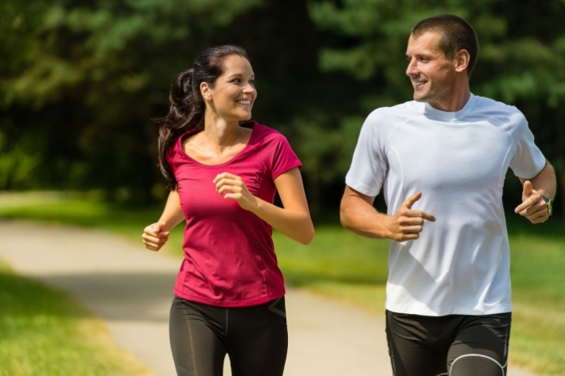
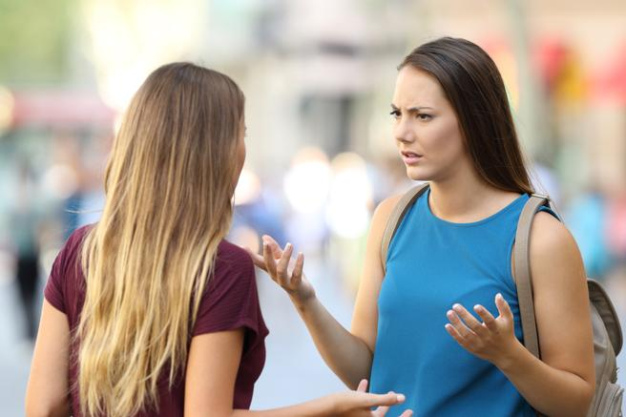
One day in the morning, Camila and her boyfriend ran in the park when they started talking about the reason why she went out with her friends last weekend. While they were arguing, she started crying and ran to her best friend Sofia's house.
Upon arrival, Sofia was not at home and had to wait for her by talking to her sister. They were talking when Sofia arrived and found Camila crying, she was very worried because she thought that someone had hurt her.They went up to their room and started talking. While they were talking, Camila's boyfriend arrived and she left.

