Slide 1
Unit 8. It’s a long story
cycle 2

Slide 2

Task #3. Unit 8. Cylce 2.
Watch the video on the link and answer the 8 questions below. Place your answers on a Word file to turn in.
Title: What Have You Been Doing? - Present Perfect Continuous.
Link: https://www.youtube.com/watch?v=AKzqRMA_1lo
Comprehension questions.
What does Andrew need as soon as possible?
Why does Andrew look so tired during the driving lesson?
How long has Andrew been practicing parking maneuvers?
How long has Andrew been having driving lessons?
What has Robert been doing lately?
How long has Robert been playing basketball?
Who has been fixing cars for years?
What has Dad been doing in the house for several hours?
Notice how Andrew describes actions that started in the past and continued into the present.

Slide 3
Present Perfect Continuous Tense
It is used to describe an action that started in the past and continues into the present.
e.g. I’ve been working two jobs for the last six months.
It can also be used without a time expression to describe an activity that started in the past but is still in progress.
e.g. I’ve been trying to become an actor.
STRUCTURE
1 | 2 | 3 | 4 | 5
I | ´ve | been | working | two jobs.
I | haven’t | been | doing | much lately.
Subject + have/has (not) + been + verb + -ing + (rest)

Slide 4
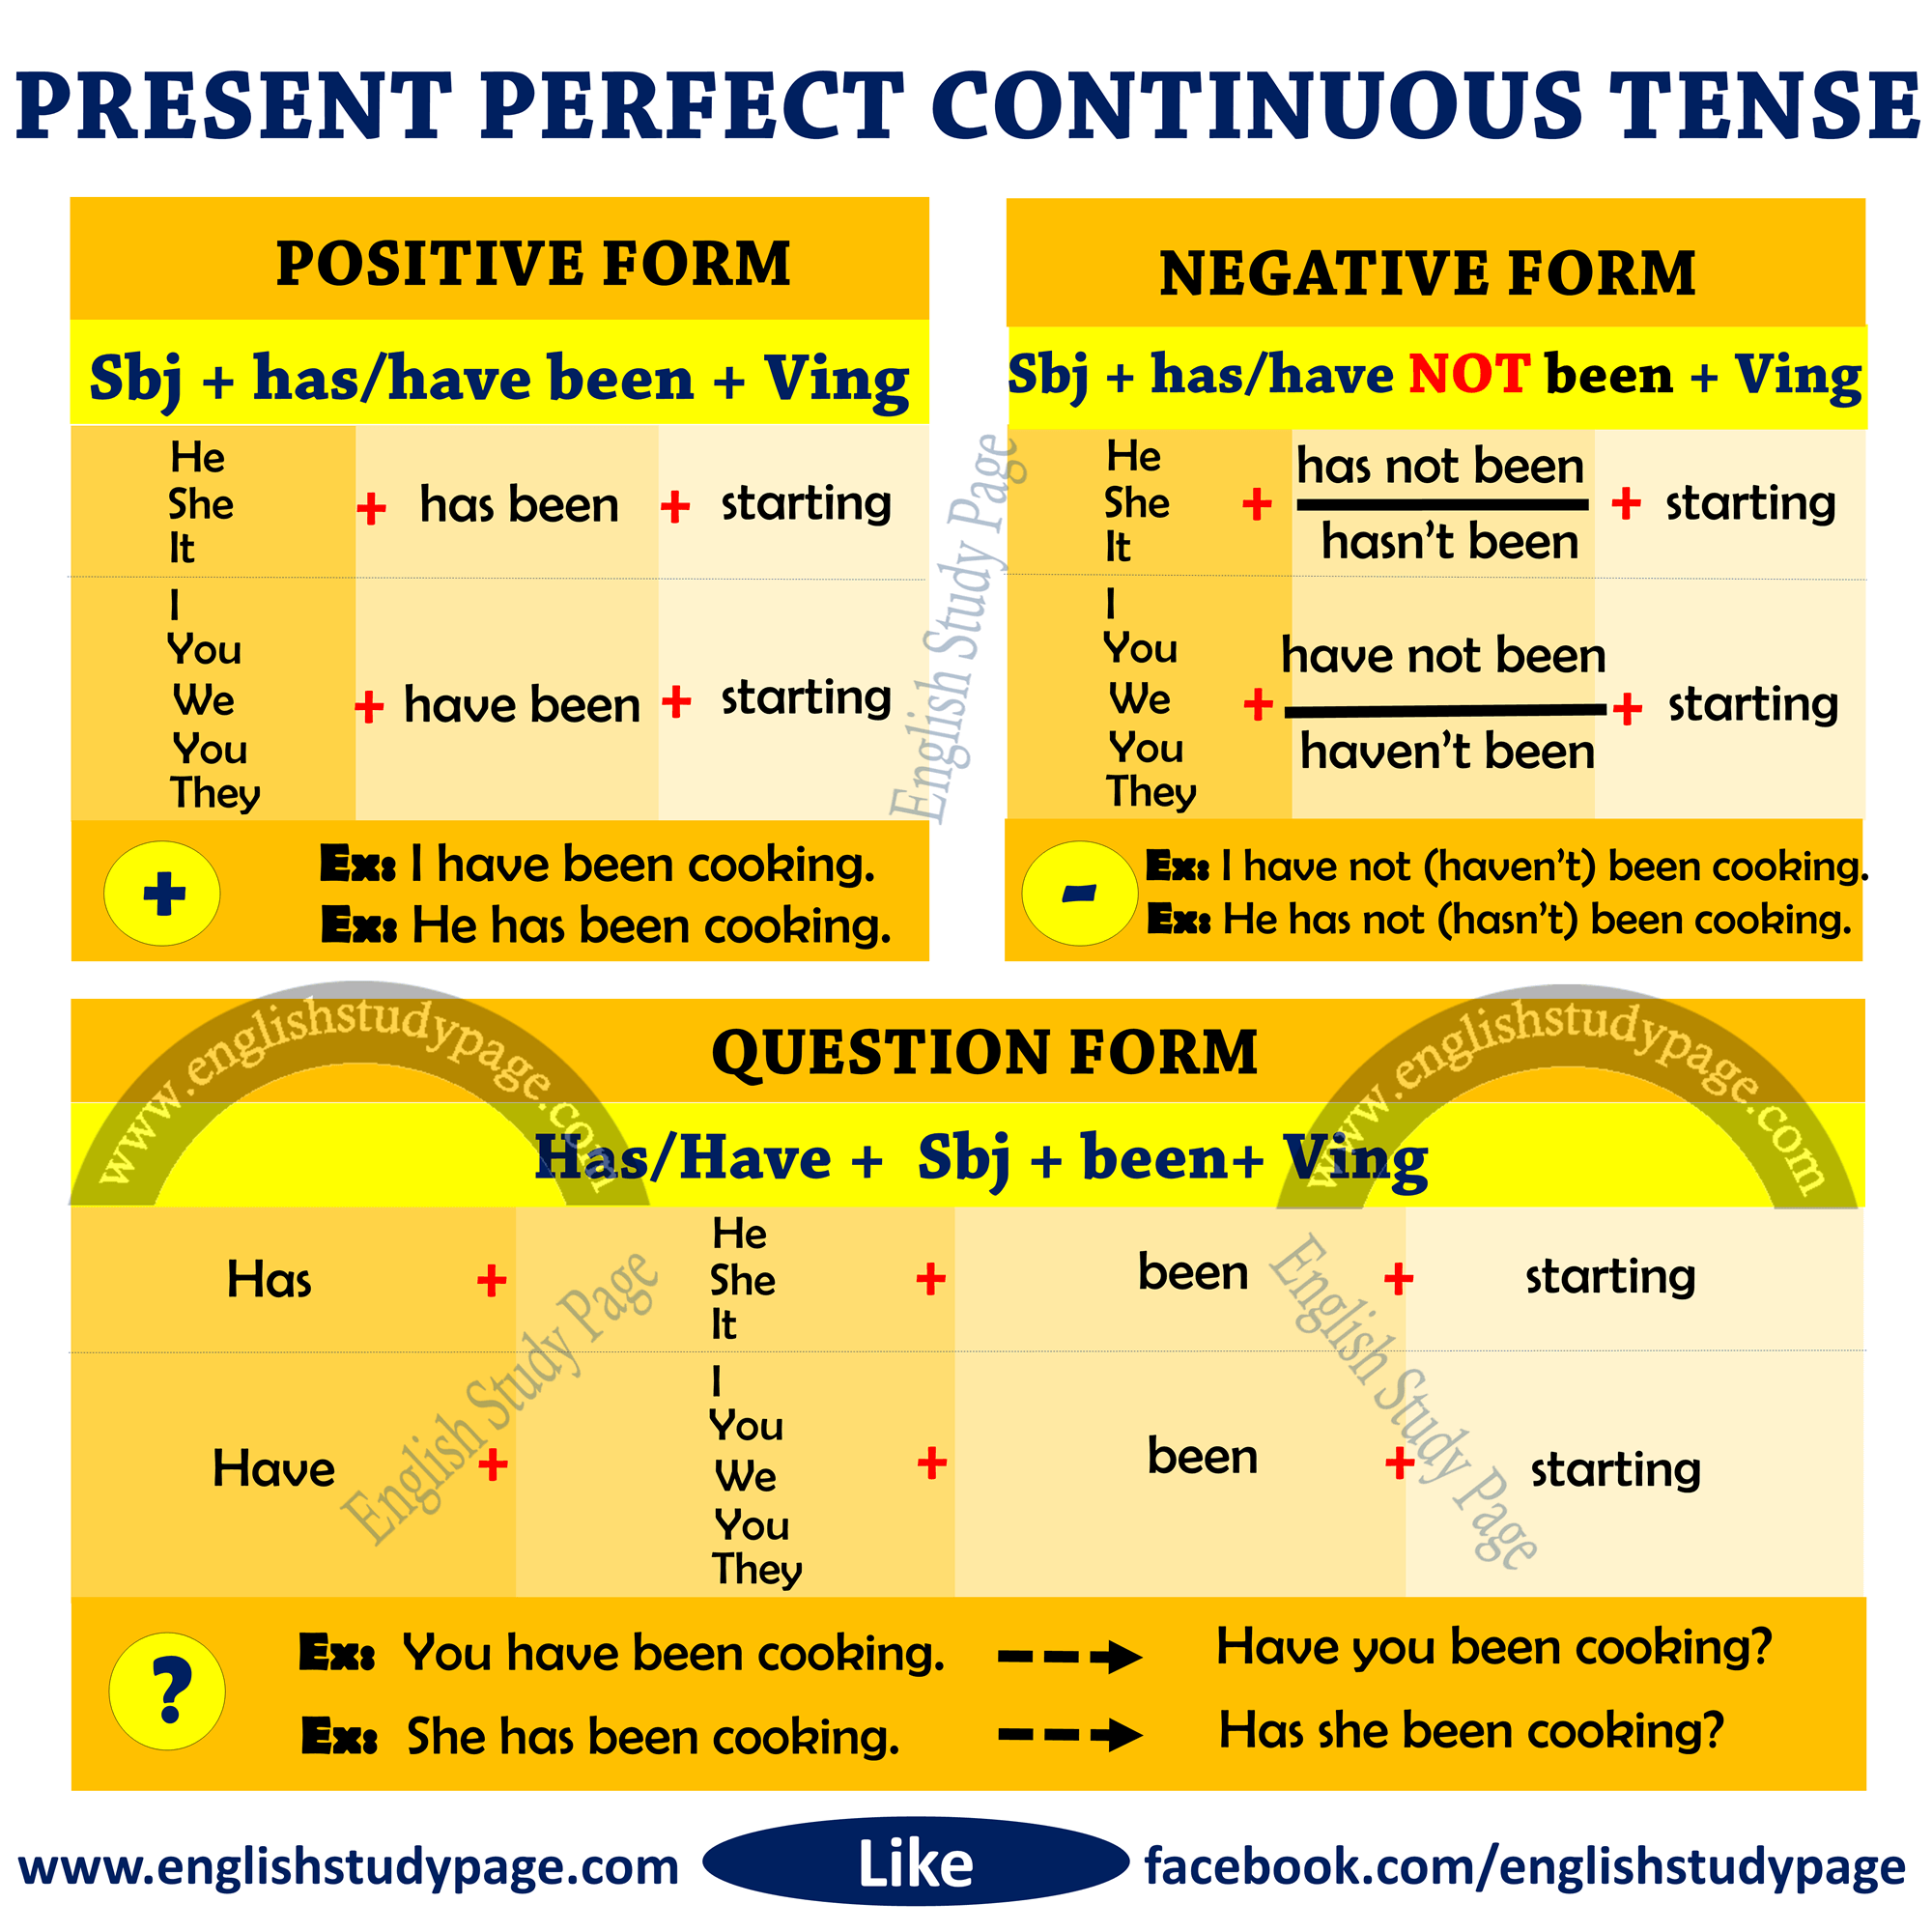
Structure

Slide 5
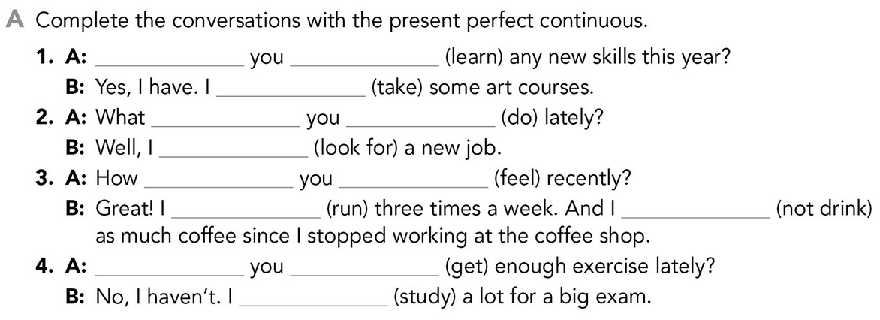
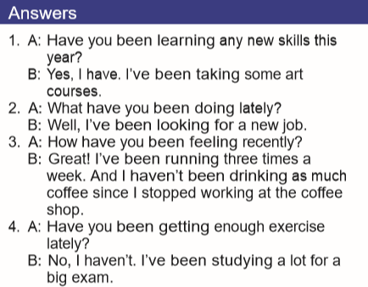
Go to your book, Unit 8, activity 8 GRAMMAR FOCUS, exercise A.
Challenge yourself. After you have completed the exercise, look at the answers and compare them with your answers.
Have the structure in mind:
(+) Subject + have/has + been + verb + -ing + (rest)
(-) Subject + have/has (not) + been + verb + -ing + (rest)
(+) Have/Has + Subject + been + verb + -ing + (rest)?
For extra self-check practice:
Complete Grammar Plus exercises in your book.
Also: https://www.perfect-english-grammar.com/present-perfect-continuous-exercise-1.html

Slide 6
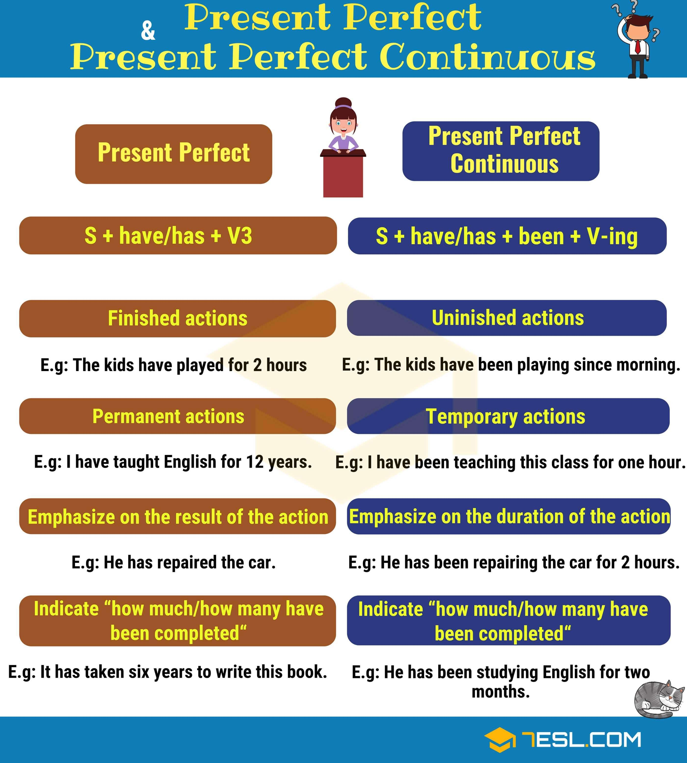
What is the difference between Present Perfect and Present Perfect Continuous?

Slide 7
The Present Perfect Continuous is used to talk about a continuous action or situation while Present Perfect is used to talk about a finish action or situation.
Present perfect
Present perfect continuous
I have seen Transformers movies 20 times, in my life.
I have planted several new flowers in my backyard.
I’ve lived in Japan for 12 years/since 2008.
She hasn’t eaten since 7 o’clock.
The boy has played baseball for 5 years.
I’ve already read three books since the contingency started.
I have been watching Transformers movies for 5 hours.
I’ve been planting flowers in my garden since early morning.
I’ve been living in Japan or 8 years / since 2012.
She hasn’t been eating well for several days.
The boy has been playing baseball for hours today.
I’ve been reading a new book since the contingency started.

Slide 8
“since” or “for”
For is used when specifying the amount of time (how long).
Since is used when specifying the starting point.
Challenge yourself and choose since or for to complete these time expressions. Then, look into the answers and assess yourself.
________ last spring.
________ the beginning of the year.
________ they bought it.
________ a few weeks.
________ last week.
________ six months.
________ 2001.
________ three years.
________ march 16^{th.}
________ eight o’clock.
ANSWERS
since last spring.
since the beginning of the year.
since they bought it.
for a few weeks.
since last week.
for six months.
since 2001.
for three years.
since march 16^{th.}
since eight o’clock.

Slide 9


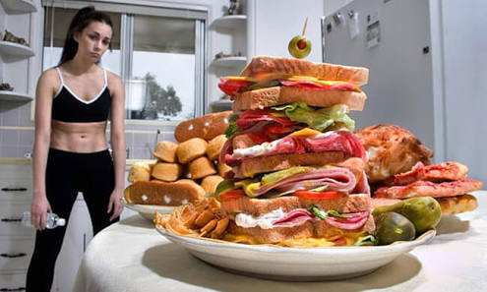
Task #5. Unit 8. cycle 2.
What about you?
Have you been taking advantage of the situation?
What have you been doing during the contingency?
WRITING. Tell 10 actions you and your family have been doing since the contingency started and continue into the present in your life. Use Present Perfect Continuous and time expressions FOR and SINCE and highlight them with different colors.
Examples:
My family and I have been arranging everything around the house since the first day of the contingency.
I’ve been putting the family pictures in order since Easter week.
I’ve been separating the trash and my children have been burying the biodegradable food waste in the backyard for 15 days.
resting
making
eating
sleeping
working
drinking
feeling
watching
helping
studying
doing
dreaming
thinking
reading

Slide 10
Task #6. Unit 8. cycle 2.
What about you?
What have you been doing during the contingency?
Have you been taking advantage of the situation?
SPEAKING. Join the Zoom meeting to share what you have been doing lately. Or, in case you have problems with your camera and microphone, video record yourself telling what you’ve been doing during the contingency. Send it to mezmarie@gmail.com
Maria Meza le está invitando a una reunión de Zoom programada.
Tema: What have you been doing?
Hora: 7 may 2020 11:00 AM Ciudad de México
Unirse a la reunión Zoom
https://us04web.zoom.us/j/73299984664?pwd=cGhxaGhIY1RtbGVwbG1EdTBQcmkxZz09
ID de reunión: 732 9998 4664
Contraseña: 3yRKMx

