Slide 1
Level 6.
B1 Level
UNIT 1.
English for Success
In this unit you will learn how to keep a conversation going. You will also discuss jobs and work and look at ways to end phone conversations at work. You will explore ways to talk about family life, as well as ask about and talk about family members, their habits, traits, behavior, and personalities. You will also study structures to help you talk about plans and intentions, as well as ask for, make and respond to suggestions

Slide 2
Weekly Activities.
English B1 ~ November 16th – 22nd
Go to learn.elltechnologies.com and log in the English for Success platform.
Complete Unit 1. New Path, lessons 1 to 3. Remember to focus on the learning points and target words which will be assessed during our class on Friday.
Due Date: Wednesday, November 18th

Slide 3
Weekly Activities.
English B1 ~ November 16th – 22nd
Go to learn.elltechnologies.com and log in the English for Success platform.
Complete Unit 1. New Paths, lessons 4 and 5. Remember to focus on the learning points and target words which will be assessed during our class on Friday.
Look for the activity **EFS U1~L1-5 November 16th – 20th** in Escuela en Red, complete the activity and upload your work in the platform.
Due Date: Friday, November 20th

Slide 4
Weekly Activities.
English B1 ~ November 16th – 22nd
We will have our virtual session on Friday, November 20th from 5:30 to 6:00 p.m.
https://us04web.zoom.us/j/77078590528?pwd=WE5zODVwK2pQZ1doalVHeFFoeVZRZz09
Join the meeting using the following link:
  Meeting ID: 770 7859 0528
  Passcode: ENEP

Slide 5
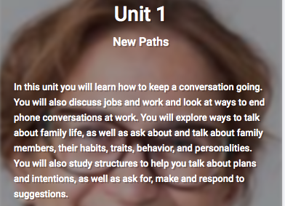
Unit 1 ~ Level 6
New Paths

Slide 6

Lesson 1. Just Coffee, Black
Target Words
Grammar Learning Outcomes:
  Superlatives
  Habits and Routines
    Simple Present
    Frequency Words
Work on the 3 “Let’s Practice” Sections
Check your Progress

Slide 7

Lesson 2. Family Talk
Target Words
Grammar Learning Outcomes:
  Talking About Family
  Simple Present vs Present Continuous Tense
Work on the 3 “Let’s Practice” Sections
Check your Progress

Slide 8

Lesson 3. Generation Gap
Target Words
Grammar Learning Outcomes:
  Future
  Personal Qualities and Behavior (Adjectives)
Work on the 3 “Let’s Practice” Sections
Check your Progress

Slide 9

Lesson 4. Mind the Gap
Target Words
Grammar Learning Outcomes:
  Consonant Clusters –Bl Sound
  Stressing new Information
Work on the 3 “Let’s Practice” Sections
Check your Progress

Slide 10

Lesson 5. Returning your Call
Target Words
Grammar Learning Outcomes:
  Talking on the Phone
  The Future with Will, Be Going To, and the Present Continuous
Work on the 3 “Let’s Practice” Sections
Check your Progress

