Slide 1
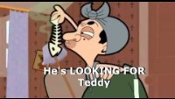
GRAMMAR FOCUS “ PRESENT CONTINUOUS”
The present countinuous tenese is used to talk about actions that are happening right now
Click on the following link to watch and learn how to use the present progressive
https://www.youtube.com/watch?v=lfePQ6H3v6o

Slide 2
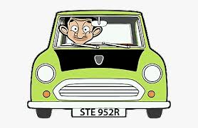

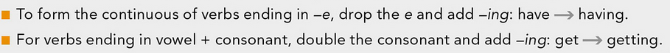
PRESENT CONTINUOUS “statements”
+
To be
+
Verb- ing
Subject
Form
He is
driving his car
More examples:
She is driving
We are driving
They are driving
Spelling | Clue words
sleep = sleeping | At the moment
get = getting (+ t) | These days, this year
have = having (- e) | Now

Slide 3
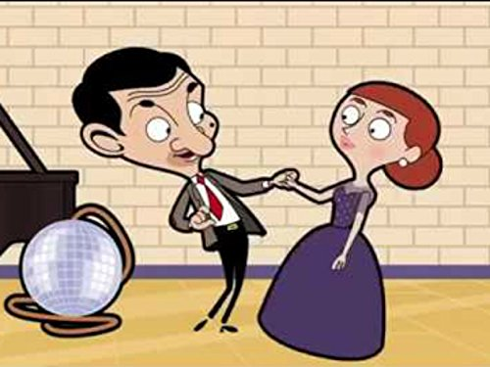
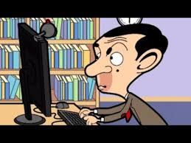
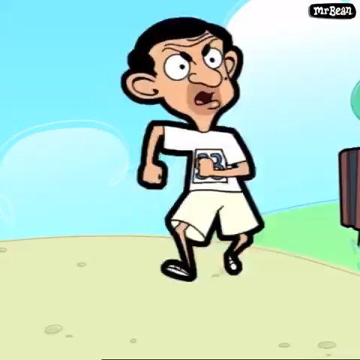
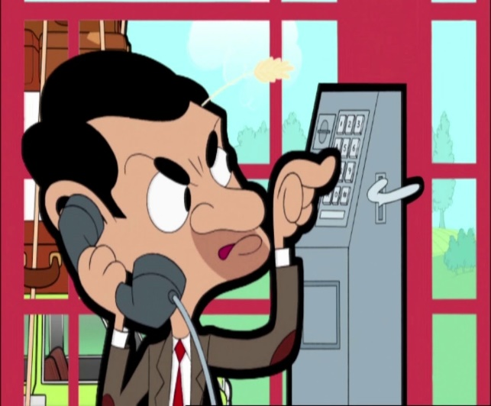
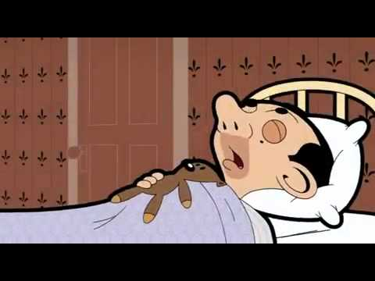
Practice statements
Write complete present continuous statements, then record your voice with your practice
He is driving his car

Slide 4
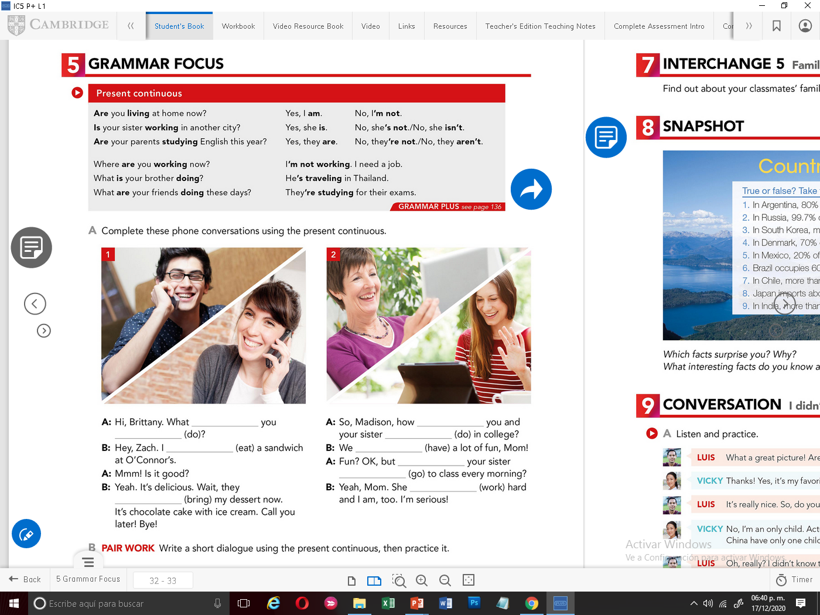
PRESENT CONTINUOUS “ yes/no questions”
To be
+
Subject
+
Verb- ing
Form
Is he
driving a truck?
No, he is not driving a truck. He is driving a car
More examples:

Slide 5
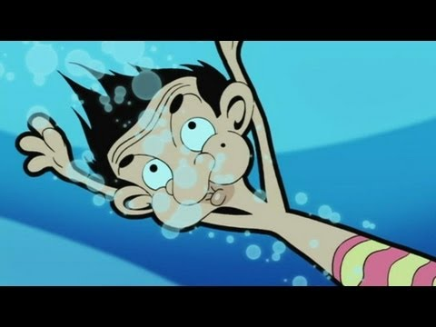
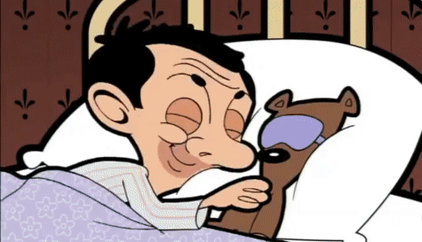
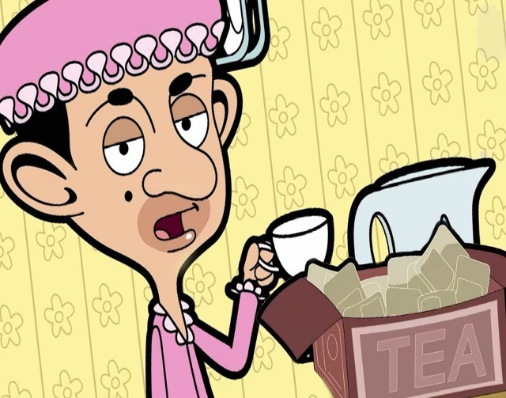
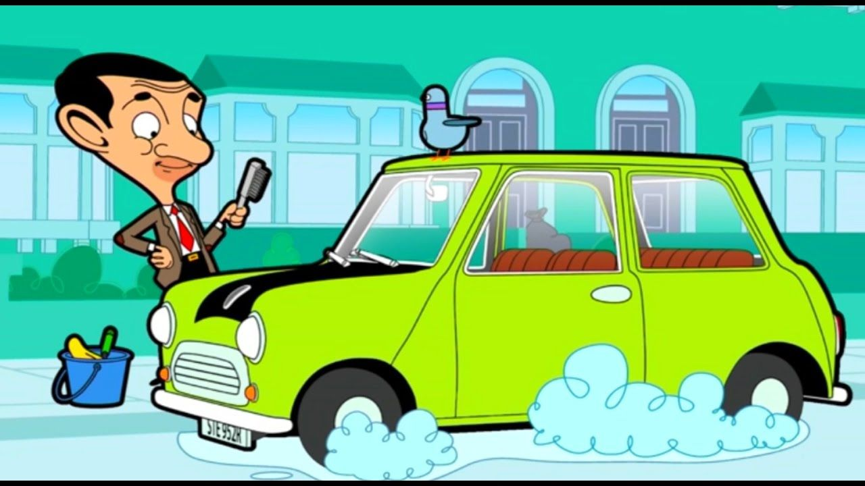
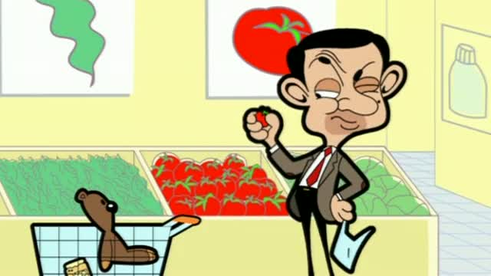
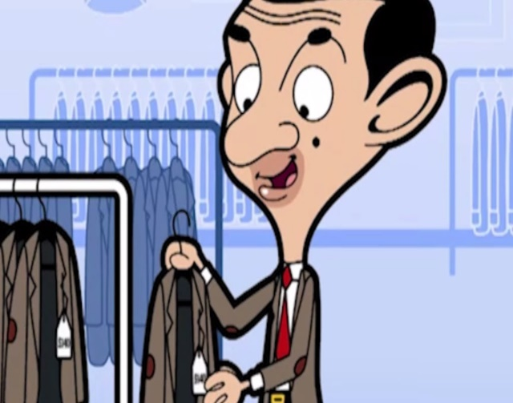
Practice Yes/No questions
Complete the following with yes/no questions or responses
Is he drinking soda?
Is he running?
No, he is not running he is swimming
Yes, he is sleeping
Is he shopping a scarf?.
Yes, he is washing his car
Yes, he is buying vegetables

Slide 6
PRESENT CONTINUOUS “ Wh.. questions”
+
+
Subject
+
Verb- ing
Wh
To be
Form
What
is he
driving?
More examples:

Slide 7

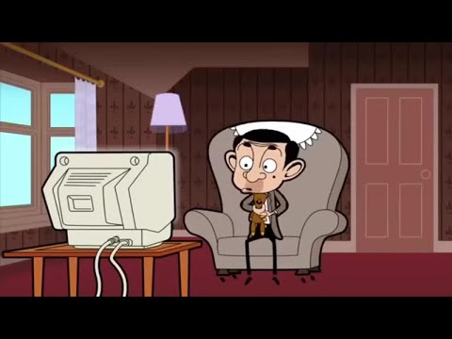
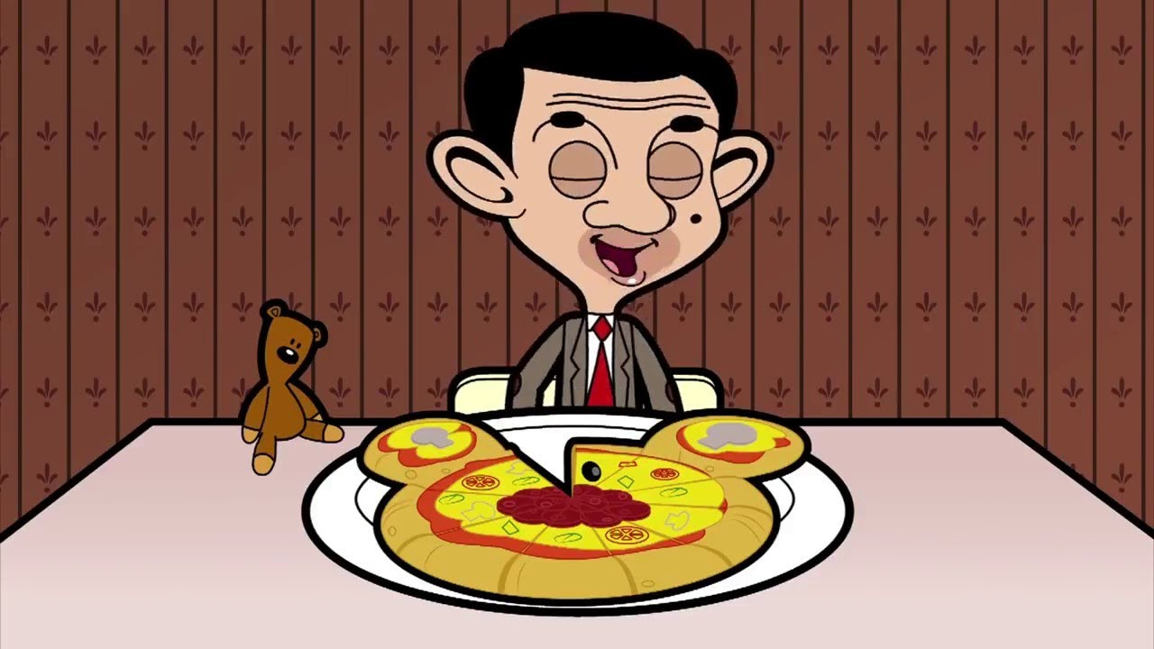
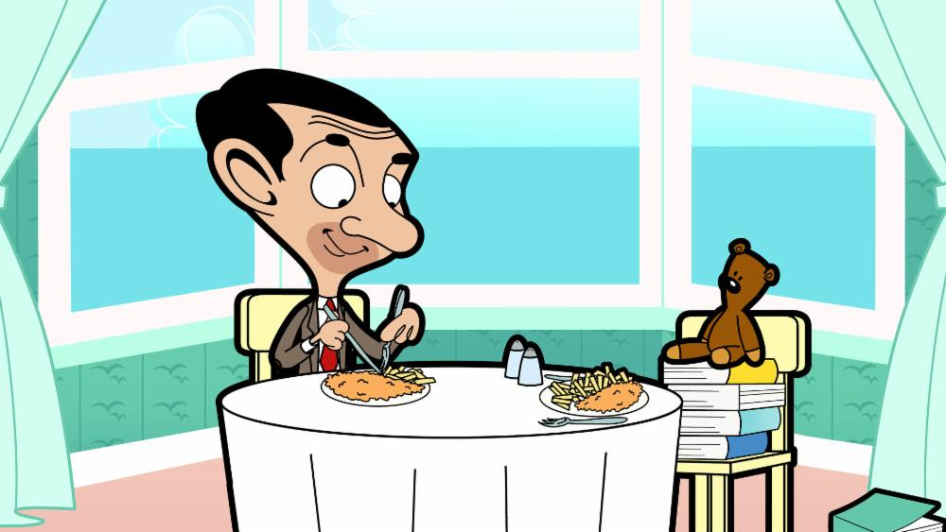
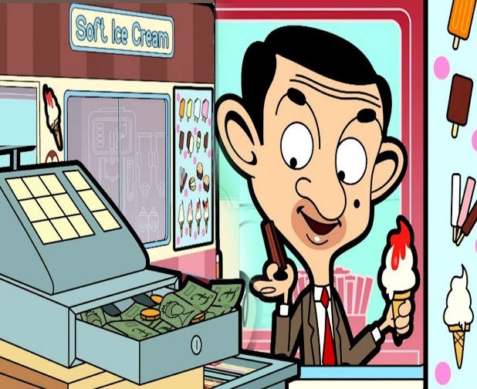
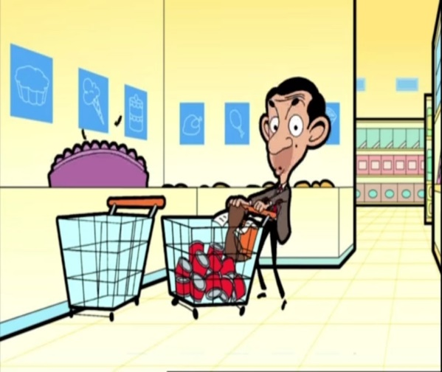
Practice Wh questions
Complete with present continuous wh questions or responses
What is he reading?
He is reading the newspaper
Where is he watching
He is eating pizza
Where is he eating?
Where is he shopping ?
He is buying icecram

Slide 8
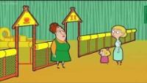
Click on the following link to practice the use of the present progressive
https://www.youtube.com/watch?v=vphY4T57DTQ

