Slide 1
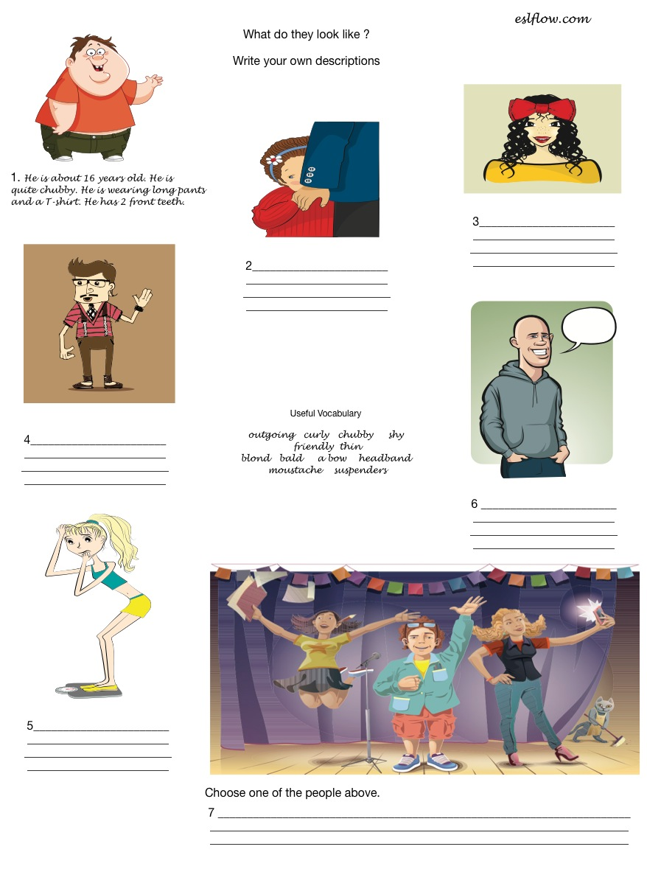

Slide 3
I THINK YOU WILL LIKE THIS GAME, IT´S ABOUT PERSONAL APPEARANCE (WITH personality ADJECTIVES )
http://learnenglishkids.britishcouncil.org/en/word-games/make-the-sentences/people-and-appearance
When you´ve played the complete game, you will be given with a result like the following, copy screen with your results here.

