Slide 1
CHRISTMAS
Project
https://www.youtube.com/watch?v=tbbKjDjMDok&index=3&list=PLA-vix1dc3M6VOf5MgK1KkWHtxMX1_58j

Slide 2
Snowflakes
Snowflakes
snowflakes
SNOWFLAKES
snowflakes
snowflakes
Snowflakes
SNOWFLAKES
snowflakes
Snowflakes
snowflakes
Snowflakes

Slide 3
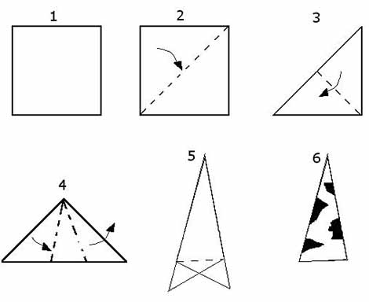
FOLD
FOLD
FOLD
CUT

Slide 5
