Slide 1
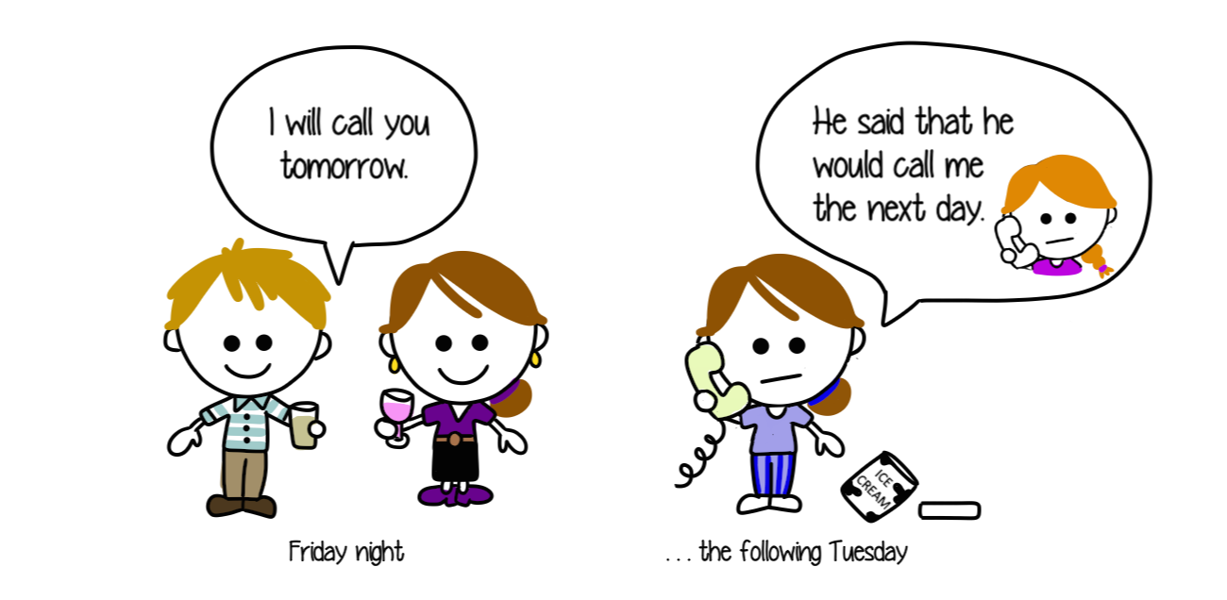
Reported Speech
Click on the following link to watch for the reported speech explanation
http://www.perfect-english-grammar.com/reported-speech.html
http://www.edufind.com/english-grammar/tense-changes-when-using-reported-speech/

Slide 2
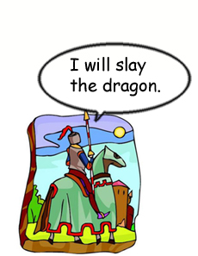
Reported Speech
We use reported speech to tell what other people have said. For example:
The knight said that he would slay the dragon.
Note that ‘will’ has been changed to ‘would’. Usually, when we report what others have said, we change it to the past tense. Sometimes, we leave it in the present tense if it’s a general truth.
Try these:
“I am going to the castle.”
______________________________________________________
“I want to speak to the king.”
______________________________________________________
“I can help get rid of the dragon.”
______________________________________________________
“I am not afraid of a giant lizard.”
______________________________________________________
“I have to find a good place to see the dragon.”
______________________________________________________

Slide 3
Click on the following link to practice with reported speech then copy paste your results
https://learnenglish.britishcouncil.org/en/grammar-reference/reported-speech-1

Slide 4
Click on the following links to have fun and learn some more about the use of reported speech
https://www.youtube.com/watch?v=t__Kbprp-8Y
https://www.youtube.com/watch?v=u2TxjJ2zdM0
https://www.youtube.com/watch?v=SHrTimqqxFI

