Slide 1
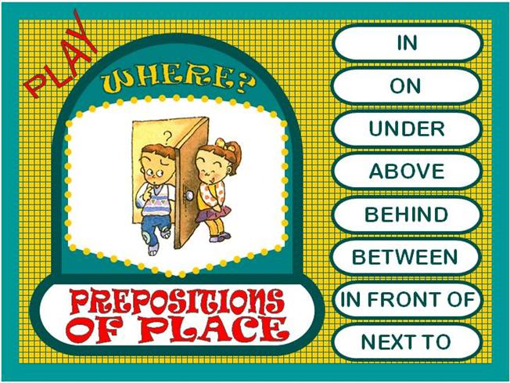
http://www.eslgamesplus.com/videos/toys-where-is-my-teddy-esl-video-lesson/

Slide 2
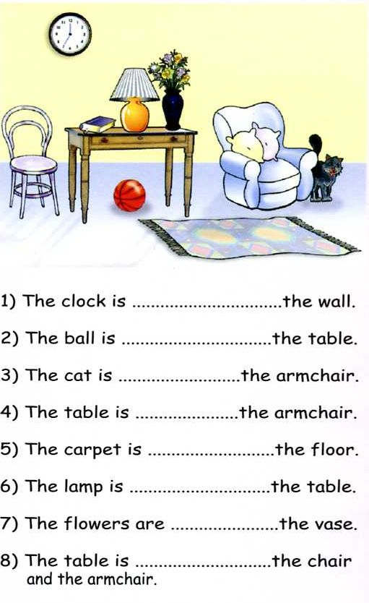
Class work
Practice prepositions of place, complete the following sentences

Slide 3
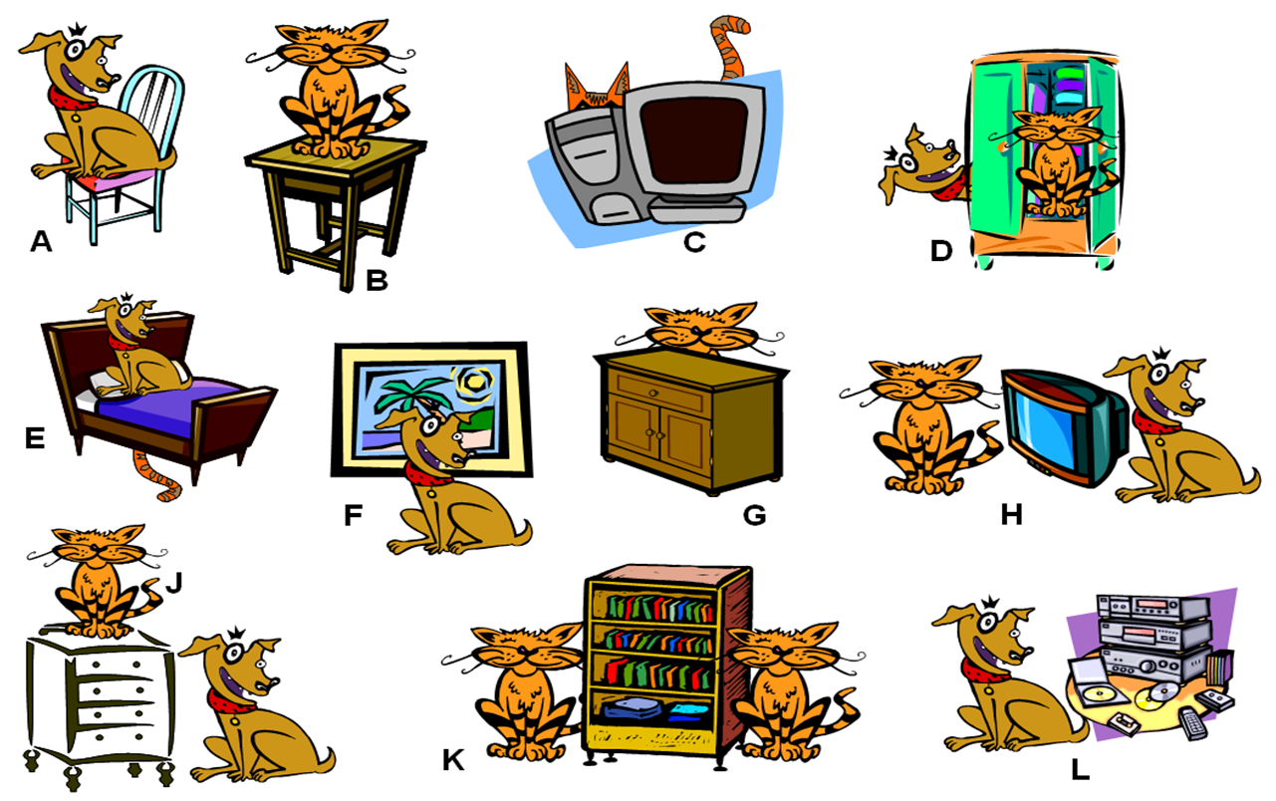
Class work
Write 10 sentences (min). use prepositions of place, practice with your partner orally

Slide 4
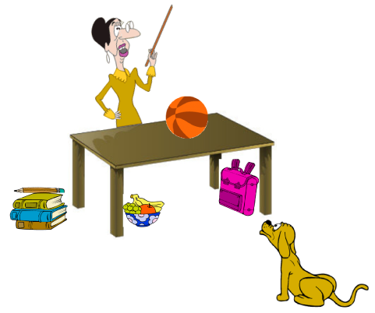
EXTRA Practice At home!!!
Make oral sentences use prepositions of place

Slide 5
Practice with prepositions of place in the following website
http://englishflashgames.blogspot.mx/2008/06/prepositions-of-place-game.html

