Slide 1
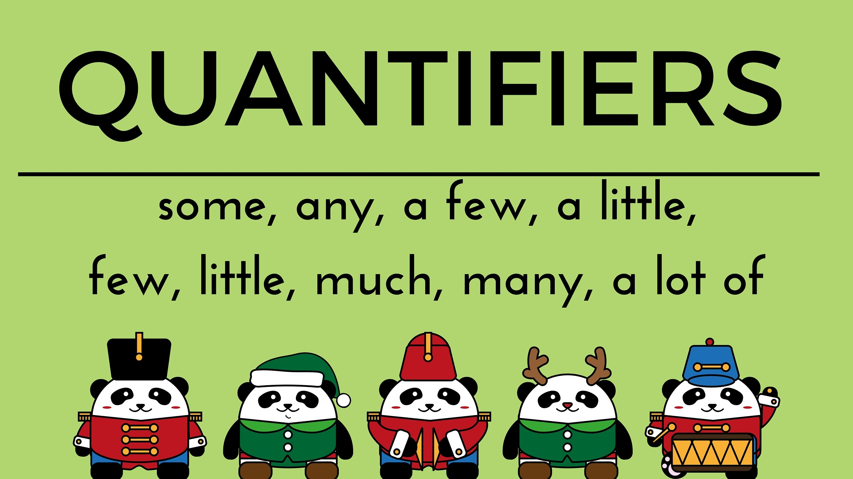
https://www.youtube.com/watch?v=aLQ5_zjdhQ8
Click on the links to watch and learn
https://www.youtube.com/watch?v=CPfGRK0jF6A
https://www.youtube.com/watch?v=q5I2aqkHfIk

Slide 2
1. When do we use much and when many?
much: uncountable nouns (milk, marmalade, money, time etc.)
many: countable nouns (bottles of milk, jars of marmalade, dollars, minutes etc.)
Examples:
How much money have you got?
How many dollars have you got?
In informal English these questions are often answered with a lot of, lots of. There is no much difference between the two phrases.
2. When do we use a little/little and when a few/few?
a little: non countable nouns (milk, marmalade, money, time etc.)
a few: countable nouns (bottles of milk, jars of marmalade, dollars, minutes etc.)
Examples:
He has a little money left.
He has a few dollars left.
We use few and little without the article a to point out a more negative meaning.
Examples:
A few students of our school know this. (There are some student who know it.)
Few students know this. (It is almost unkonown.)

Slide 3
Countables | Uncountables
Some(+) | Some (+)
Any (?) (-) | Any (?) (-)
many | much
A few (+) few (not enough) | a little (+) Little ( not enough)
Lots of (+) | A lot of (+)

Slide 4
Practice on the following website with quantifiers then give your results
http://www.eslgamesplus.com/some-any-moonshot/

