Slide 1
Simple present (+ and – sentences)
Positive (of 'play')
I play
you play
he plays
she plays
it plays
we play
they play
Negative (of 'play')
I do not play | I don't play
you do not play | you don't play
he does not play | he doesn't play
she does not play | she doesn't play
it does not play | it doesn't play
we do not play | we don't play
they do not play | they don't play

Slide 2
Click on the following link to learn about simple present possitive and negative sentences
https://www.youtube.com/watch?v=3W3AZ5Zw0n0

Slide 3
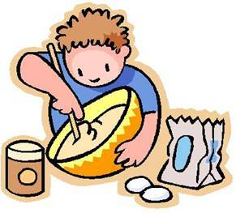
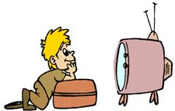
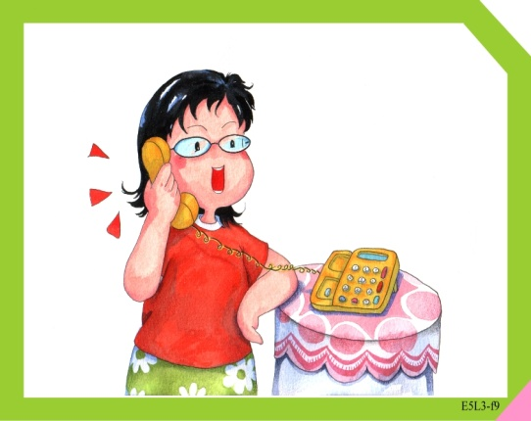
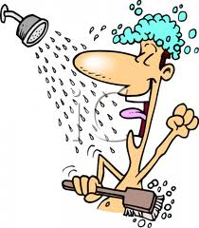
Start
Move
forward
2 squares
(My parents)
Go shopping
(I) Make my
bed
(Alan)
Cook dinner
(My brother)
Watch tv.
Finish
Lose
Turn
Move
back
2 squares
(Rosy)
Talk by
phone
(Frank)
Do the
Laundry
(my mother)
Clean the house
(Tom)
Take a shower
(my friend)
Excercise
At home
(my grandmother)
read

