Slide 1
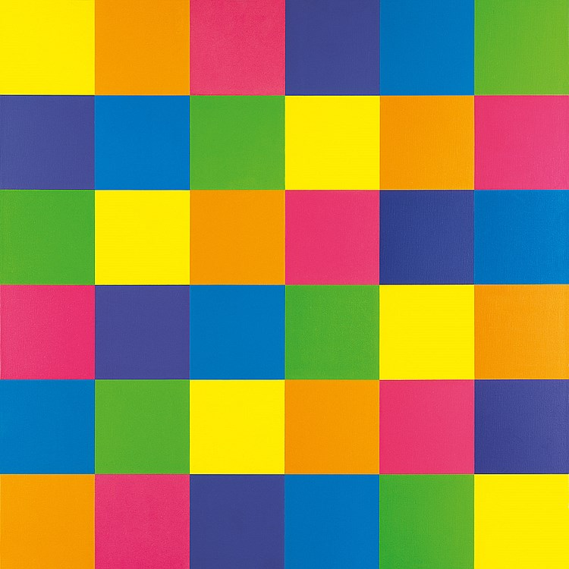
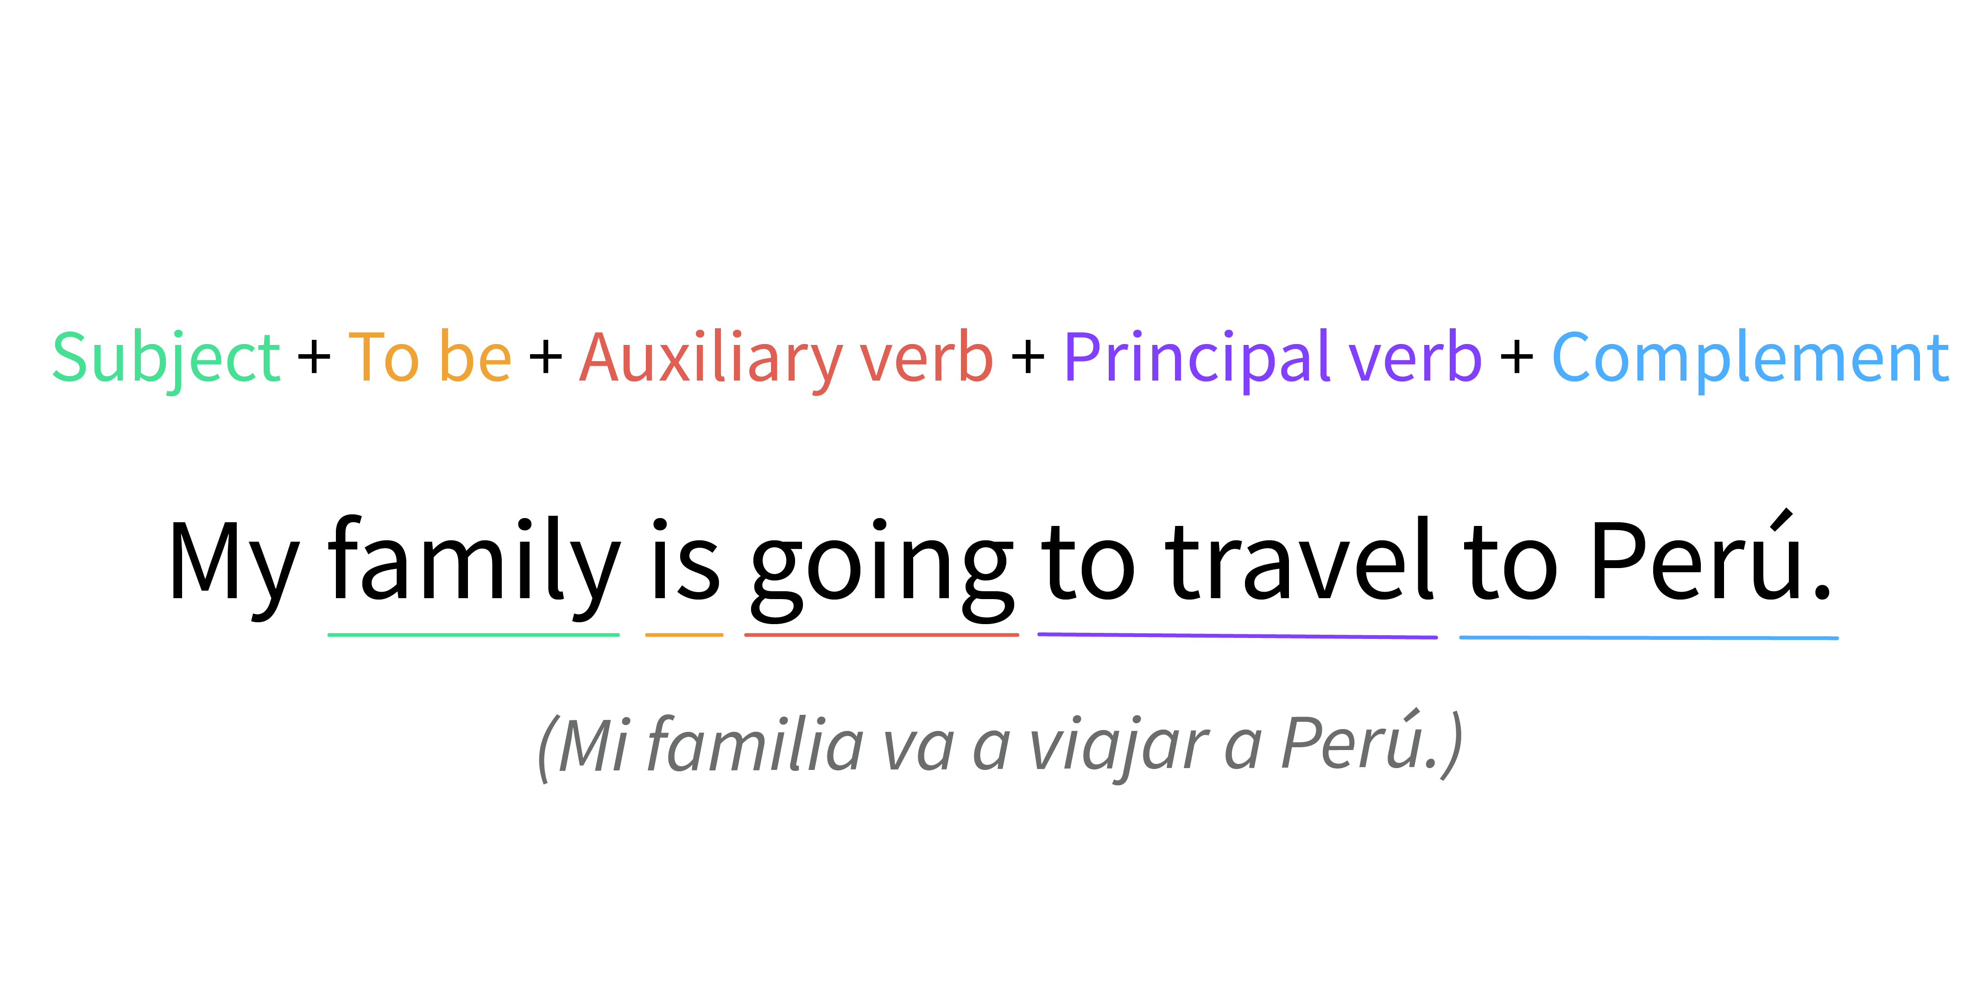
OLIVO MALDONADO LORENA FERNANDA
MORALES MENDOZA MARIA GUADALUPE.
JIMENEZ RAMIREZ JULIA FAELA
OCHOA RAMOS JESSICA ANAHÍ
IBARRA CEPEDA BRENDA GUADALUPE
Rules
GOING TO
Future

Slide 2

It is used to express forceful plans or events for the future.
It is important to note that in this form of the future tense, the verb to be is used in the present form.

Slide 3

Going to uses:
1. To express a plan:
Lucas is going to make another movie.
Lucas va a hacer otra película.
2. It expresses the intention of a person to do something in future tense:
Miss. Anderson is going to be a jury in the contest.
La señorita Anderson va a ser jurado en el concurso.
3. State something you are certain about:
It's going to rain.
Va a llover.

Slide 4

Function
The use of "going to" to refer to future events suggests a very strong link to the present. The precise moment is not relevant, it is after the now, but the attitude implies that said event depends on something we know about the current situation. "Going to" is mostly used to talk about our plans and intentions, or to make predictions based on current evidence. In everyday speech, "going to" is often shortened to "gonna", especially in American English, although it is never written that way.

Slide 5
Sujeto | + to be (conjugado) | + going | + infinitivo
She | is | going | to leave.
I | am | going | to stay.
He | is | going | to jog.
Negativa
He | is not | going | to jog.
Interrogativa
Is | he | going | to jog?
Interrogativa negativa
Isn't | he | going | to jog?

Slide 6
SUBJECT

Slide 7
TO BE

Slide 8
AUXILIARY
VERB

Slide 9
PRINCIPAL
VERB

Slide 10
COMPLEMENT

Slide 11
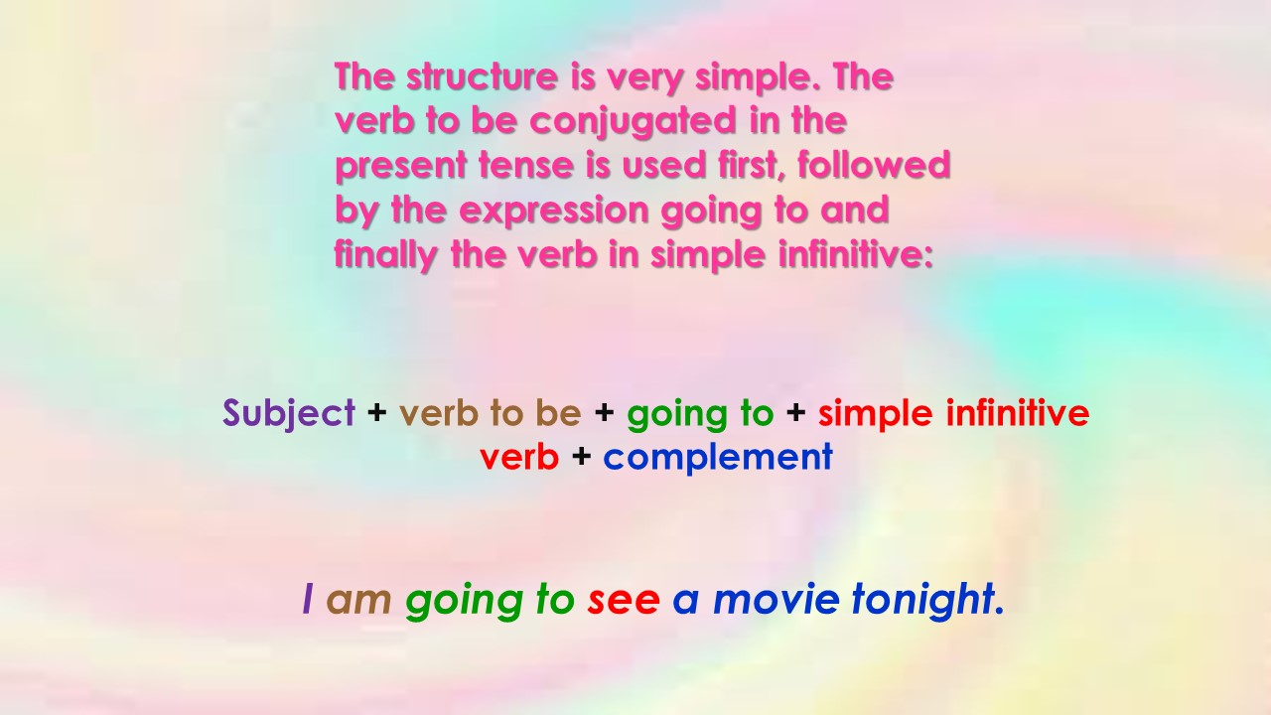

Slide 12
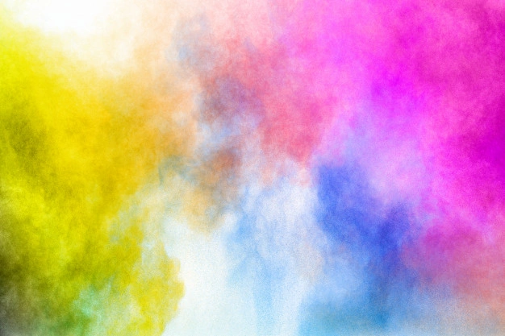
EXAPLES
Is Freddy going to buy a new car soon?
Are John and Pam going to visit Milan when they are in Italy?
I think Nigel and Mary are going to have a party next week.
We are going to have dinner together tomorrow.
Aren't you going to stay at the library until your report is finished?

