Slide 1

What do you do?
Unit 2
Aims: Ask and answer questions about jobs

Slide 2
Objective:
By the end of the unit 2, students must be able to ask and answer the following questions.
Where do you work? What do you do there? Where do you go to school?
Do you like your classes? What’s your favorite class?
Where does [classmate] work/go to school? What about [other classmate]? What does he/she do, exactly? How does he/she like it?
Describe your daily schedule. What do you do early in the morning? What do you do in the afternoon? What do you do late at night? What do you do only on weekends?
When do you usually get up/come to school/have lunch/get home/go to bed?
What’s something you do before 9:00 A.M.?
What’s something you do after 9:00 P.M.? What time do you go to work/school?
Ask me about my job. or Ask [classmate] about his/her job or classes.

Slide 3
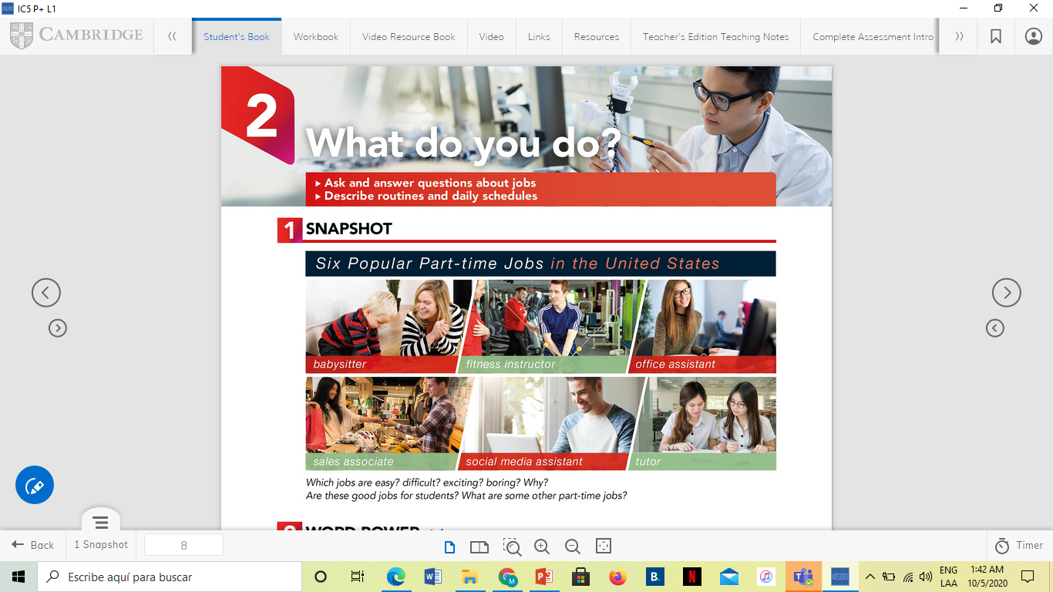
SNAPSHOT
Answer the following questions about part-time Jobs.
Are part-time Jobs good for students? Why?
A=because it makes it easier for us students to do both at the same time
Which jobs are easy?
A=work outside companies and offices
Which jobs are exciting?
A=jobs in restaurant areas
Which jobs are boring? Why?
A=it depends on your field and what you like
What are some other part-time jobs?
A=jobs in cinemas
Do you have part-time job? What do you do?
A= no, my job is full time

Slide 4



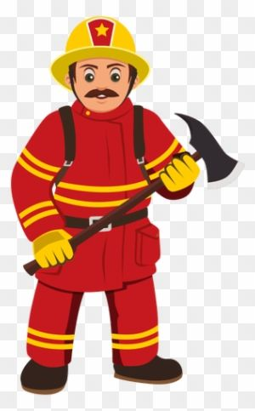
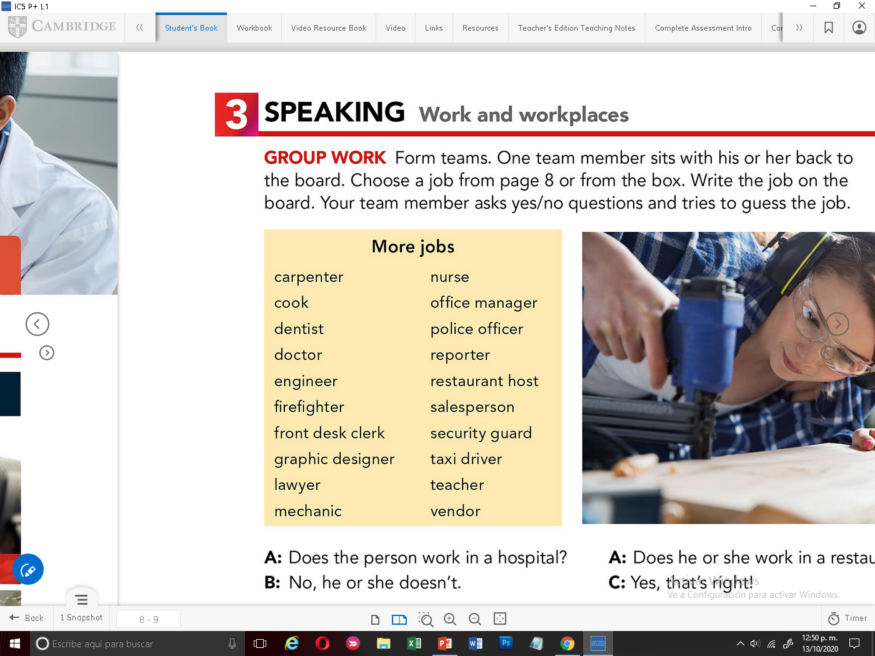


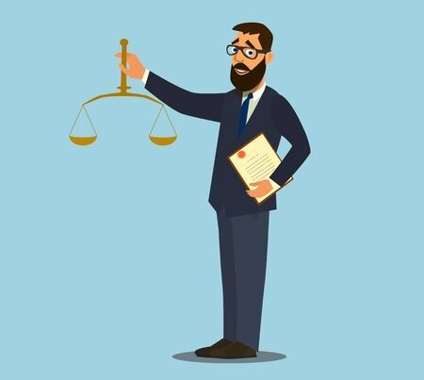
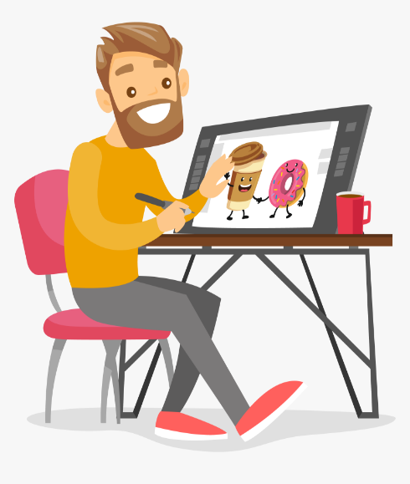

WORD POWER Jobs
A) Label the pictures with the right word
mechanic
carpenter
engineer
firefighter
Graphic designer
dentist
lawyer
Front desk clerck
B) See an internet dictionary and practice the pronunciation of these vocabulary words. Record your voice saying the words.

Slide 5
WORD POWER Jobs
C) Complete the Word map with the Jobs from the list.
Food Service
cashier
chef
cook
Restaurant host
Accountant
Cashier
Dancer
Flight attendant
Chef
Musician
Pilot
Receptionist
Server
Singer
Tour guide
Web designer
Cook
Dentist
Doctor
Nurse
Reporter
Restaurant host
Graphic designer
Office manager
Health service
dentist
doctor
Nurse
Jobs
Entertainment business
dancer
musician
singer
reporter
Office work
accountant
receptionist
Web designer
Graphic desinger
Office manager
Travel industry
Fligh attendant
pilot
server
Tour guide

Slide 6
LISTENING Jobs
Listen to the recording. You will hear a man talking about a job.
Underline the job that goes with the sentence you hear.
3.
accountant
manager
software programmer
4.
police officer
landscaper
truck driver
5.
teacher
travel agent
tour guide
1.
bank teller
host
Chef
2.
professor
therapist
fire fighter

Slide 7
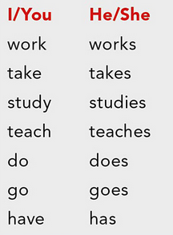

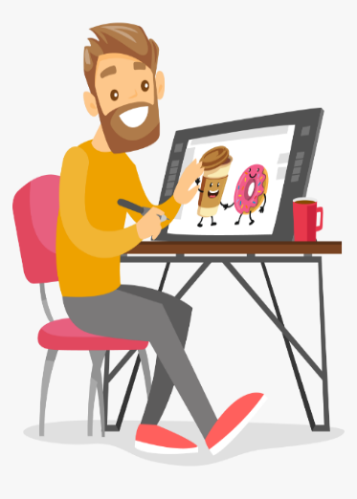

GRAMMAR “ SIMPLE PRESENT”
Remind that verbs in simple present for third person end in “s” or “es ”
She´s a dancer
She works at a dance company
She performs in theaters
She likes her work very much
He´s a lawyer
He works at the court
He gives advice on legal matters
He doesn´t like his work very much
A. Write sentences in simple present about the following jobs
He’s a mechanic
He works in the mechanical workshop
He fixers the cars
He likes her work
He’s a graphic designer
He works in the office
He designs everithing you want
He loves your work
Remind that verbs in simple present for third person end in “s” or “es”

Slide 8
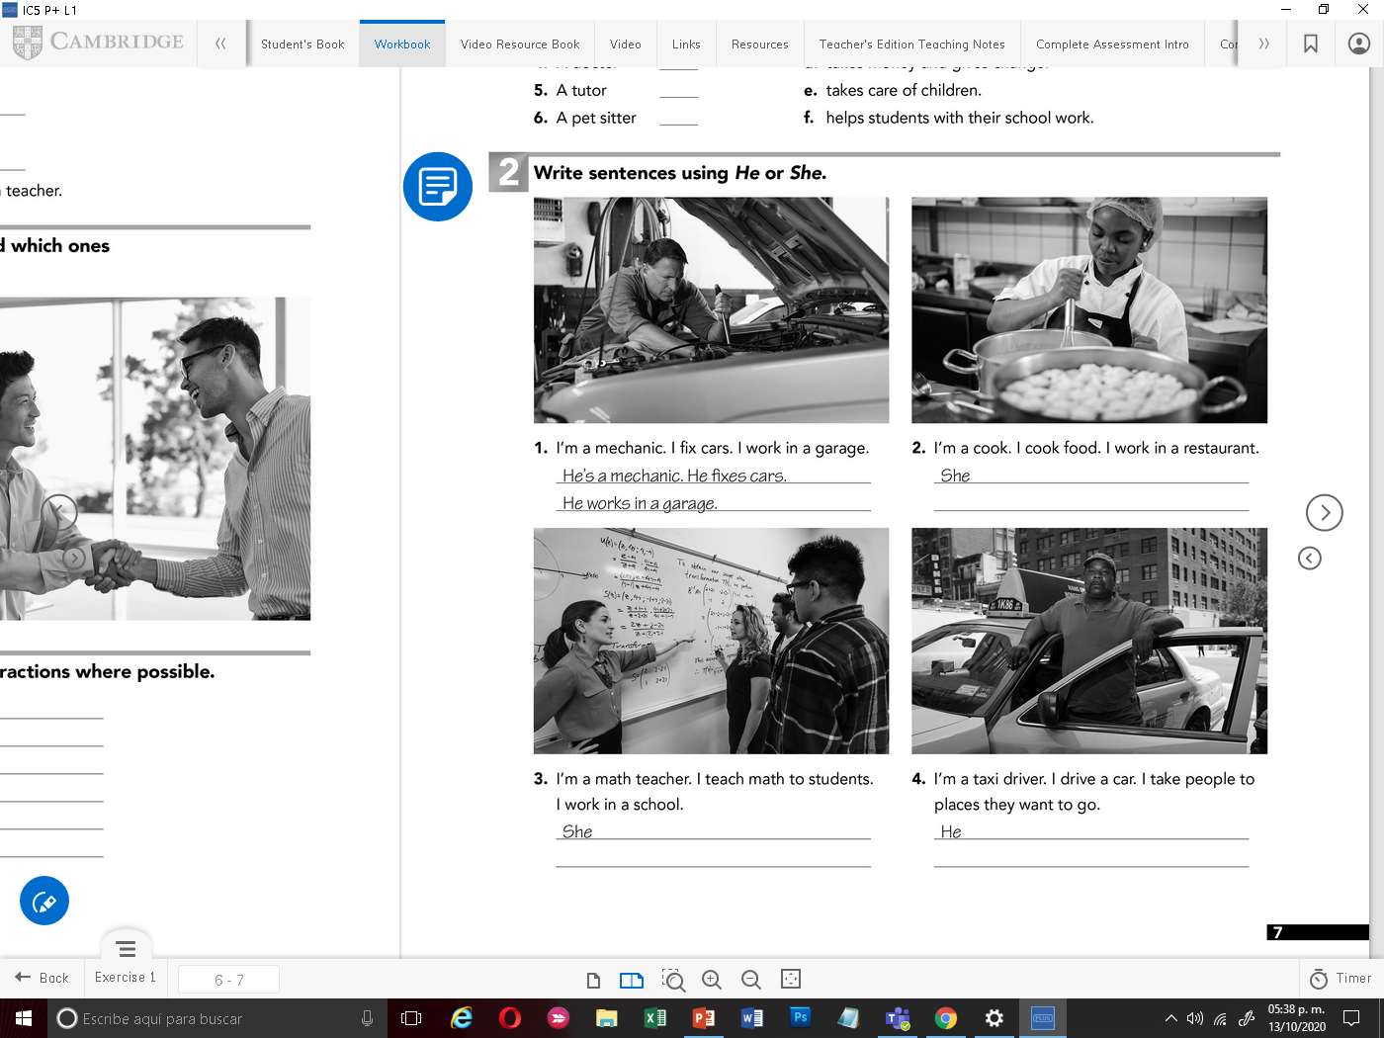
WRITING SIMPLE PRESENT STAMENTS
‘s a chef, she prepair the food
She works in a restaurant
‘s a teacher. She teach in the school
She works in the school

