Slide 1
What do you do?
Unit 2
Aims: Ask and answer questions about jobs

Slide 2
Objective:
By the end of the unit 2, students must be able to ask and answer the following questions.
Where do you work? What do you do there? Where do you go to school?
Do you like your classes? What’s your favorite class?
Where does [classmate] work/go to school? What about [other classmate]? What does he/she do, exactly? How does he/she like it?
Describe your daily schedule. What do you do early in the morning? What do you do in the afternoon? What do you do late at night? What do you do only on weekends?
When do you usually get up/come to school/have lunch/get home/go to bed?
What’s something you do before 9:00 A.M.?
What’s something you do after 9:00 P.M.? What time do you go to work/school?
Ask me about my job. or Ask [classmate] about his/her job or classes.

Slide 3
SNAPSHOT
Answer the following questions about part-time Jobs.
Are part-time Jobs good for students? Why?
A=because they can study too
Which jobs are easy?
A=Office assistant, sales associate, social media assistant, tutor
Which jobs are exciting?
A=babysitter fitness, instructor
Which jobs are boring? Why?
A=office assistant, because because you're sitting
What are some other part-time jobs?
A=Car Wash Attendant, Pizza Delivery, Host
Do you have part-time job? What do you do?
A=No, I do not work

Slide 4
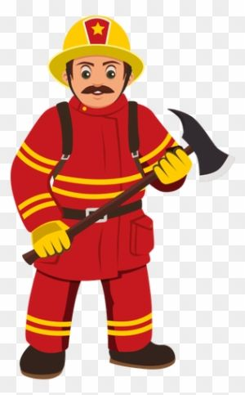
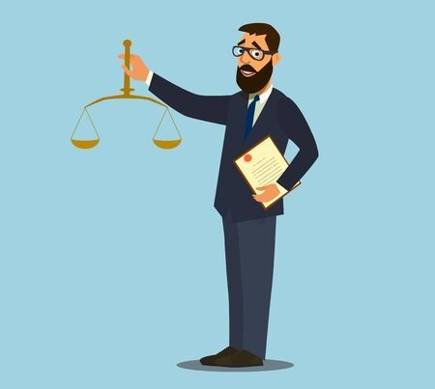
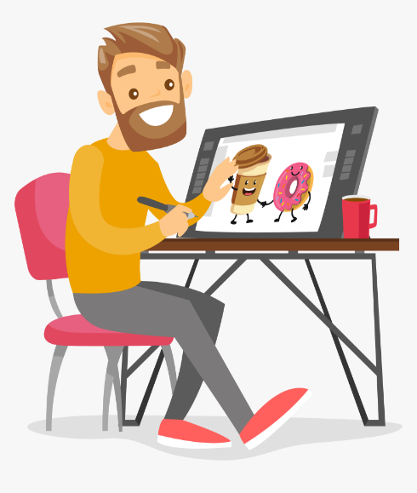
WORD POWER Jobs
A) Label the pictures with the right word
Carpenter
engineer
mechanic
firefighter
Front desk clerk
Graphic designer
Dentist
lawyer
B) See an internet dictionary and practice the pronunciation of these vocabulary words. Record your voice saying the words.

Slide 5
WORD POWER Jobs
C) Complete the Word map with the Jobs from the list.
Food Service
cashier
chef
cook
Restaurant host
server
Accountant
Cashier
Dancer
Flight attendant
Chef
Musician
Pilot
Receptionis
Server
Singer
Tour guide
Web designer
Cook
Dentist
Doctor
Nurse
Reporter
Restaurant host
Graphic designer
Office manager
Health service
dentist
doctor
nurse
Jobs
Entertainment business
dancer
musician
singer
reporter
Office work
accountant
Web designer
Graphic designer
Office manager
receptionist
Travel industry
Fligh attendant
pilot
Tour guide

Slide 6
LISTENING Jobs
Listen to the recording. You will hear a man talking about a job.
Underline the job that goes with the sentence you hear.
3.
accountant
manager
software programmer
4.
police officer
landscaper
truck driver
5.
teacher
travel agent
tour guide
1.
bank teller
host
Chef
2.
professor
therapist
fire fighter

Slide 7
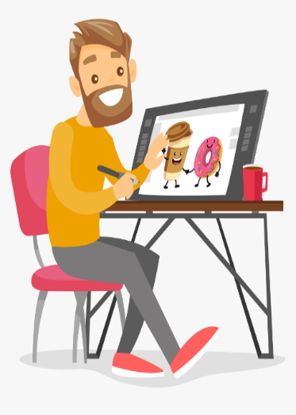
GRAMMAR “ SIMPLE PRESENT”
Remind that verbs in simple present for third person end in “s” or “es ”
She´s a dancer
She works at a dance company
She performs in theaters
She likes her work very much
He´s a lawyer
He works at the court
He gives advice on legal matters
He doesn´t like his work very much
A. Write sentences in simple present about the following jobs
He's a graphic designer
He works in an office
He makes designs
He likes his work very much
He's a mechanic
He works in a garage
He fixes cars
He likes his work very much
Remind that verbs in simple present for third person end in “s” or “es”

Slide 8
WRITING SIMPLE PRESENT STAMENTS
's a chef. She cooks food.
She works in a restaurant
's a math teacher. She teaches math to students. He works in a school

