Slide 1
ESCUELA NORMAL DE EDUCACIÒN PREESCOLAR Licenciatura en educaciòn preescolar Curso: Ingles Maestra: Brenda Bollain Y Goytia Alumna: Montserrat Rodriguez Rivera #18 Evidencia unidad 1

Slide 5
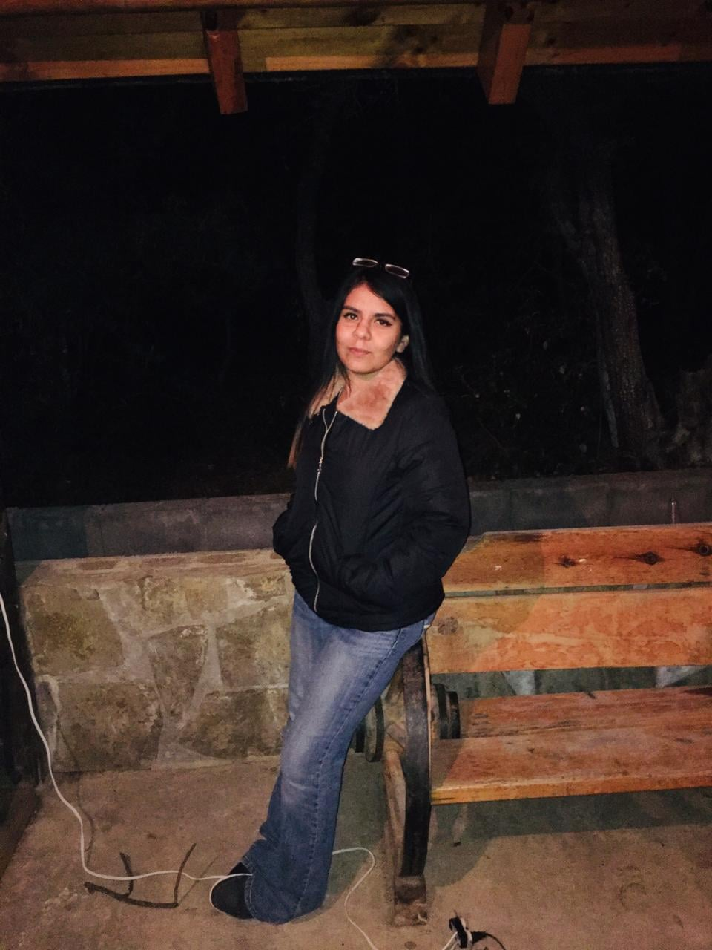
I really love the forest, for it’s sky. Seven months ago, we went to the forest to some cabins. They were far away but after driven a lot we arrived. We saluted and after having chosen the cabin we rested. For the late meal we did meat with sausages. When it was the night we lit a fire with sticks from the forest. And we went to sleep because it was very cold. This experience is important because it was the last before covid.
One night in the forest

