Slide 1
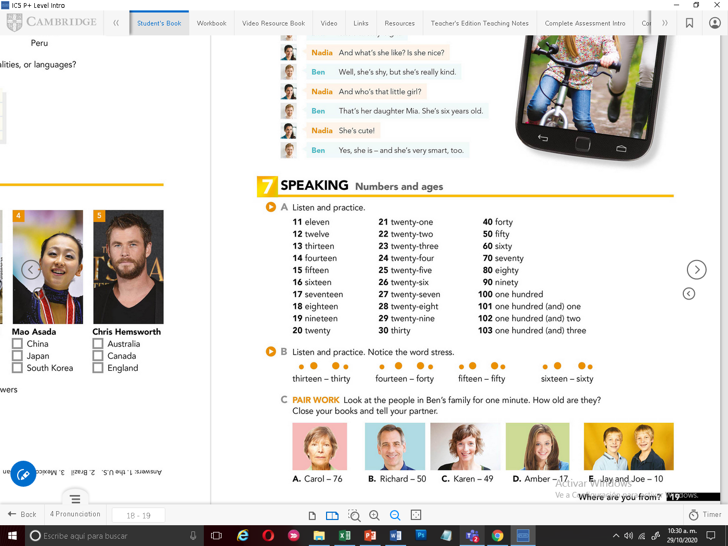


Slide 2
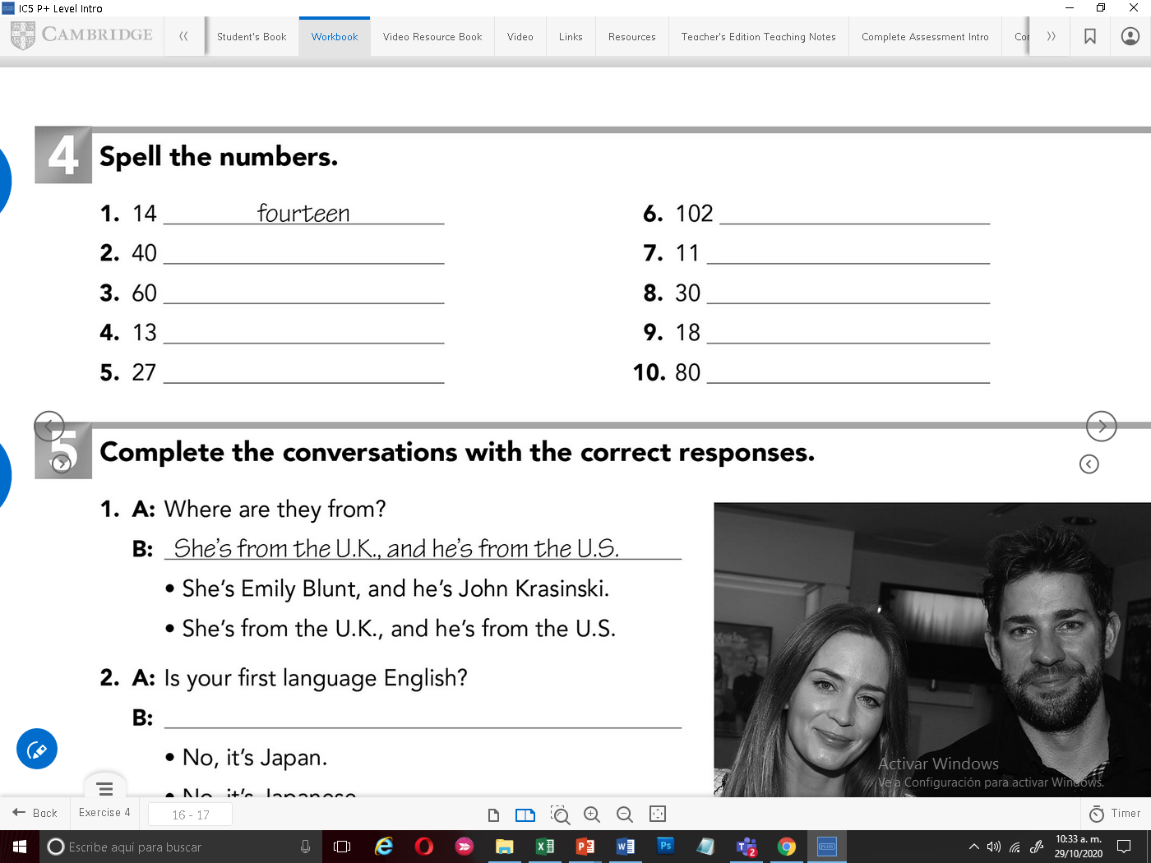
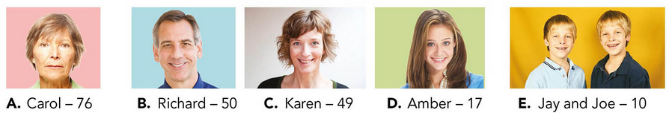
hundred two
forty
eleven
sixty
thirty
thirteen
eighteen
twenty seven
eighty
Record your voice mentioning the age of each person. Example: Carol is 76 years old
Graba tu voz mencionando la edad de cada persona. Ejemplo: Carol tiene 76 años

Slide 3
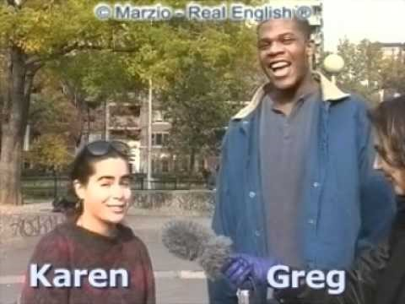
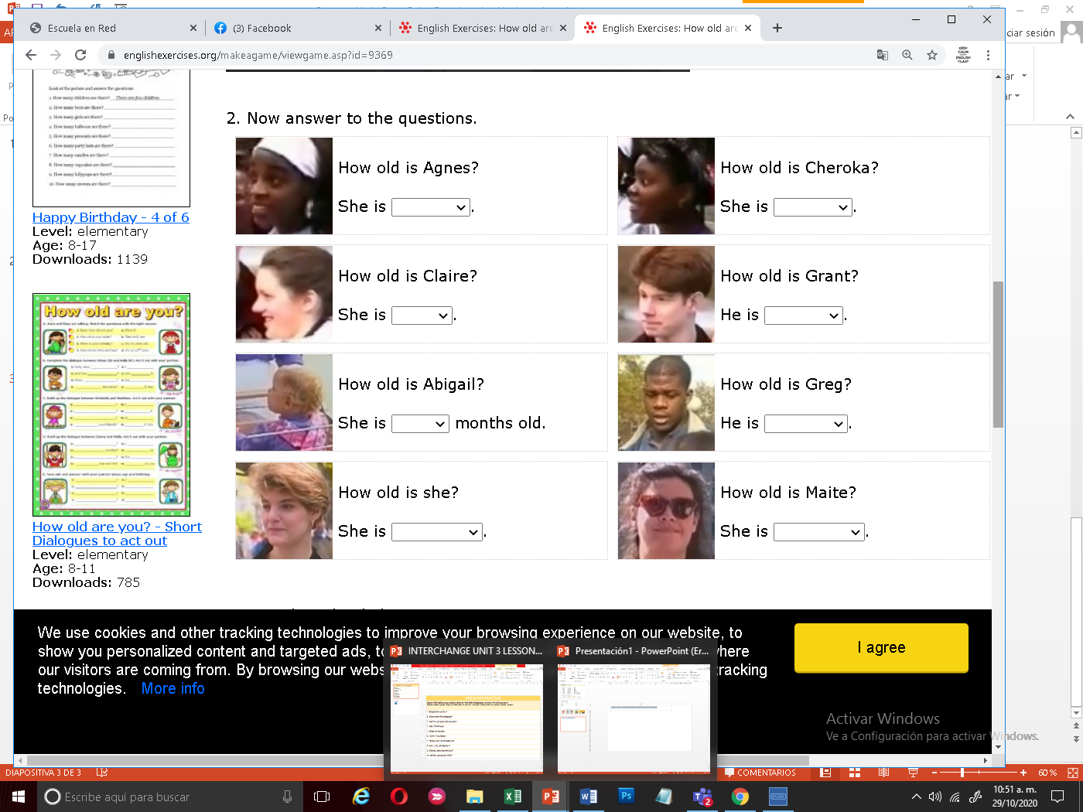
Click on the following video, then answer the practice with ages. Ve, el siguiente video y contesta el ejercicio de practica con las edades
https://www.youtube.com/watch?v=3qa8K7b07GI&feature=youtu.be
twenty –two
years old,
22
18
eighteen years old.
seventeen years old.
seventeen years old.
17
17
twenty years old.
fifteen years old.
20
15
Eleven years old.
twenty – one years old.
21
11

