Slide 1
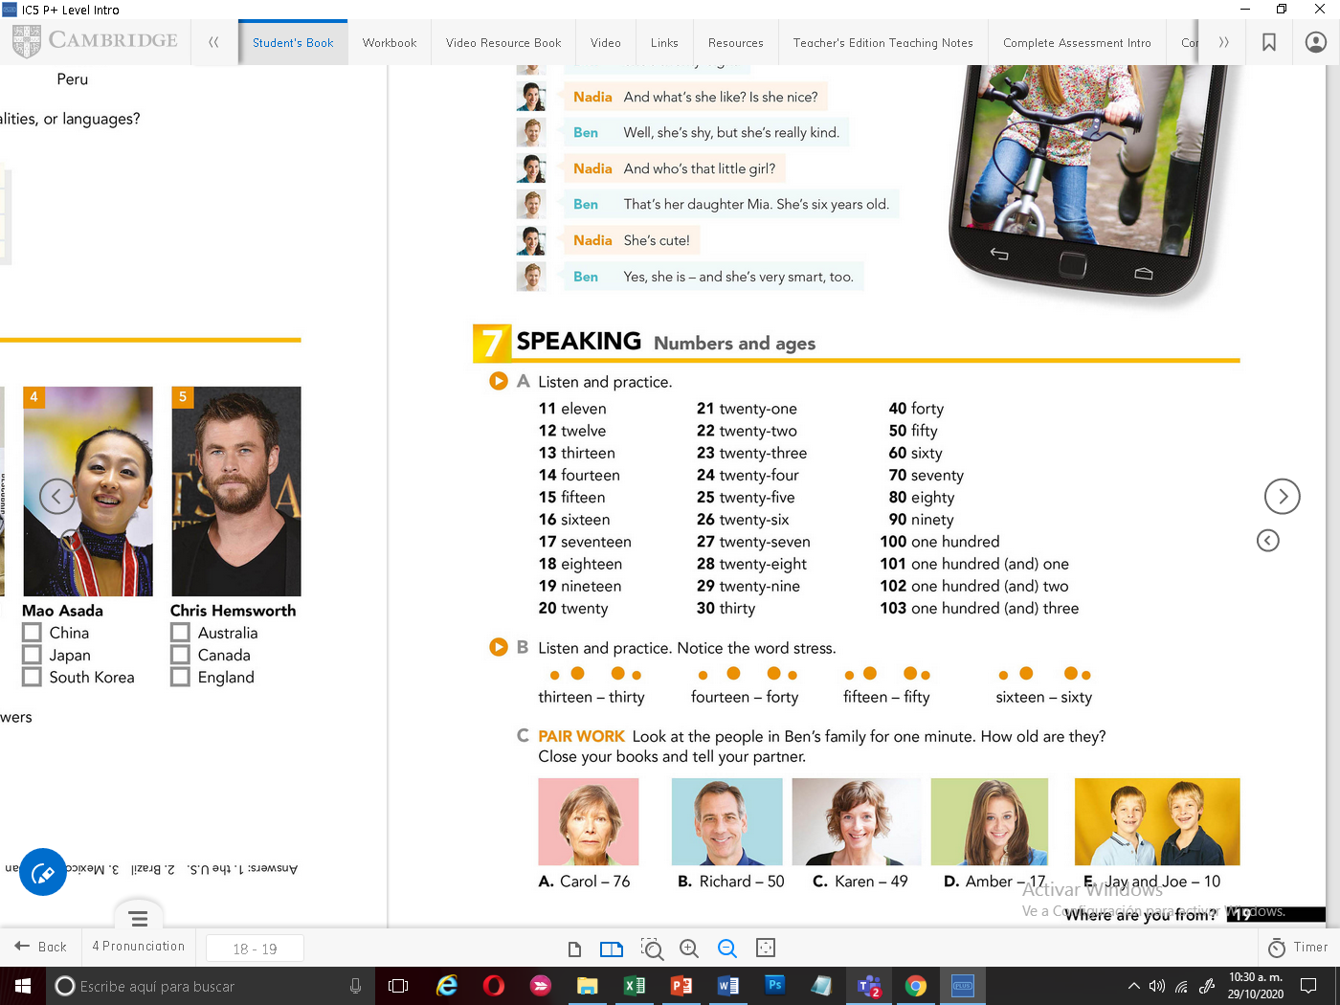


Slide 2
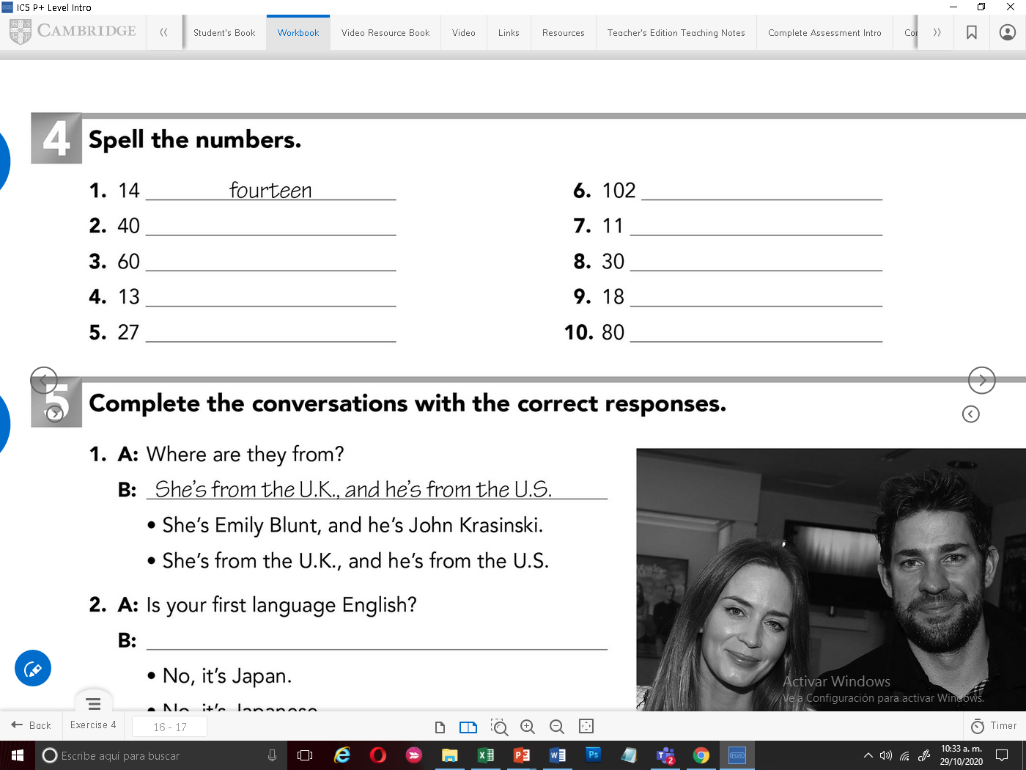
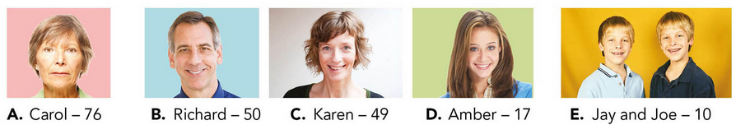
One hundred two
forty
eleven
sixty
thirty
thirteen
eighteen
Twenty - seven
eighty
Record your voice mentioning the age of each person. Example: Carol is 76 years old
Graba tu voz mencionando la edad de cada persona. Ejemplo: Carol tiene 76 años

Slide 3
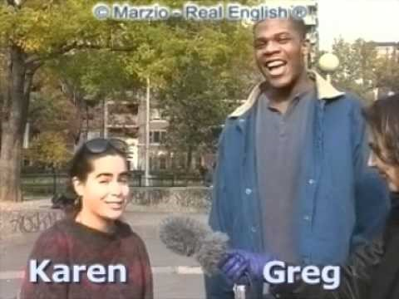
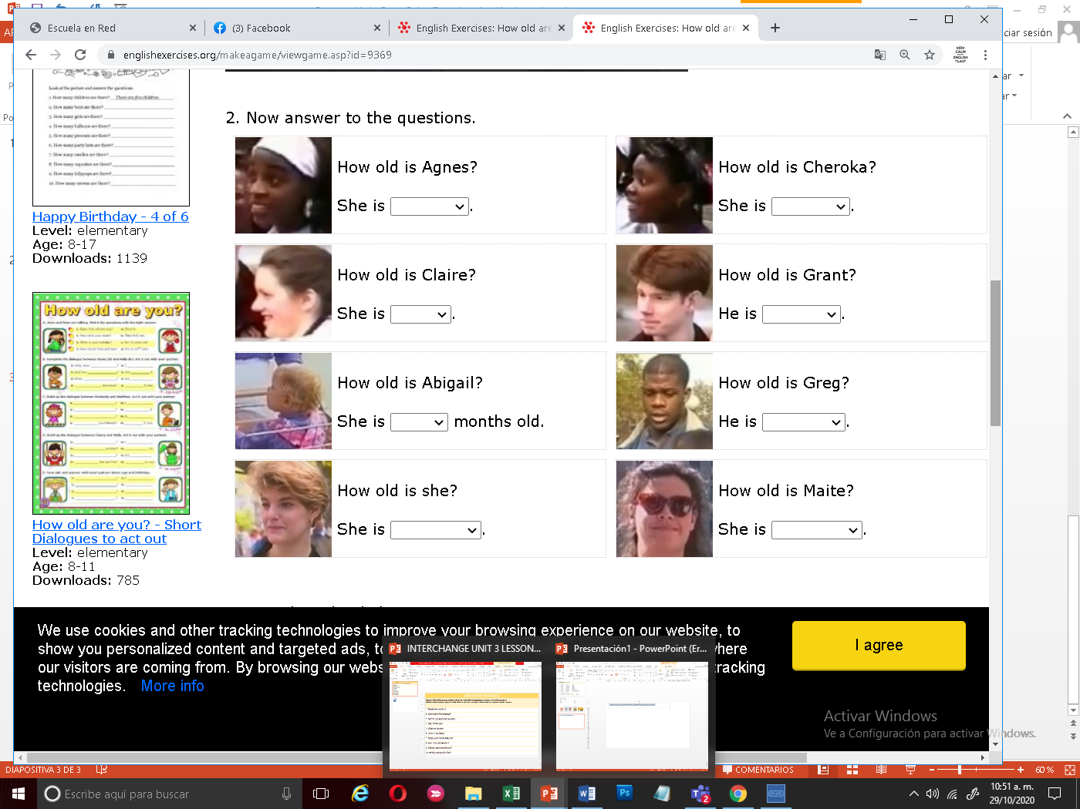
Click on the following video, then answer the practice with ages. Ve, el siguiente video y contesta el ejercicio de practica con las edades
https://www.youtube.com/watch?v=3qa8K7b07GI&feature=youtu.be
She is 22 years old
She is 18 years old
He is 17 years old
She is 17 years old
He is 20 years old
She is 15 years old
She is 11 months old
She is 21 years old

