Slide 1
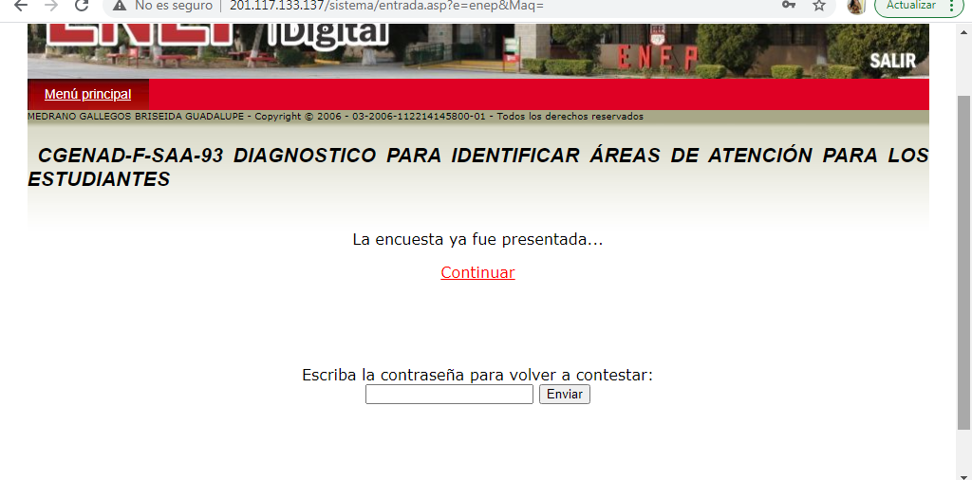
Briseida Guadalupe Medrano Gallegos #11

