Slide 2
Bob: We need to make a decision on who we are going to hire for the new salesperson position.
Darren: I know. There are a lot of good applicants. So far we have interviewed 10 people and have looked at over 50 resumes.
Bob: Well, let’s take a look at some of the best and make a decision.
Darren: OK, the first person is Phil. He has worked as a salesperson for 10 years in both The United States and Canada. Also, he has been the manager of the sales department of a large auto-parts company.
Bob: Sounds interesting, but has he ever worked in the food sales industry?
Darren: No he hasn’t.
Bob: That might be a problem. We need someone with food experience.
Darren: OK, what about Karen? She has worked in the food industry for 6 years. She has been a manager of a major supermarket and worked in marketing for a large meat company.
Bob: OK. Has she worked in international sales before?
Darren: No, she has never worked in international sales.
Bob: Well, that could be a problem. This job will require a lot of international experience. I think we need someone who has worked in an international environment.
Darren: Well what about Larry? We haven’t met him yet but his resume looks good. He has been a salesperson in the food industry for 13 years. He has worked in The United States, Canada and Mexico. In the past 4 years he has learned to speak Spanish and French.
Bob: Wow, sounds great!
Darren: The problem is we still haven’t had an interview with him. I have called him many times, but I haven’t been able to reach him.
Bob: Well, why don’t you send him an email? Perhaps he will respond that way.
Darren: OK, I will try that. I will let you know.
Bob: Great, thanks.

Slide 3
Comprehension questions
How many people have they interviewed?
Who has worked in the food industry?
Who have they not met?
Why haven’t they interviewed Larry?
What is Phil’s experience?
What is Karen’s experience?
What is Larry’s experience?

Slide 4
What is your experience?

Slide 5
Grammar focus: Present Perfect Tense
When did you do those activities?
Arrive to Internship NOW
a preschool experience
We use this tense with past actions when the exact time is not important.

Slide 6
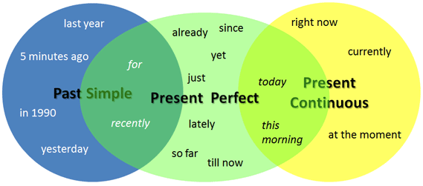

Slide 7
Rules
Subject + has/have + past participle.
Subject + has/have + past participle.
Has/Have + subject + past participle?

Slide 8
Yet and already
(Placement, meaning)
Yet goes at the end of present perfect questions and at the end of negative statements.
A: Have you been to Bosque Magico (magic forest) yet?
B: I haven’t been there yet.
Already goes before the past participle and means “earlier than expected.
I have already been to Magic Forest in Monterrey.

Slide 9
Remember
PRESENT PERFECT
With an unfinished time word (this week, this month, today):
I've seen John this week.
PAST SIMPLE
With a finished time word (last week, last month, yesterday):
I saw John last week.
We use the present perfect for actions which started in the past and are still happening now OR for finished actions which have a connection to the present.
I have played baseball for 10 years.
I have been to Mazatlan 15 times so far.
We CAN'T use the present perfect with a finished time word:
NOT: I've been to the museum yesterday.

Slide 10
Completing and matching activity
(+) 1. I_____ __________ dinner…
(-) I _____ __________ dinner …
(+) 2. I _____ __________ the dishes…
(-) I _____ __________ the dishes…
(+) 3. I _____ __________ to music…
(-) I _____ __________ to music…
(+) 4. I _____ __________ laundry…
(-) I _____ __________ laundry…
(+) 5. I _____ __________ to a restaurant…
(-) I _____ __________ to a restaurant…
(+) 6. I _____ __________ the house…
(-) I _____ __________ the house…
every day this week.
four times this week.
once this week.
five times this week.
this week.
three times this week.
twice this week.

