Slide 1
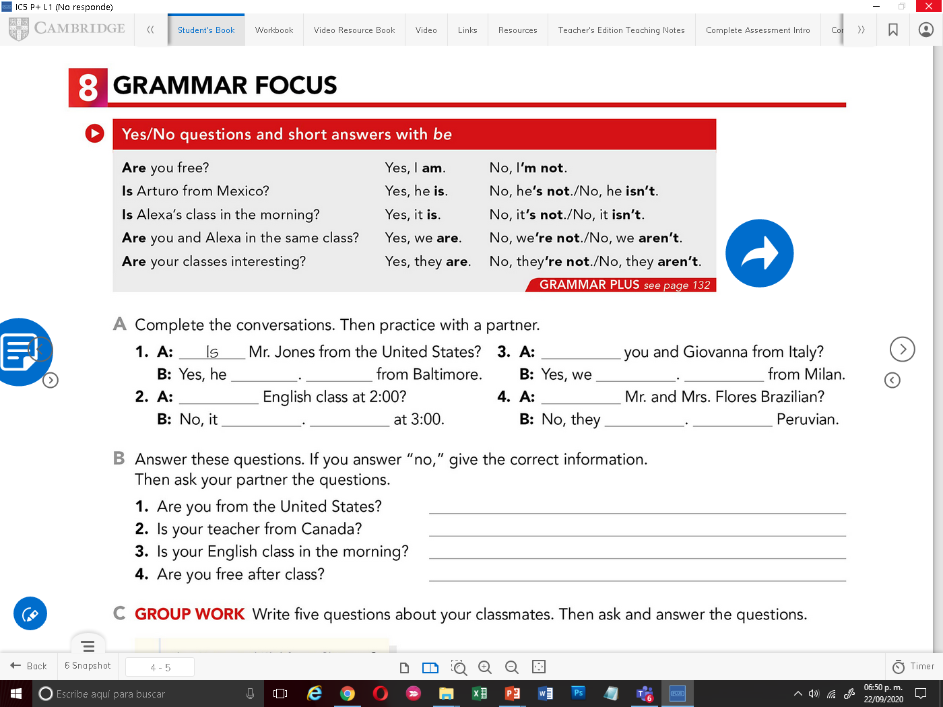

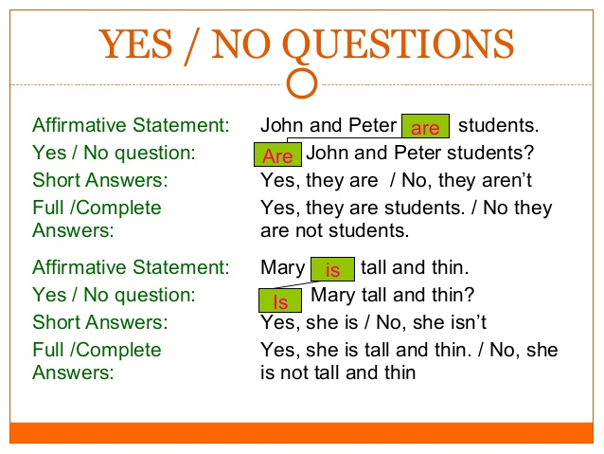
In English, there are two main types of questions in this lesson we are going to study the first type which is:
Yes / No Questions
Yes / No questions are the questions which are expected to be answered with yes or no.
To form Yes/No questions, we use auxiliary verbs as “Be”
The verb “ To Be ” has three forms in the present; am, is and are.
The structure of the question starts with “Be”(am,is,are ) + Subject +complement

Slide 2

GRAMMAR FOCUS
Arturo is a student.
Subject Verb
Julia and Elena are sisters.
S V
Practice
A) Turn the statements into questions.
It is raining.
A=
She is busy.
A=
We are ready.
A=
You are hungry.
A=
They are the same.
A=
Yes/No questions begin with a verb + subject.
For example:
Is Arturo a student?
V S
Are Julia and Elena sisters?
V S

Slide 3
Complete the following questions and give an aswers.
1.- |  | Jane and Alice sisters? | Yes,
2.- |  | this car yours? | Yes,
3.- |  | I in your class? | No,
4.- |  | you Canadian? | Yes,
5.- |  | Mary and Juan friends? | No,
6.- |  | you and your friend in the same school? | No,
7.- |  | Mexico a big city? | Yes,
8.- |  | the doctor in his office? | No,
9.- |  | the children in school? | No,
10.- |  | it hot outside? | Yes,

Slide 4
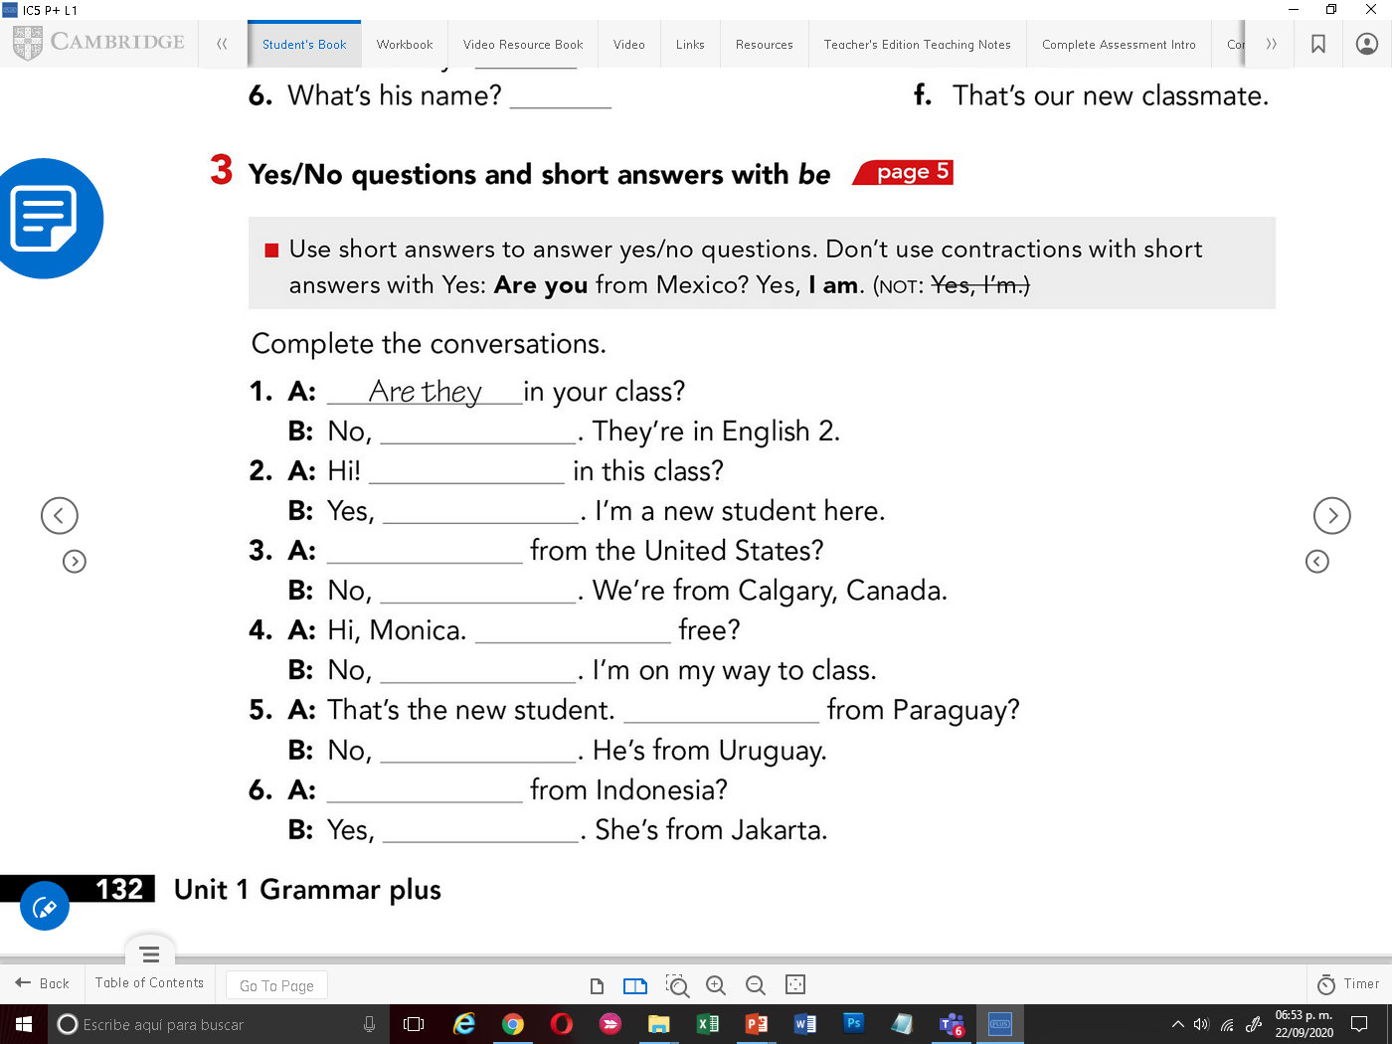
Is David Bisbal your favourite singer?
Is your mother from England?
Are you twelve years old?
Are your friends good students?
Is Messi your favourite footballer ?
Is your teacher young?
Is your house big?
Are you funny?
Is Maluma handsome?
Is Jennifer Lopez mexican?
Answer the following questions with “be”, use contrtactions if possible

Slide 5

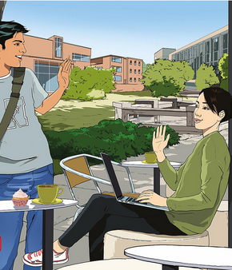
Listening practice
Play the audio to listen a conversation between Arturo and Soo-jin
Play the audio again and answer the following questions:
1. Are Arturo’s classes interesting this semester?
A=
2. Are Arturo and Alexa in the same biology class?
A=
3. Is Arturo’s class in the afternoon?
A=

Slide 6
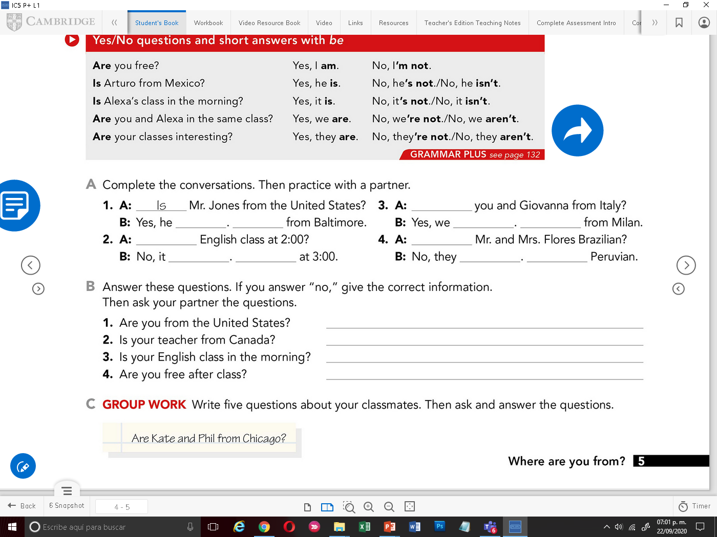

Complete the following conversations with “verb to be”, use contractions if posible.
1.-
2.-
3.-
4.-
5.-
6.-
7.-
9.-
8.-
10.-

Slide 7
Answer the following questions.
If you answer “no”, give the correct information.
Write 3 more questions and give answers.
1.- Are you from United States?
2.- Is your teacher from Canada?
3.- Is your English class in the morning?
4.- Are you free after class?
5.-
6.-
7.-

Slide 8
In pairs roleplay your previous questions and answers, record a video. (Insert your video in this page).

