Slide 1
Introductions
My name is Gabriela López
you can callme Gaby
First name
last name

Slide 2
Greetings
A. Write a conversation using expressions to say hello in the dialogue boxes

Slide 3
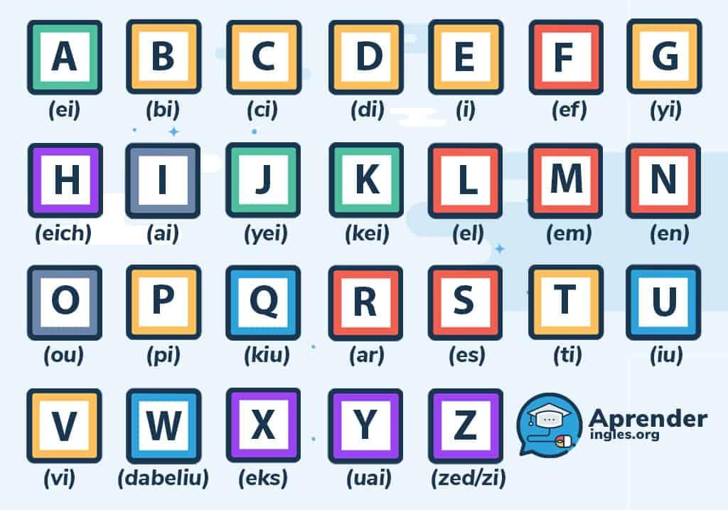
How do you spell your name?

Slide 4
LISTENING Phone and e-mail address
Click to listen pone numbers and e-mail addresses
What is your pone number
Escucha y practica números telefónicos y correos electrónicos
What is your e-mail address
.
_
punto
-
@
Guion medio
Guion bajo
arroba

Slide 5
GRAMMAR
Contraction of what is:

Slide 6
In the gramatical sense, a personal pronoun refers to a particular person.
 | Pronoun |  | Verb be | Contractions | Verb be + not
Singular | I |  | Am | I´m | I´m not
 | You |  | Are | You´re | You´re not
 | He |  | Is | He´s | He´s not
 | She |  | Is | She´s | She´s not
 | It |  | Is | It´s | It´s not
Plural | We |  | Are | We´re | We´re not
 | You |  | Are | You´re | You´re not
 | They |  | Are | They´re | They´re not

Slide 7
Personal pronouns or subjects are followed by the verb to be to make sentences in simple present.
(+)It is a nice car
(+)She is a student
(+)he is my brother
(contraction) It´s a nice car
(contraction) She´s a student
(contraction) he´s my brother
(-) it´s not a nice car
(-) She´s not a student
(-) he´s not my brother
(+)I am intelligent
(+)We are friends
(+)They are friends
(contraction) I´m intelligent
(contraction) We´re friends
(contraction) They´re friends
(-) I´m not intelligent
(-) We´re not friends
(-) They´re not friends

Slide 10
UNIT 2
VOCABULARY
a, an are indefinite articles.
Are used with singular nouns.
Are used before (a) consonants or (an) vowels sounds

Slide 11
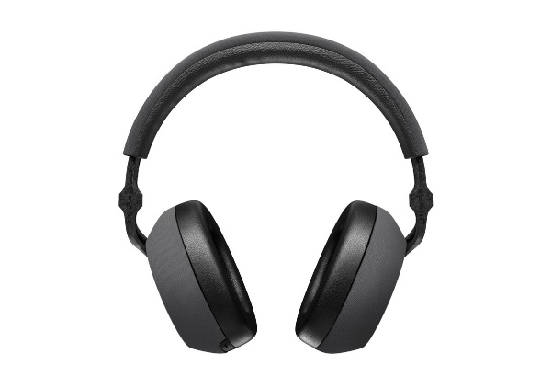
GRAMMAR “Words in plural”
La regla general para los plurales es sustantivo en singular + s = sustantivo en plural
General rule
Singular noun + s = plural noun
box
boxes
clip
clips
Some nouns are always plural
Algunos sustantivos son siempre plurales
glasses
headphones

Slide 12
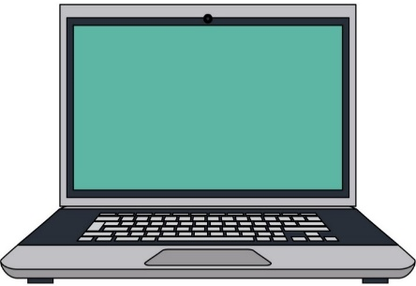
GRAMMAR “this and these”
This and these are demonstratives, they refer to nouns that are near in space and time.
This and These son demostrativos, se refieren a sustantivos cercanos en el espacio y el tiempo
This is used with singular nouns
What´s this ?
This is a laptop
It´s a laptop
What´s this ?
This is an umbrella
It´s an umbrella
Que es esto?
Esta es una laptop
Es una laptop
These refers to plural nouns
What are these ?
These are laptops
They´re laptops
What are these ?
These are umbrellas
They´re umbrellas
Que son estas?
Estas son laptops
Son laptops

Slide 13
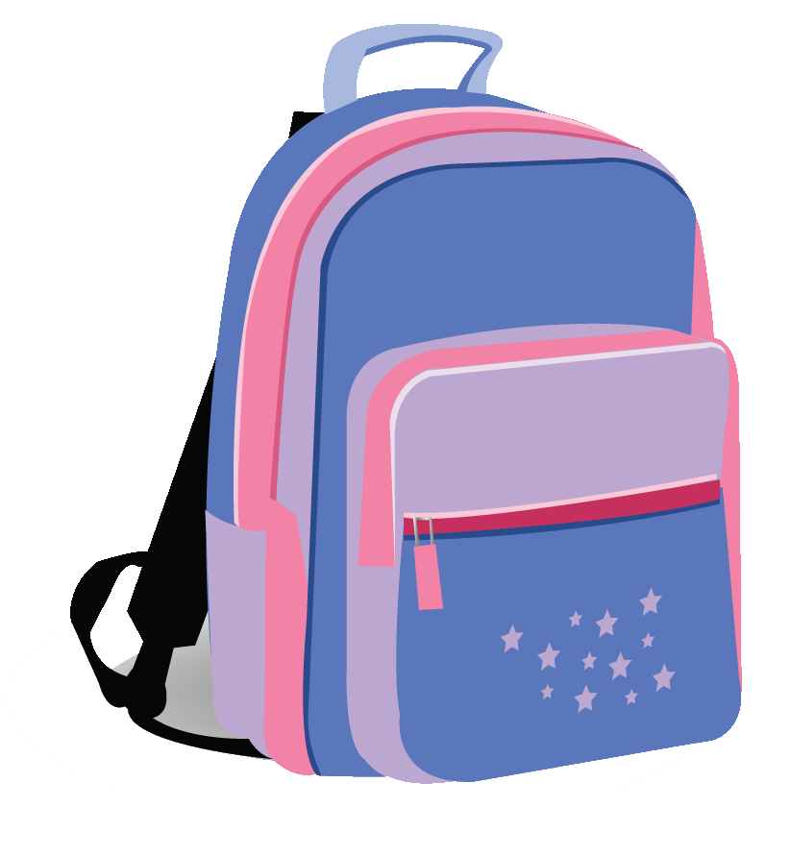
Complete the following questions
A: What is this ?
B: It´s a flashdrive
A: What ?
B:
A: What ?
B:
A: What ?
B:

Slide 14
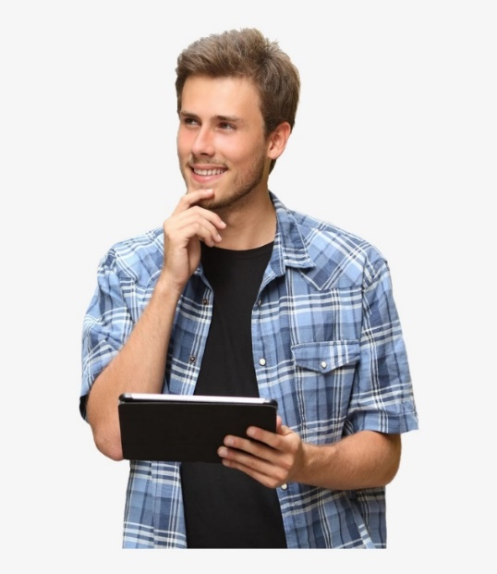
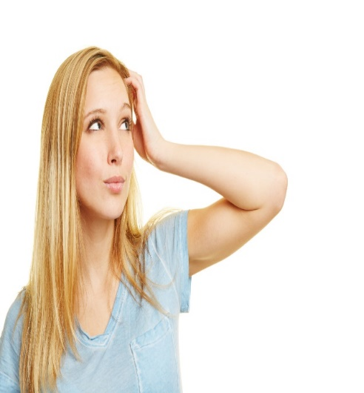
GRAMMAR “yes/no questions with be”
Give questions and answers with “be” / formula preguntas y responde con “be”
Singular
Yes, it is
No, it´s not
Is this your Tablet ?
Yes,
No,
Is____________?
Plural
Yes, they are
No, they´re not
Yes,
No,
Are these your keys ?
Are____________?

Slide 15
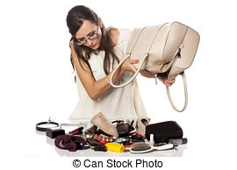
GRAMMAR “where questions with be”
Question Where refers to a place or position
La pregunta Where (donde) se refiere a un lugar o posición
Where´s my haibrush?
Singular
It´s in my purse
Plural
Where are my keys?
They´re in my purse

Slide 16
GRAMMAR “Prepositions of place”
A preposition of place is used to refer to a place where something or someone is located
Una preposición de lugar se usa para referirse a un lugar donde se encuentra algo o alguien
In | On | Under
Behind | Next to | In front of
The notebook is in the backpack
The laptop is on the table
The umbrella is under the table
The wastebasket is behind the chair
The keys are next to the wallet
The pen is in fronte of the purse

Slide 17
Practice with prepositions of place, give statements

